Slide 1
CROSSING Winter School on Quantum Security 2016
TU Darmstadt, January, 25th-29th, 2016
Marc Fischlin
Tommaso Gagliardoni

Slide 2
Behind the Scenes
Organized by
in cooperation with
Supported by
Notes:
Name ID Quantique

Slide 3
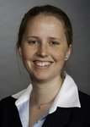
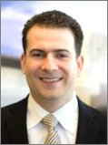
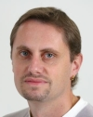
Program Monday
9:00-10:00 | Anne Broadbent | Introduction to Quantum Information (1/ 2)
10:00-10:30 |  | Coffee Break 1
10:30-11:15 | Anne Broadbent | Introduction to Quantum Information (2/ 2)
11:15-11:30 |  | Coffee Break 2
11:30-12:15 | Michele Mosca | Quantum Circuits
12:15-14:00 |  | Lunch
14:00-14:45 | Michele Mosca | Quantum Cryptanalysis
14:45-15:00 |  | Coffee Break 3
15:00-15:45 | Serge Fehr | The Density Matrix Formalism
15:45-16:15 |  | Coffee Break 4
16:15-17:00 | Serge Fehr | Quantum Channels
Notes:
Anne Broadbent – U Ottawa
Michel Mosca – U Waterloo
Serge Fehr - CWI

Slide 4
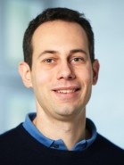
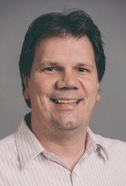
Program Tuesday
9:00-10:00 | Renato Renner | QKD (1 / 4)
10:00-10:30 |  | Coffee Break 1
10:30-11:15 | Renato Renner | QKD (2 / 4)
11:15-11:30 |  | Coffee Break 2
11:30-12:15 | Martin Roetteler | Quantum Algorithms (1 / 4)
12:15-14:00 |  | Lunch
14:00-14:45 | Martin Roetteler | Quantum Algorithms (2 / 4)
14:45-onward |  | Social activities (check reception desk)
Notes:
Renato Renner – ETH
Martin Roetteler - Microsoft

Slide 5
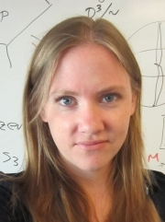
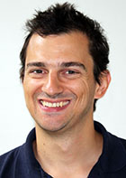
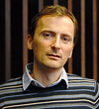
Program Wednesday
9:00-10:00 | Stacey Jeffery | Quantum Algorithms (3 / 4)
10:00-10:30 |  | Coffee Break 1
10:30-11:15 | Stacey Jeffery | Quantum Algorithms (4 / 4)
11:15-11:30 |  | Coffee Break 2
11:30-12:15 | Gorjan Alagic | Provable Security (1 / 3)
12:15-14:00 |  | Lunch
14:00-14:45 | Gorjan Alagic | Quantum Encryption
14:45-15:00 |  | Coffee Break 3
15:00-15:45 | Antonio Acìn | QKD (3 / 4)
15:45-16:15 |  | Coffee Break 4
16:15-17:00 | Antonio Acìn | QKD (4 / 4)
Notes:
Stacey Jeffrey – CalTech
Gorjan Alagic – U Copenhagen
Antonio Acin – Institute of Photonic Sciences

Slide 6
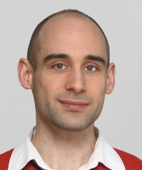
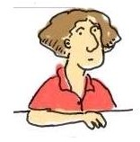
Program Thursday
9:00-10:00 | Dominique Unruh | Provable Security (2 / 3)
10:00-10:30 |  | Coffee Break 1
10:30-11:15 | Marc Kaplan | Query Complexity and Lower Bounds (1 / 2)
11:15-11:30 |  | Coffee Break 2
11:30-12:15 | Marc Kaplan | Query Complexity and Lower Bounds (2 / 2)
12:15-14:00 |  | Lunch
14:00-onward |  | Social activities (check reception desk)
Notes:
Dominique Unruh – U Tartu
Marc Kaplan - CNRS

Slide 7
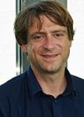
Program Friday
9:00-10:00 | Dominique Unruh | Provable Security (3 / 3)
10:00-10:30 |  | Coffee Break 1
10:30-11:15 | Stefan Wolf | Quantum Information Complexity
11:15-11:30 |  | Coffee Break 2
11:30-12:15 | Stefan Wolf | Non-causal Models
12:15-onward |  | Lunch
After lunch |  | Closing remarks and end of school
Notes:
Dominique Unruh – U Tartu
Stefan Wolf – U Lugano

Slide 8
Enjoy!

