Slide 1
Quantum Algorithms IV
Hidden subgroup and hidden shift problems
Martin Roetteler
Quantum Architectures and Computation Group
Microsoft Research
Redmond, WA, U.S.A.
CROSSING Winter School on Quantum Security
TU Darmstadt
January 26, 2016

Slide 2
Overview
LIQUi|> simulations
Hidden shift problems
Hidden subgroup problems

Slide 3

LIQ$Ui|⟩$

Slide 4

The LIQ$Ui|⟩$ simulation platform
Language
LIQUi|>: A Software Design Architecture and Domain-Specific Language for Quantum Computing. Dave Wecker, Krysta M. Svore
Languages, compilers, and computer-aided design tools will be essential for scalable quantum computing, which promises an exponential leap in our ability to execute complex tasks. LIQUi|> is a modular software architecture designed to control quantum hardware. It enables easy programming, compilation, and simulation of quantum algorithms and circuits, and is independent of a specific quantum architecture. LIQUi|> contains an embedded, domain-specific language designed for programming quantum algorithms, with F# as the host language. It also allows the extraction of a circuit data structure that can be used for optimization, rendering, or translation. The circuit can also be exported to external hardware and software environments. Two different simulation environments are available to the user which allow a trade-off between number of qubits and class of operations. LIQUi|> has been implemented on a wide range of runtimes as back-ends with a single user front-end. We describe the significant components of the design architecture and how to express any given quantum algorithm.
http://arxiv.org/abs/1402.4467
F#
Script
C#
Gates …
Circuit
Optimize
QECC
Rewrite
Noise
Export
Render…
Simulators
Universal
Stabilizer
Hamiltonian
Runtime
Back End …
Client
Service
Cloud
Classical
Quantum

Slide 5
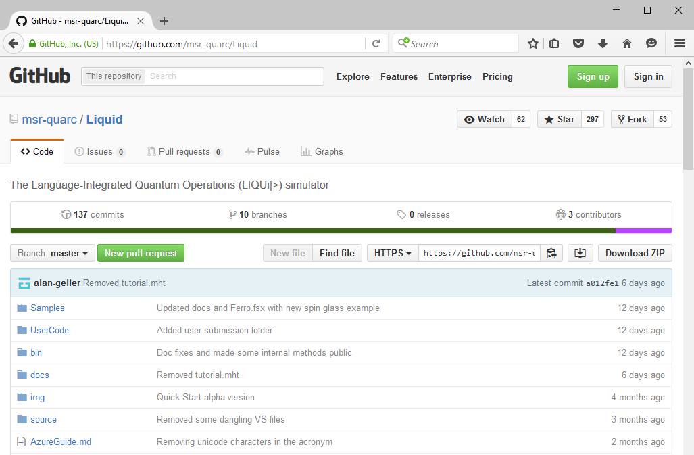

Requirements for quantum computation
LIQ$Ui|⟩$ is available from GitHub
Notes:
Our group addresses 3 main themes: what are the sorts of problems for which a quantum computer is *really* good for? How do we architect a quantum computer and how do we make it resilient against noise? And finally: how do we program it and develop software that then can be executed on such a quantum machine?
We were founded in January 2012
The latter two areas SUPPORT the development of quantum algorithms

Slide 6
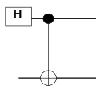
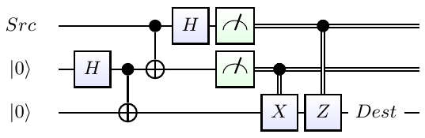
Quantum “Hello World!”
Define a function to generate entanglement:
let EPR (qs:Qubits) = H qs; CNOT qs
The rest of the algorithm:
let teleport (qs:Qubits) =
let qs' = qs.Tail
EPR qs'; CNOT qs; H qs
M qs'; BC X qs'
M qs ; BC Z !!(qs,0,2)
Notes:
EPR is the basic entanglement operation
Teleport builds the entire example. Note that the drawings on the right were generated automatically by the system.

Slide 7
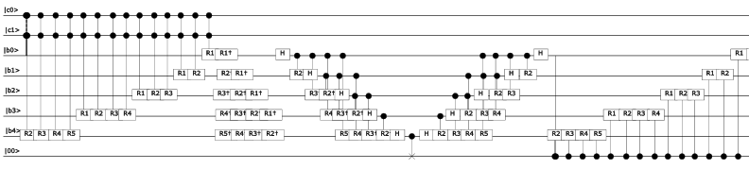
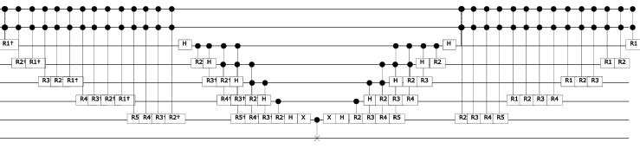
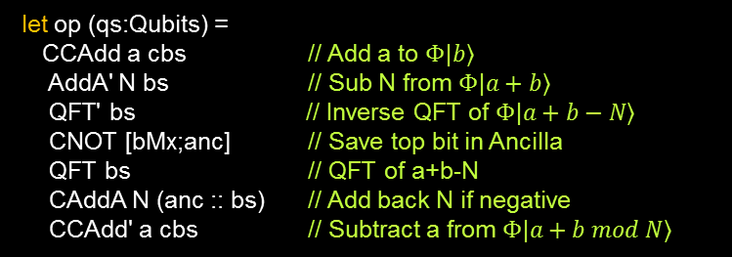

Shor’s algorithm component: modular adder
As defined in:
Circuit for Shor’s
algorithm using 2n+3 qubits
– Stéphane Beauregard
let op (qs:Qubits) =
CCAdd a cbs // Add a to $Φ|b⟩$
AddA' N bs // Sub N from $Φ|a+b⟩$
QFT' bs // Inverse QFT of $Φ|a+b−N⟩$
CNOT [bMx;anc] // Save top bit in Ancilla
QFT bs // QFT of a+b-N
CAddA N (anc :: bs) // Add back N if negative
CCAdd' a cbs // Subtract a from $Φ|a+b mod N⟩$
QFT' bs // Inverse QFT
X [bMx] // Flip top bit
CNOT [bMx;anc] // Reset Ancilla to $|0⟩$
X [bMx] // Flip top bit back
QFT bs // QFT back
CCAdd a cbs // Finally get $Φ|a+b mod N⟩$
Notes:
The core of the algorithm is a modular adder. Here is a block by block breakdown with the actual LIQ$Ui|⟩$ code that generated the circuit.

Slide 8
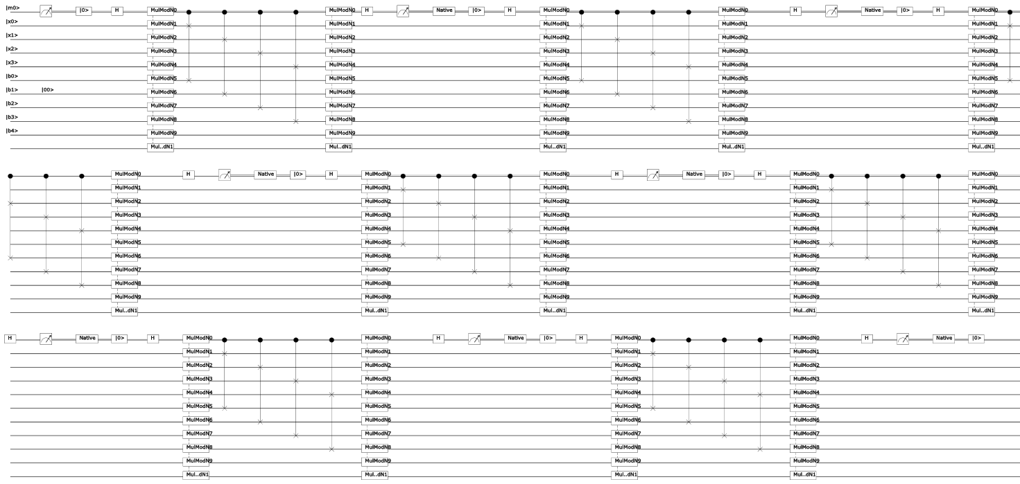

Shor’s algorithm: full circuit: 4 bits $≅$ 8200 gates
Largest Dave has done:
14 bits (factoring 8189)
14 Million Gates
30 days
Circuit for Shor’s algorithm using 2n+3 qubits – Stéphane Beauregard
Notes:
Much more complicated example. Shor’s algorithm to factor a number unto a product of two primes. The literature usually shows factoring the number 15 (4 bits) we’ve done numbers as large as 8189 (13 bits). This is the largest simulation of this type that we know of.

Slide 9
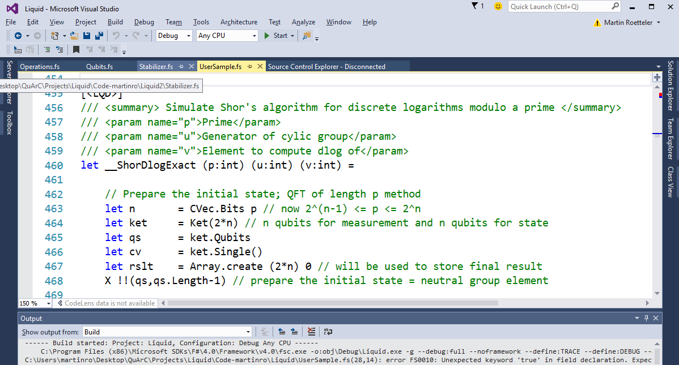

Requirements for quantum computation
Implementing Shor dlog in LIQ$Ui|⟩$
Notes:
Our group addresses 3 main themes: what are the sorts of problems for which a quantum computer is *really* good for? How do we architect a quantum computer and how do we make it resilient against noise? And finally: how do we program it and develop software that then can be executed on such a quantum machine?
We were founded in January 2012
The latter two areas SUPPORT the development of quantum algorithms

Slide 10
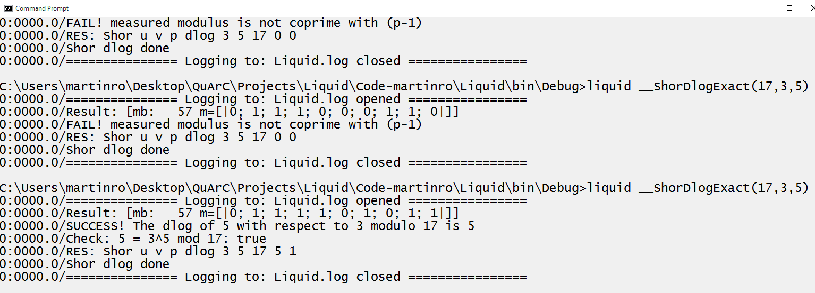

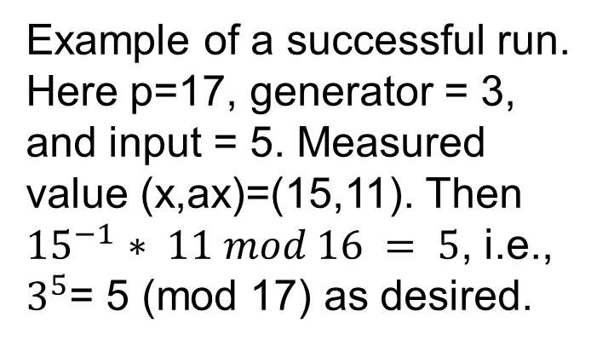
Requirements for quantum computation
Testing dlog LIQ$Ui|⟩$ implementation
Example of a successful run.
Here p=17, generator = 3,
and input = 5. Measured
value (x,ax)=(15,11). Then
${15}^{−1}$ $∗ 11 mod 16 = 5$, i.e.,
$3^{5}$= 5 (mod 17) as desired.
Algorithm run fails if measured
pair (x,ax) is such that x is a
zero-divisor mod (p-1).
Notes:
Our group addresses 3 main themes: what are the sorts of problems for which a quantum computer is *really* good for? How do we architect a quantum computer and how do we make it resilient against noise? And finally: how do we program it and develop software that then can be executed on such a quantum machine?
We were founded in January 2012
The latter two areas SUPPORT the development of quantum algorithms

Slide 11
Hidden shift problems

Slide 12
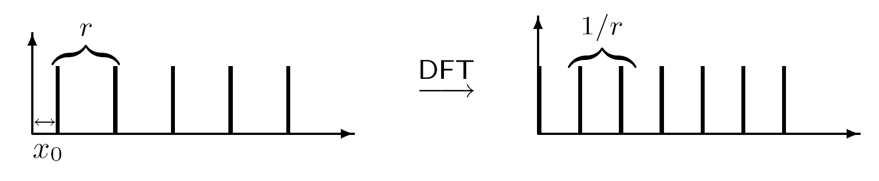
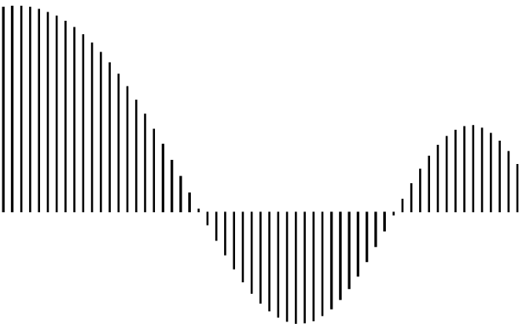

Using the Fourier Transform to correlate?
Shift invariance property of the power spectrum:
How is this used? “Forget” information about coset. Used in factoring/order finding and discrete log [Shor’94], hidden subgroup problems [Kitaev’95], Pell’s equation [Hallgren’02], hidden radius problem [Childs, Schulman, Vazirani‘07], ... Doesn’t seem useful for shifts.
Convolution property:
f g
= DFT⁻¹(DFT(f) . DFT(g))
Idea: “Correlate” two functions. Useful for shifts but works for special functions g only.
Issue: in general not unitary
*
fixed reference function

Slide 13
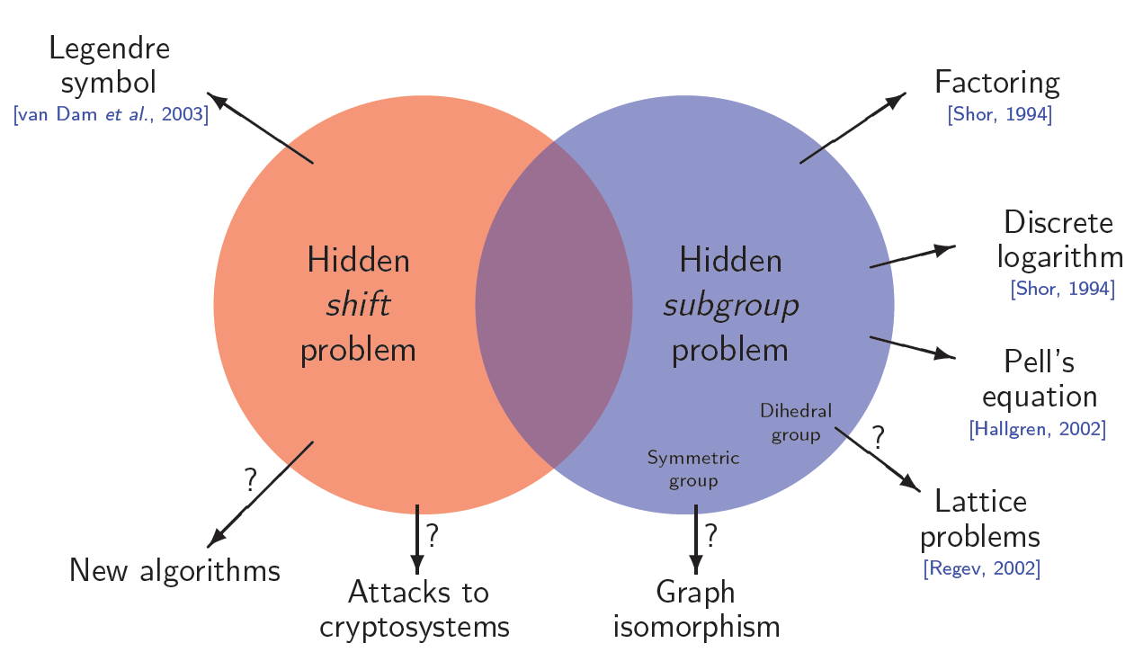
Hidden shift problem
Problem definition:
Input: Maps f, g: G → R from finite group G to set R
Promise: There is an s∈G with g(x) = f(x + s) for all x∈G
Task: Find s
s
f
g
Why is this
interesting?

Slide 14
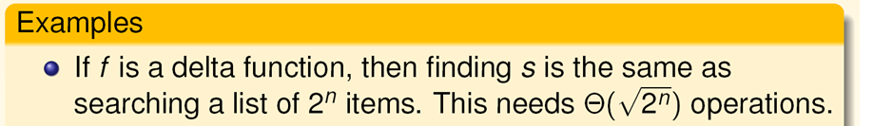
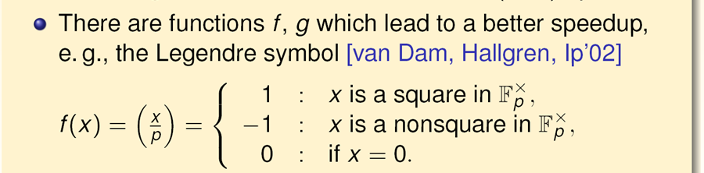
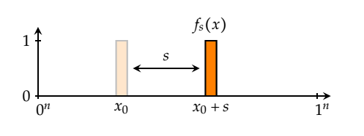

Hidden shift problem: examples
M. Roetteler
Notes:
Show that Legendre symbol has flat spectrum (whiteboard). Split character sum into 2 parts: Square and Non-squares.

Slide 15
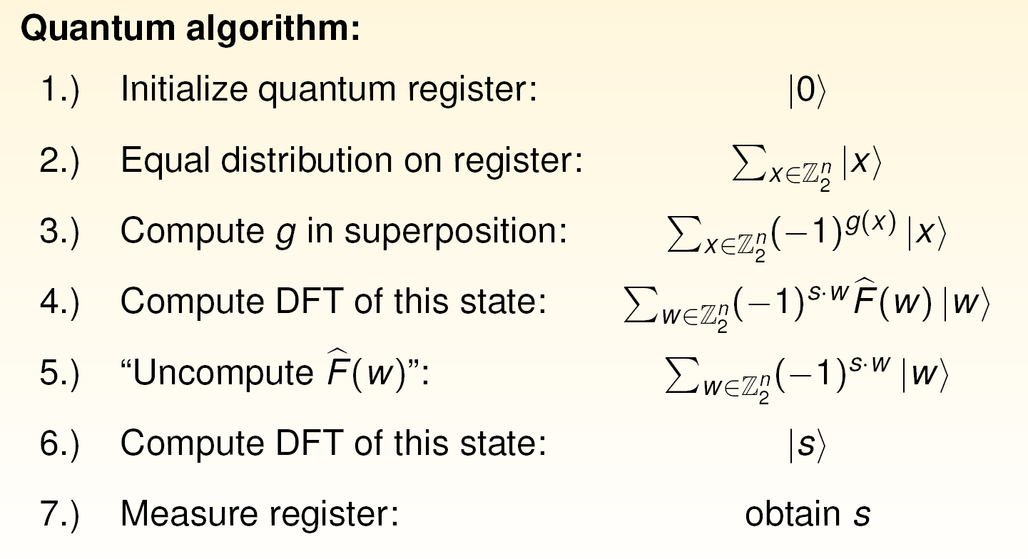
Convolution algorithm
[van Dam, Hallgren, Ip, SODA’03]
Issue: “uncomputing” in step 5.) only works if diagonal elements $\hat{F}$ have absolute value 1. How to generalize to non-flat spectrum?

Slide 16
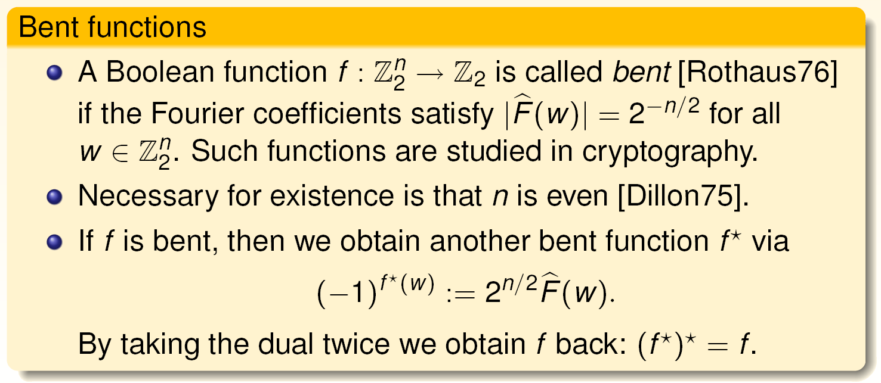
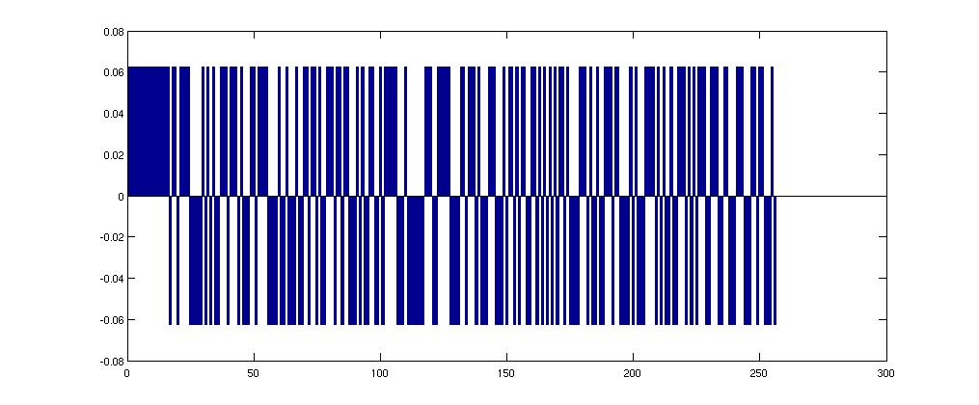
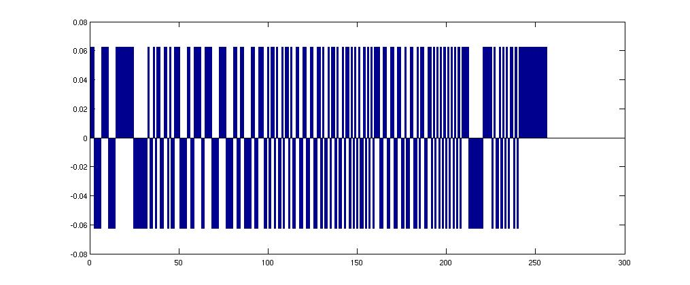


Boolean hidden shift problems
Example: (here f is so-called Maiorana-McFarland function)

Slide 17
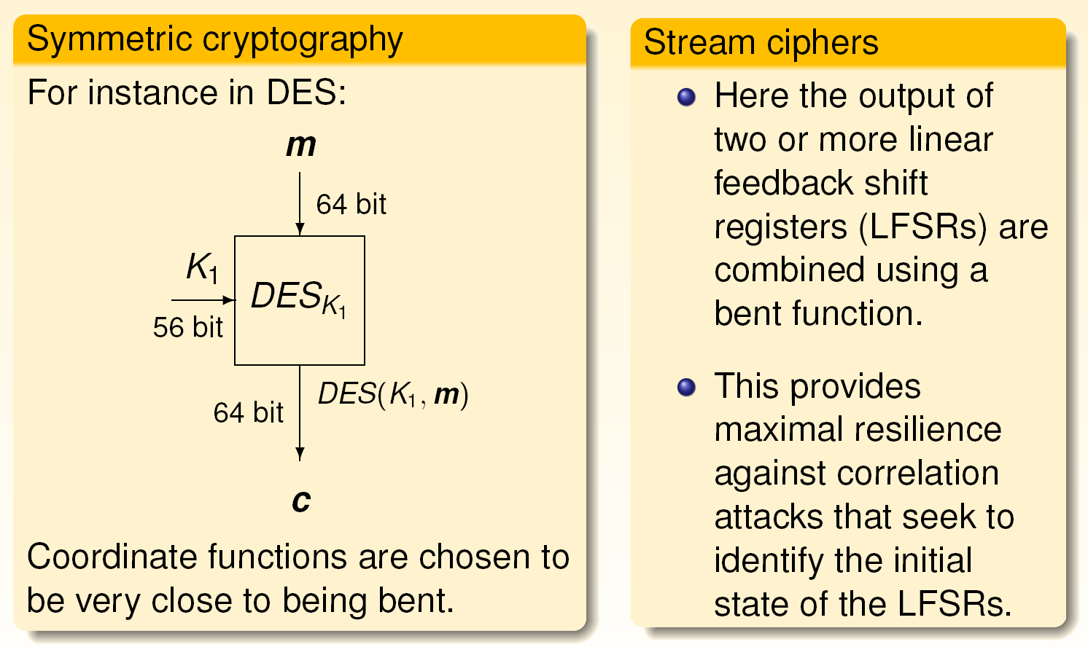
Where are bent functions used?

Slide 18
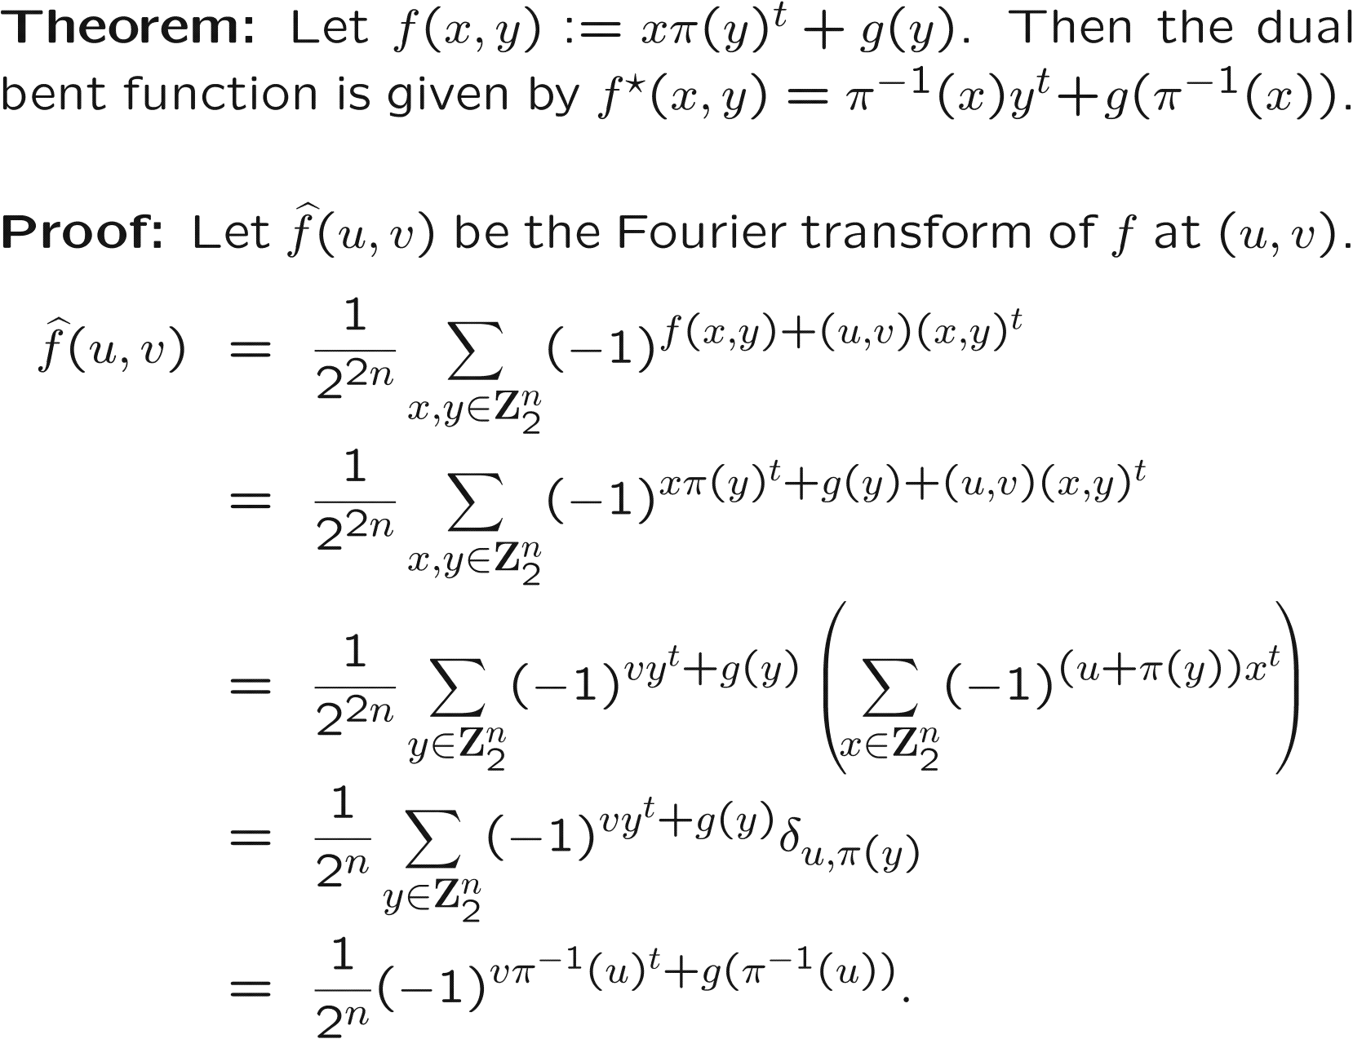
Maiorana-McFarland functions

Slide 19
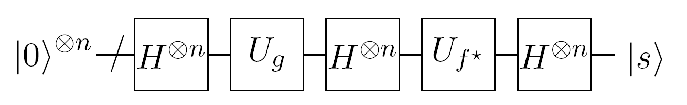
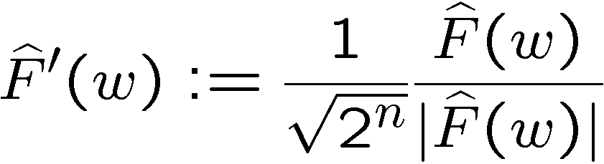

Finding hidden shifts via convolution
Quantum algorithm for finding s:
Remarks:
The algorithm is deterministic, i.e., no error occurs, provided that initial state
preparation, gates, and the measurement are perfect.
U_{g} and U_{f*} compute g and f* into the phase. For several classes of bent
functions, it is know how to compute f*, so this algorithm can be used.
If Fourier transform F(w) is not flat [D. Curtis, D. Meyer’02] proposed to renormalize
and to correlate with respect to . However, this can lead to large distortions…

Slide 20
Hidden shift: Boolean example
Delta peak at 0:

Slide 21
Hidden shift: Boolean example
Uniform state:

Slide 22
Hidden shift: Boolean example
Shifted f:

Slide 23
Hidden shift: Boolean example
Unshifted f:

Slide 24
Hidden shift: Boolean example
Spectrum of g:

Slide 25
Hidden shift: Boolean example
Convolution:

Slide 26
Hidden shift: Boolean example
Delta peak at s:

Slide 27
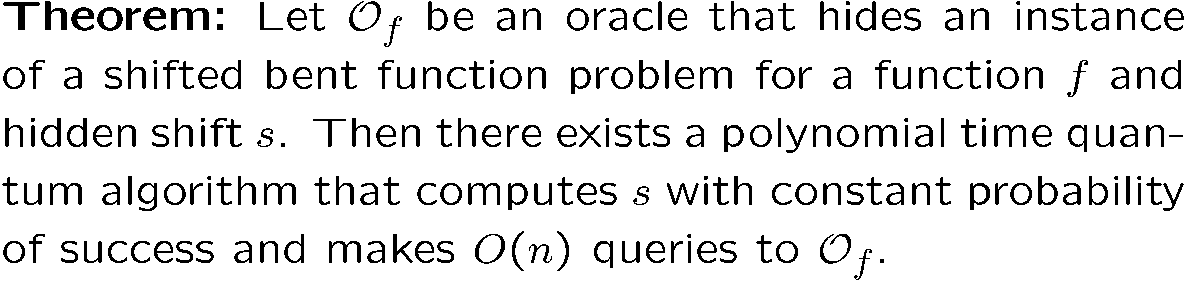
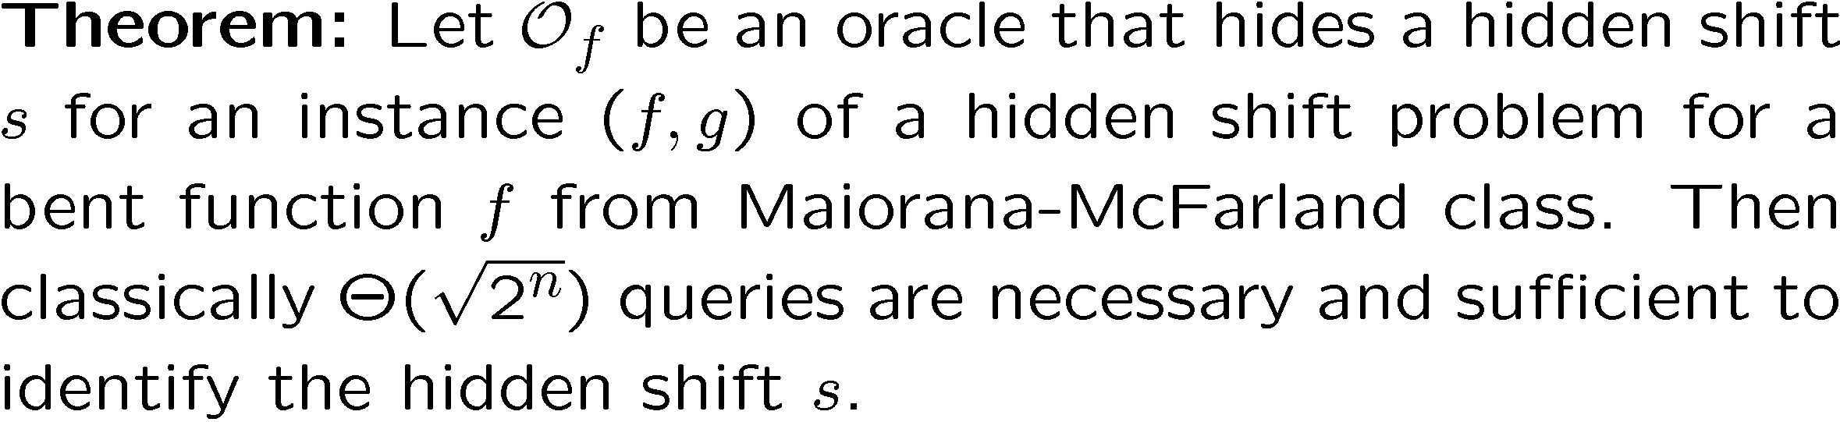
Exponential query complexity separation
Quantum upper bound
Classical lower bound*
* This assumes that f and g are given by oracles

Slide 28
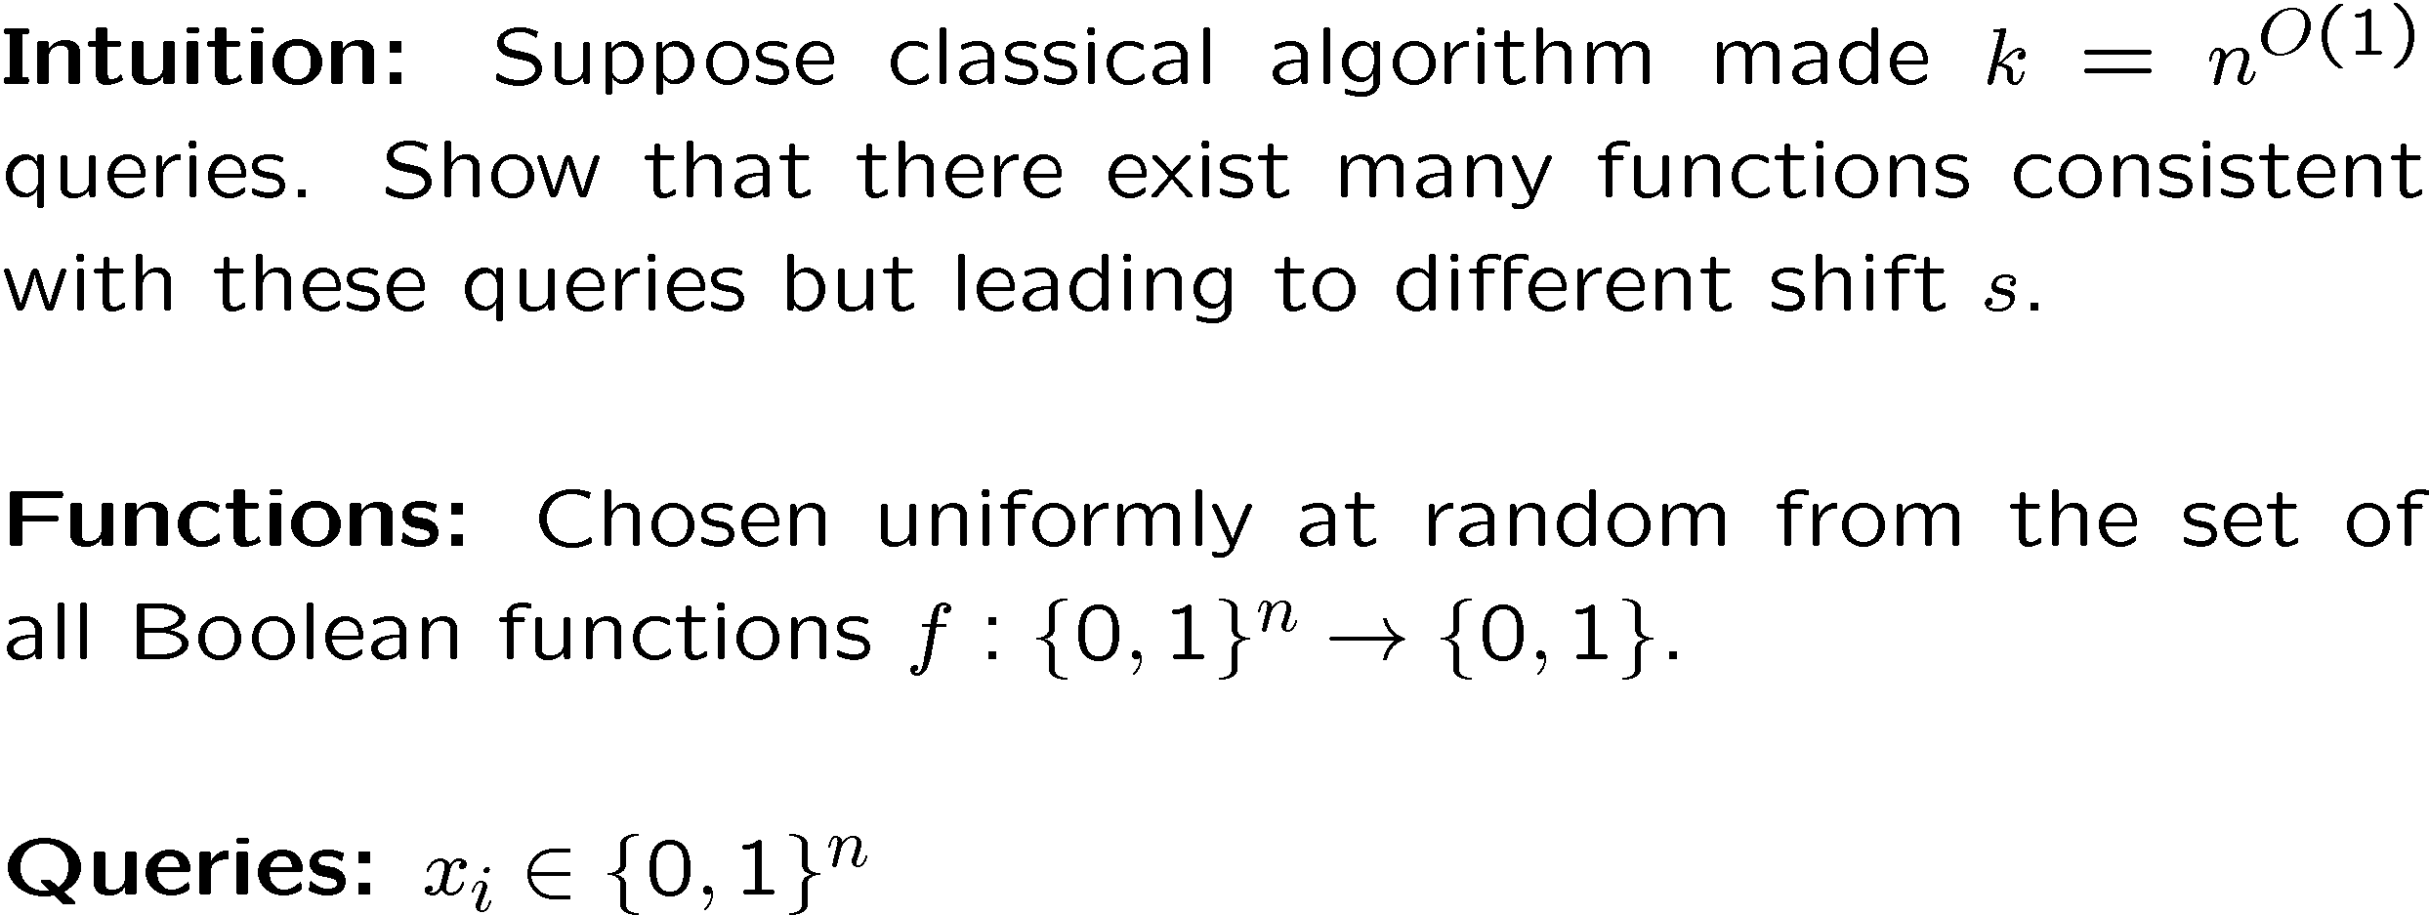

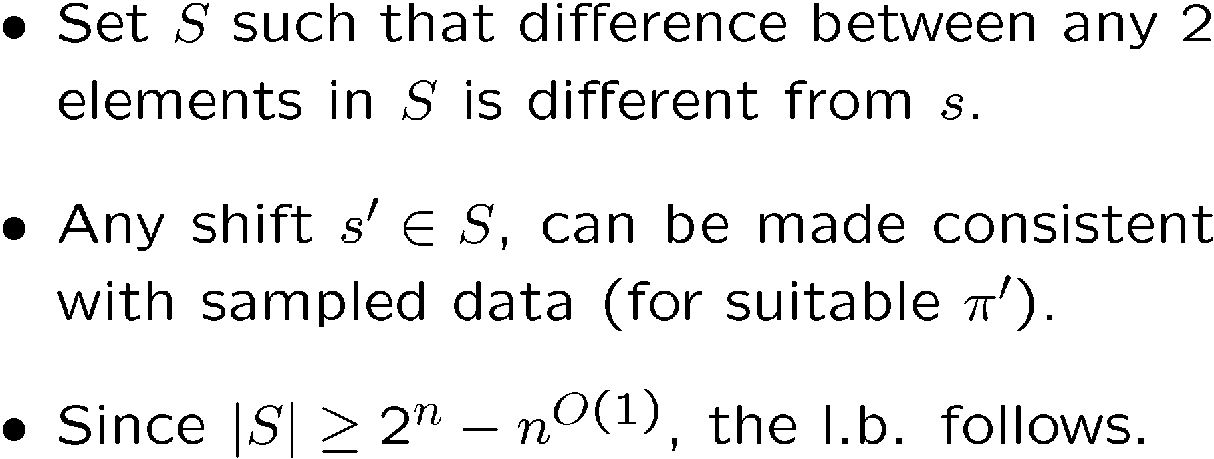


Classical lower bound

Slide 29
Hidden subgroups

Slide 30
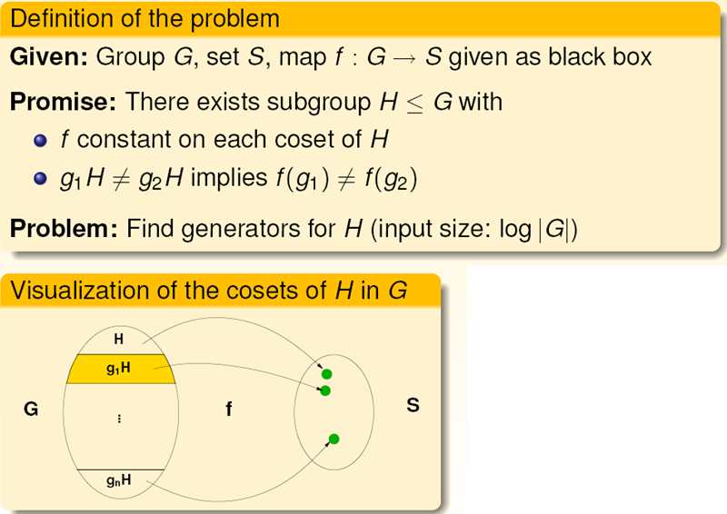
Hidden Subgroup Problem
Standard approach:
ignore the values of f.
Hardness of the problem depends on the structure of G.

Slide 31
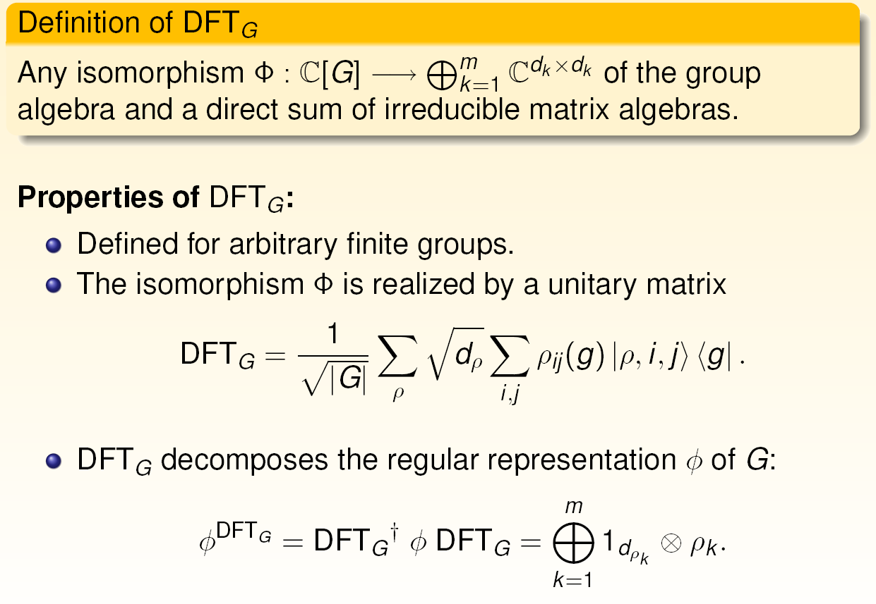
Generalized Fourier Transforms

Slide 32
Groups and irreps: at the keyboard
gap> G := DihedralGroup(10);
Group( (1,2,3,4,5), (2,5)(3,4) )
gap> Elements(G);
[ (), (2,5)(3,4), (1,2)(3,5), (1,2,3,4,5), (1,3)(4,5), (1,3,5,2,4),
(1,4)(2,3), (1,4,2,5,3), (1,5,4,3,2), (1,5)(2,4) ]
gap> T := CharTable(G);;
gap> DisplayCharTable(T);
2 1 1 . .
5 1 . 1 1
1a 2a 5a 5b
2P 1a 1a 5b 5a
3P 1a 2a 5b 5a
5P 1a 2a 1a 1a
X.1 1 1 1 1
X.2 1 -1 1 1
X.3 2 . A *A
X.4 2 . *A A
A = E(5)^2+E(5)^3
= (-1-ER(5))/2 = -1-b5
Magma or Gap or Sage
are good systems to
constructing character
tables. How to find irreps?

Slide 33

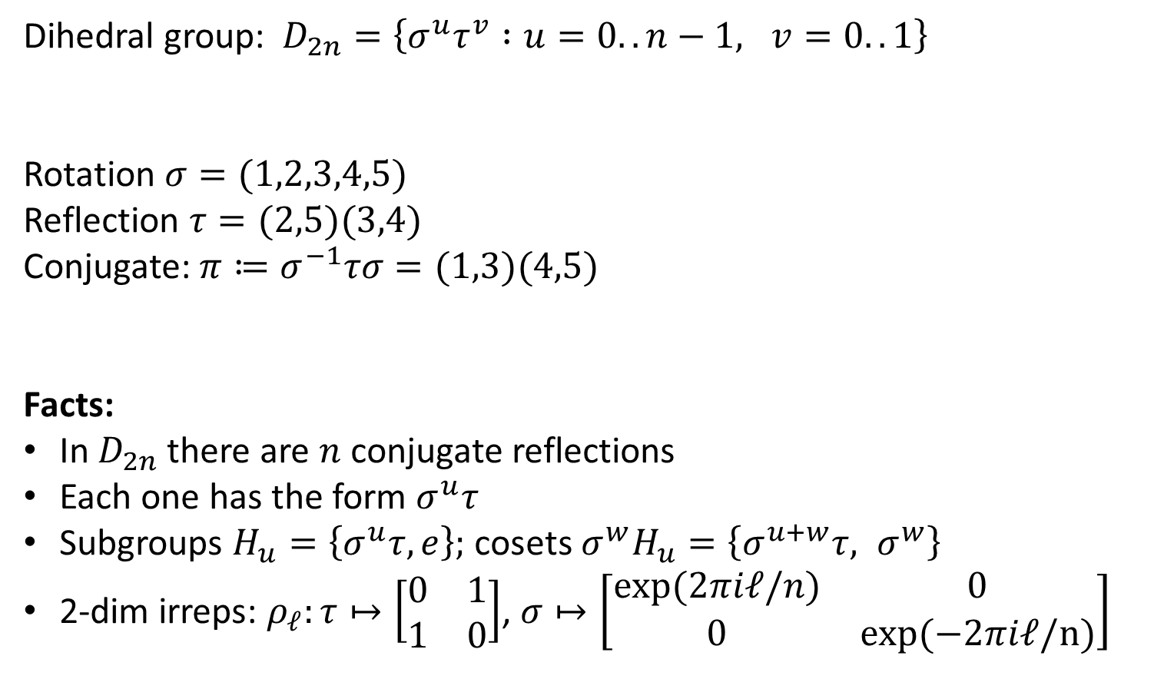

Dihedral group: reflections
Dihedral group: $D_{2n}=\left\{σ^{u}τ^{v} :u=0..n−1, v=0..1\right\}$
Rotation $σ=(1,2,3,4,5)$
Reflection $τ=(2,5)(3,4)$
Conjugate: ${π≔σ}^{−1}τσ=(1,3)(4,5)$
Facts:
In $D_{2n}$ there are $n$ conjugate reflections
Each one has the form $σ^{u}τ$
Subgroups $H_{u}=\left\{σ^{u}τ, e\right\};$ cosets ${σ^{w}H}_{u}=\left\{σ^{u+w}τ, σ^{w}\right\}$
2-dim irreps: $ρ_{ℓ}:τ↦\left[\begin{matrix}0 & 1 \\ 1 & 0\end{matrix}\right]$, $σ↦\left[\begin{matrix}exp⁡(2πiℓ/n) & 0 \\ 0 & exp⁡(−2πiℓ/n)\end{matrix}\right]$
1
5
2
$$π$$
4
3
$$τ$$

Slide 34
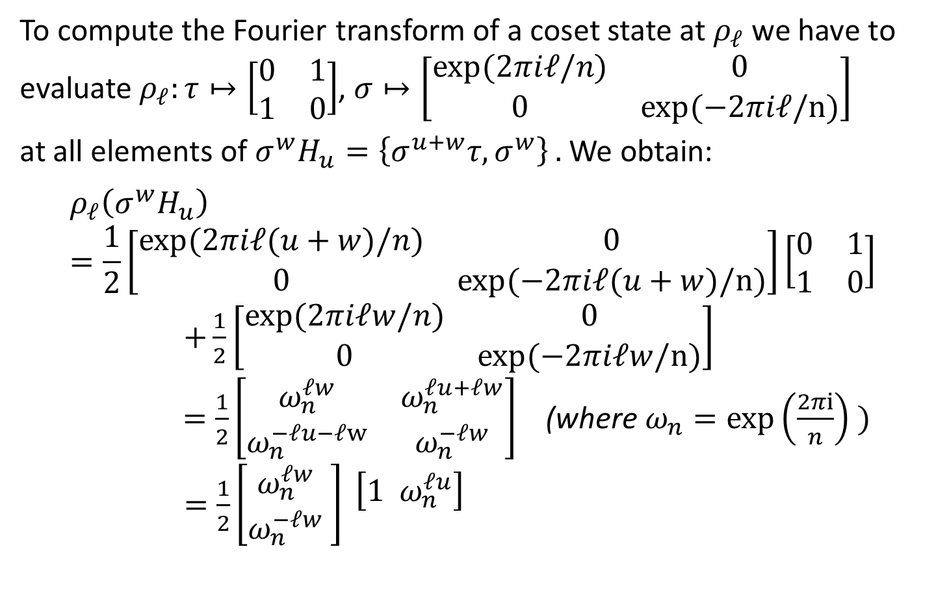
Dihedral group: coset states
To compute the Fourier transform of a coset state at $ρ_{ℓ}$ we have to
evaluate $ρ_{ℓ}:τ↦\left[\begin{matrix}0 & 1 \\ 1 & 0\end{matrix}\right]$, $σ↦\left[\begin{matrix}exp(2πiℓ/n) & 0 \\ 0 & exp(−2πiℓ/n)\end{matrix}\right]$
at all elements of ${{σ^{w}H}_{u}=\left\{σ^{u+w}τ, σ^{w}\right\}}_{ }.$We obtain:
$$ρ_{ℓ}\left({σ^{w}H}_{u}\right)=\frac{1}{2}\left[\begin{matrix}exp(2πiℓ(u+w)/n) & 0 \\ 0 & exp(−2πiℓ(u+w)/n)\end{matrix}\right]\left[\begin{matrix}0 & 1 \\ 1 & 0\end{matrix}\right]$$
$+\frac{1}{2}\left[\begin{matrix}exp(2πiℓw/n) & 0 \\ 0 & exp(−2πiℓw/n)\end{matrix}\right]$
$=\frac{1}{2}\left[\begin{matrix}ω_{n}^{ℓw} & ω_{n}^{ℓu+ℓw} \\ ω_{n}^{−ℓu−ℓw} & ω_{n}^{−ℓw}\end{matrix}\right]$ (where $ω_{n}=\exp\left(\frac{2πi}{n}\right) )$ $=\frac{1}{2}\left[{\begin{aligned}ω_{n}^{ℓw} \\ ω_{n}^{−ℓw}\end{aligned}}_{ }^{ }\right]\begin{matrix} \left[{1 ω}_{n}^{ℓu}\right] & \\ & \end{matrix}$

Slide 35


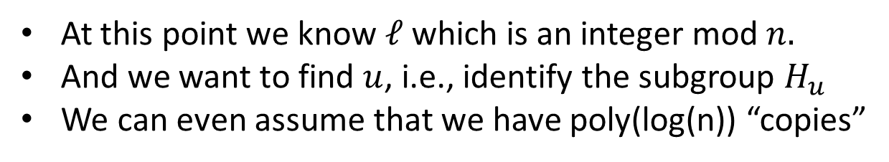
Dihedral group: coset states
$$ρ_{ℓ}\left({σ^{w}H}_{u}\right)=\frac{1}{2}\left[{\begin{aligned}ω_{n}^{ℓw} \\ ω_{n}^{−ℓw}\end{aligned}}_{ }^{ }\right]\begin{matrix} \left[{1 ω}_{n}^{ℓu}\right] & \\ & \end{matrix}$$
“Rows contain no information about the subgroup”
Discarding the row information leaves us with a pure state:
$${|Ψ_{ℓ}〉}_{ }= \begin{matrix}\frac{1}{\sqrt{2}}\left[{1 ω}_{n}^{ℓu}\right] & =\frac{1}{\sqrt{2}}( | 0〉+ω_{n}^{ℓu}|1〉 ) \\ & \end{matrix}$$
At this point we know $ℓ$which is an integer mod $n.$
And we want to find $u$, i.e., identify the subgroup $H_{u}$
We can even assume that we have poly(log(n)) “copies”

Slide 36



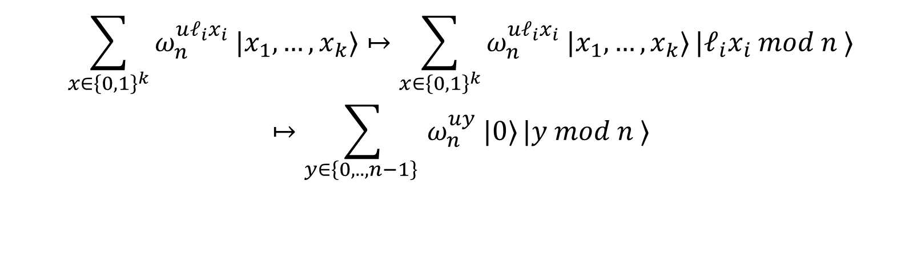
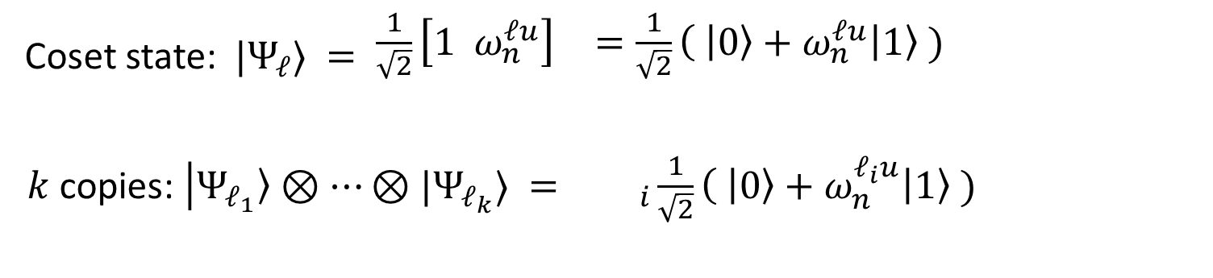
Dihedral group HSP and subset sum
Coset state: ${|Ψ_{ℓ}〉}_{ }= \begin{matrix}\frac{1}{\sqrt{2}}\left[{1 ω}_{n}^{ℓu}\right] & =\frac{1}{\sqrt{2}}( | 0〉+ω_{n}^{ℓu}|1〉 ) \\ & \end{matrix}$
$k$ copies: ${|Ψ_{ℓ_{1}}〉⊗…⊗|Ψ_{ℓ_{k}}〉}_{ }={ }_{ i}\frac{1}{\sqrt{2}}( | 0〉+ω_{n}^{ℓ_{i}u}|1〉 )$
$$⊗$$
If we had a classical algorithm for subset sum, we would be done!
Indeed, the following computes $u$ from this state, where $k=\log{(n):}$
$$\sum_{x∈{\left\{0,1\right\}}^{k}}{ω_{n}^{uℓ_{i}x_{i}} |x_{1}, …, x_{k}〉}↦\sum_{x∈{\left\{0,1\right\}}^{k}}{ω_{n}^{uℓ_{i}x_{i}} |x_{1}, …, x_{k}〉}|ℓ_{i}x_{i} mod n 〉$$
$$↦\sum_{y∈{\left\{0,.., n−1\right\}}^{ }}{ω_{n}^{uy} |0〉}|y mod n 〉$$
$$↦|y〉$$

Slide 37
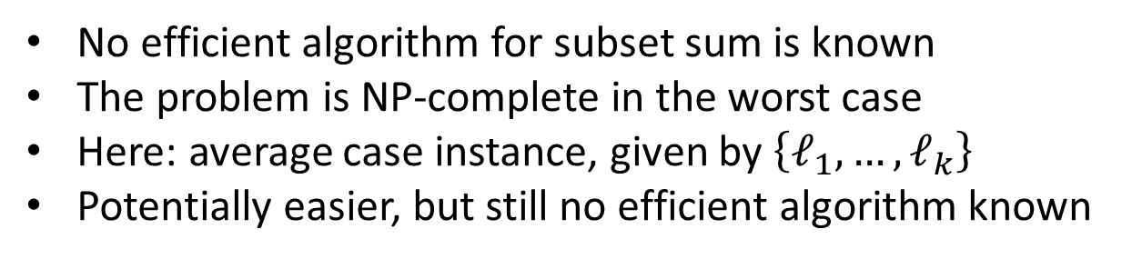
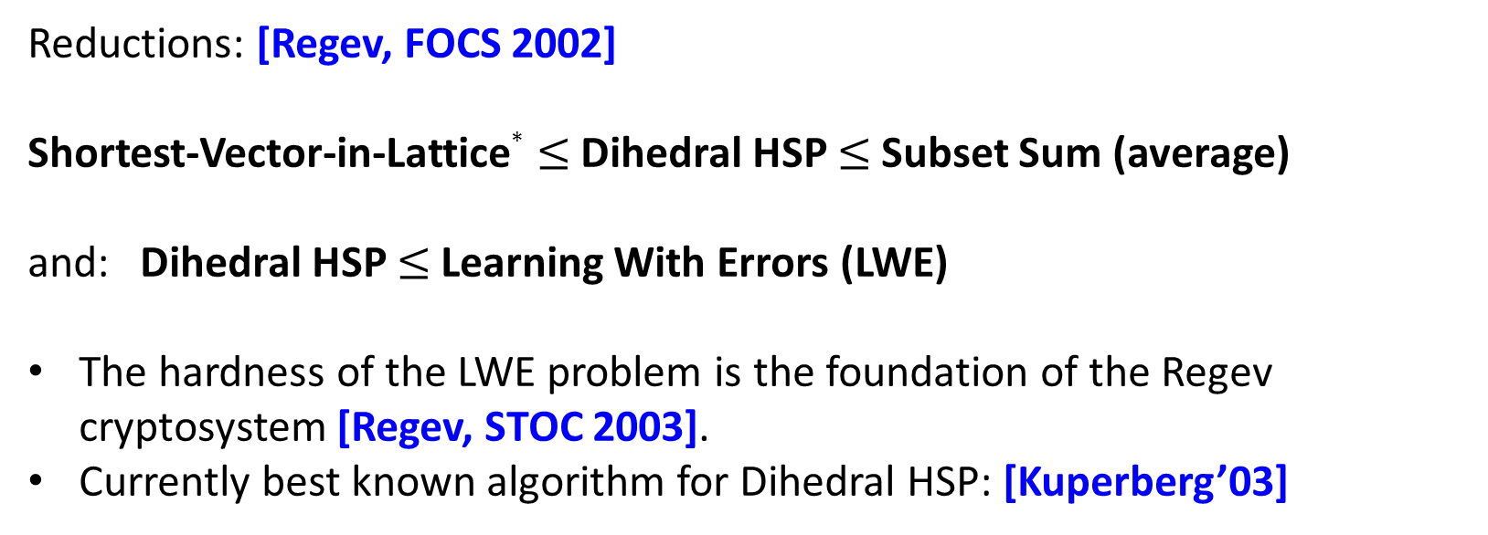
Challenge: solve the Dihedral HSP !
No efficient algorithm for subset sum is known
The problem is NP-complete in the worst case
Here: average case instance, given by $\left\{ℓ_{1}, …, ℓ_{k}\right\}$
Potentially easier, but still no efficient algorithm known
Reductions: [Regev, FOCS 2002]
Shortest-Vector-in-Lattice$∗$ $≤$Dihedral HSP $≤$Subset Sum (average)
and: Dihedral HSP $≤$Learning With Errors (LWE)
The hardness of the LWE problem is the foundation of the Regev cryptosystem [Regev, STOC 2003].
Currently best known algorithm for Dihedral HSP: [Kuperberg’03]
*: with gap promise

Slide 38

Graph Isomorphism
The problem (GI): decide whether two given graphs are isomorphic or not
No polynomial time algorithm classical algorithm known
Run-time of best classical algorithm is
Unlikely to be NP-complete (sits in NP∩coAM)
[ Slide concept: D. Bacon, U Washington ]

Slide 39
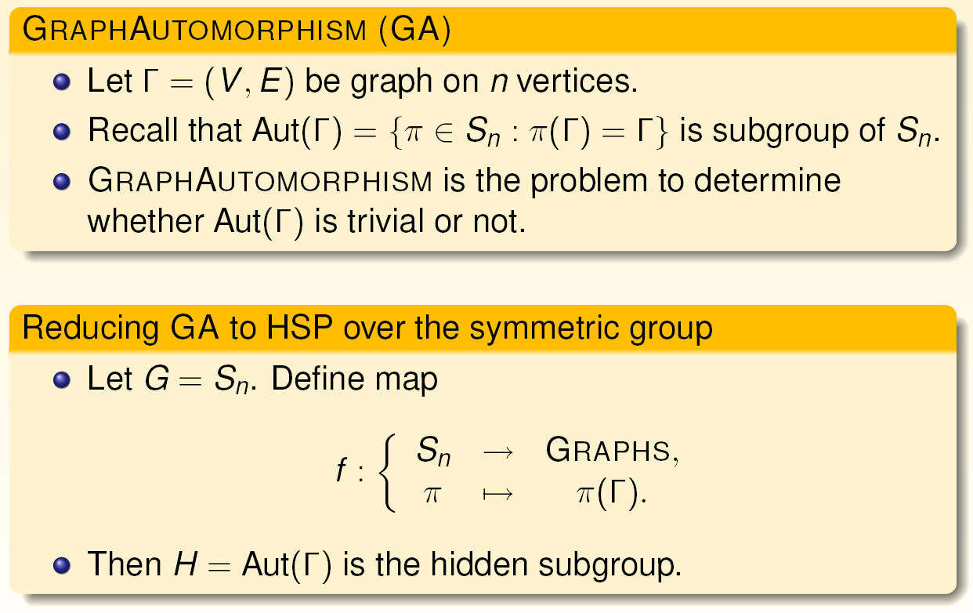
Graph Automorphism and HSP

Slide 40
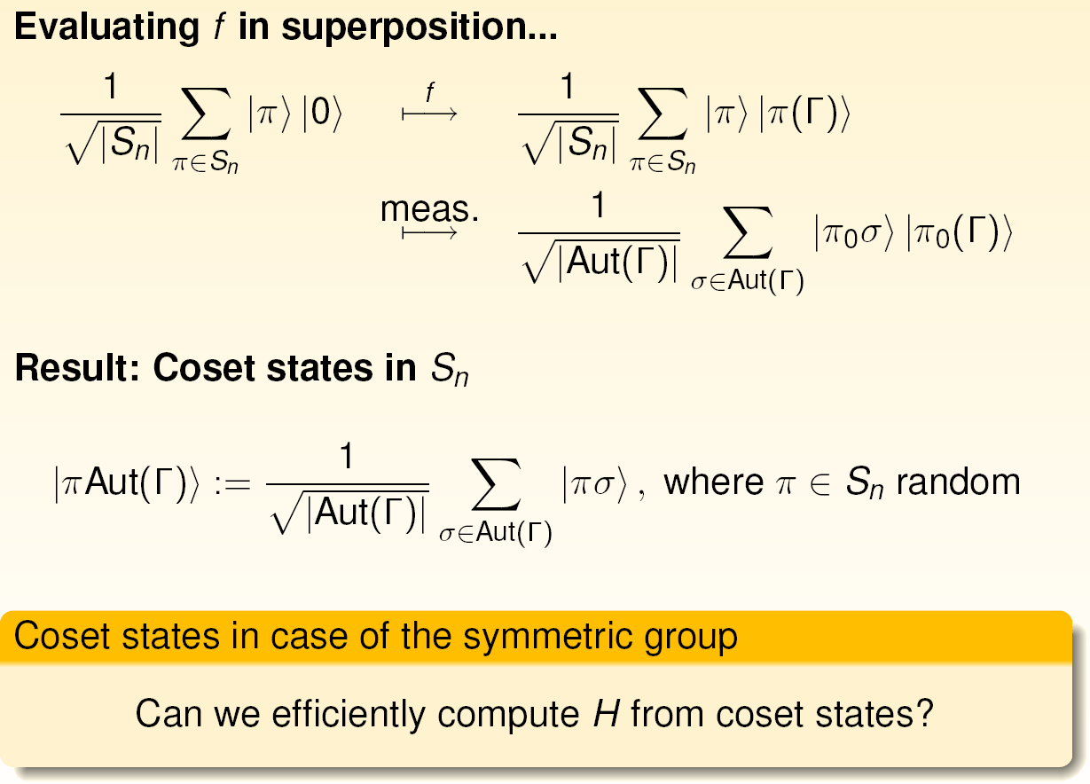
Quantum coset states

Slide 41
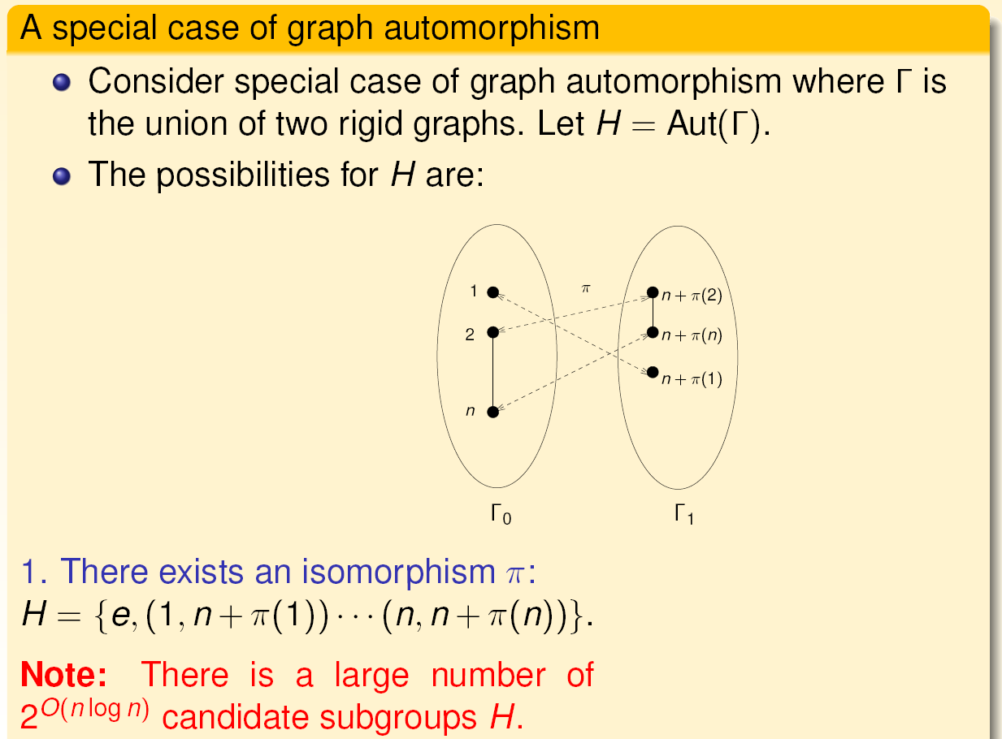
Graph-Automorphism

Slide 42
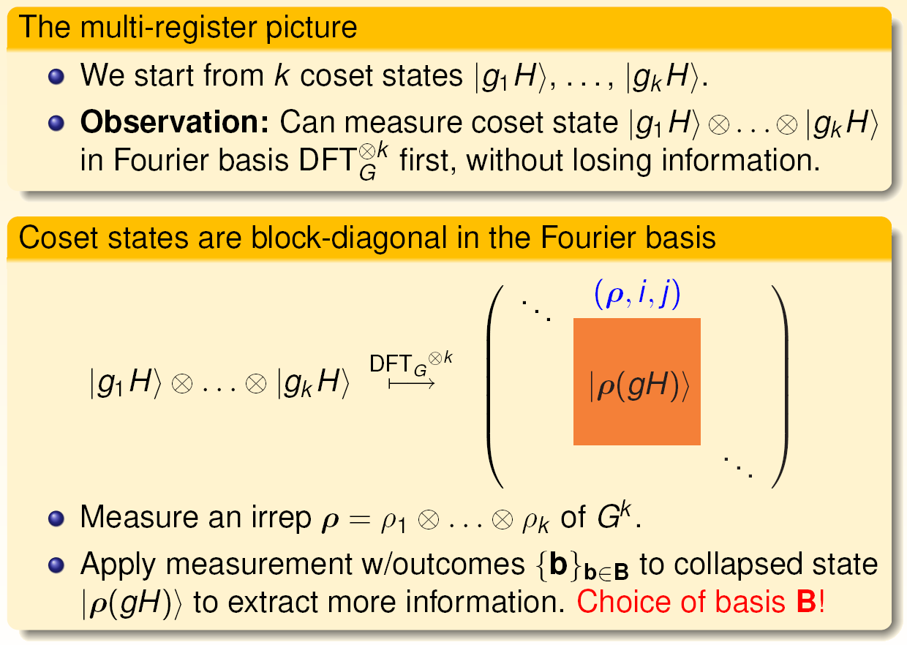
Multi-register approach to HSP

Slide 43
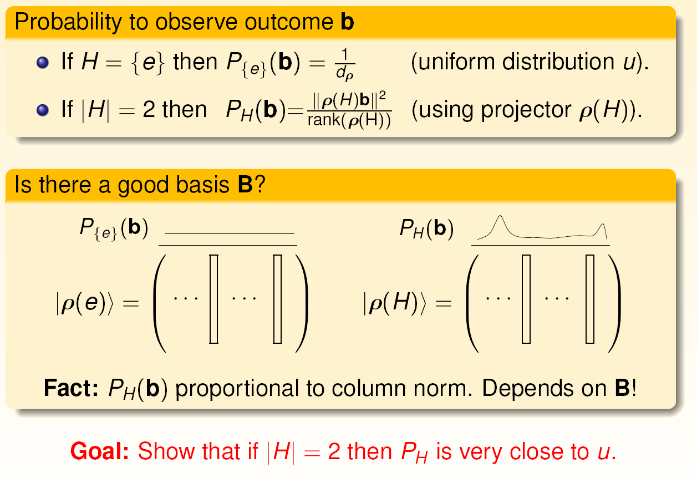
Multi-register approach to HSP

Slide 44
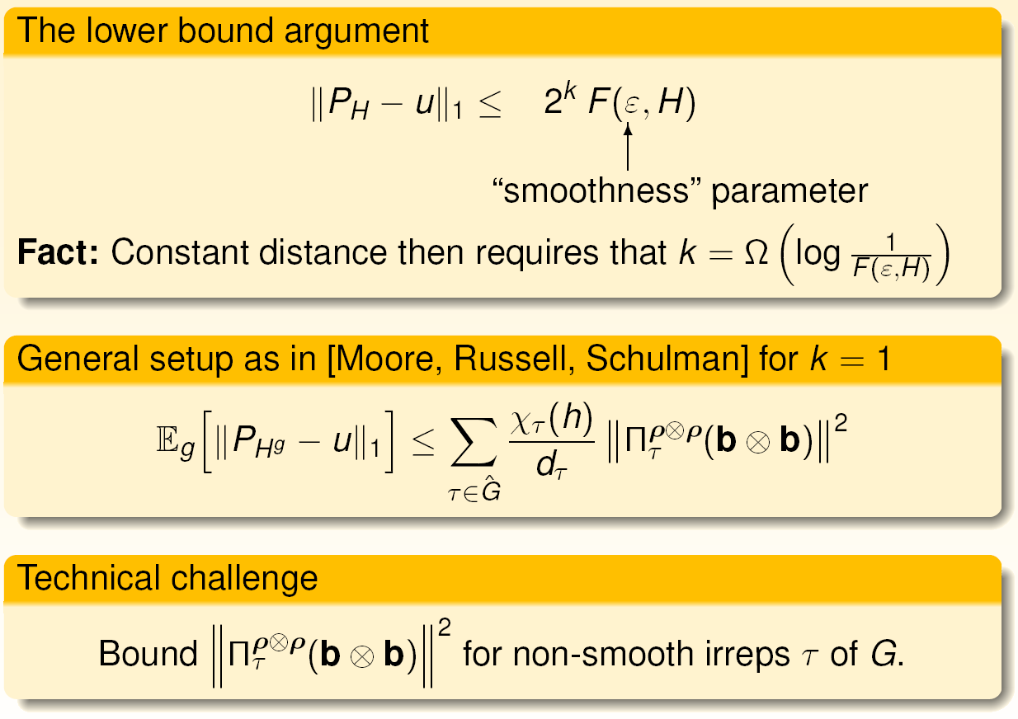
Bounding total variation distance

Slide 45
No-go results for graph isomorphism

Slide 46
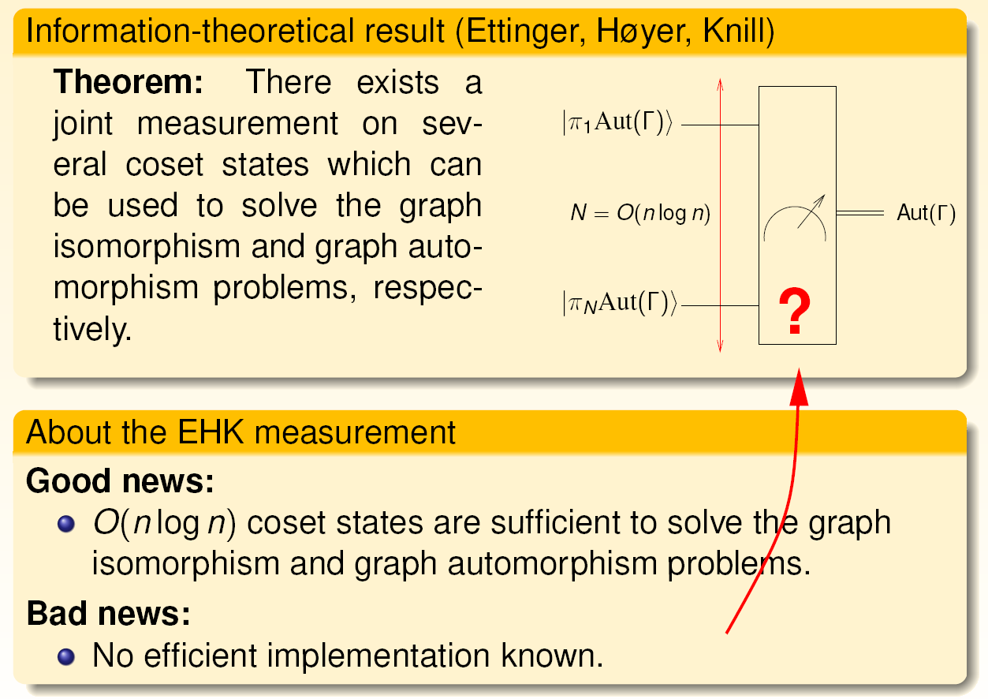
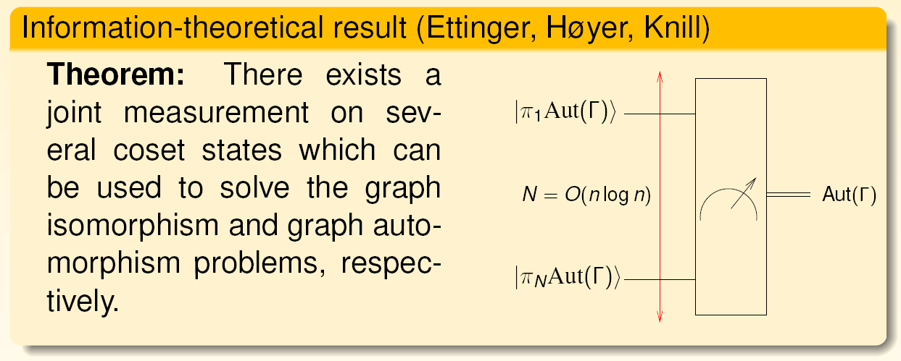
Entangling measurements

Slide 47
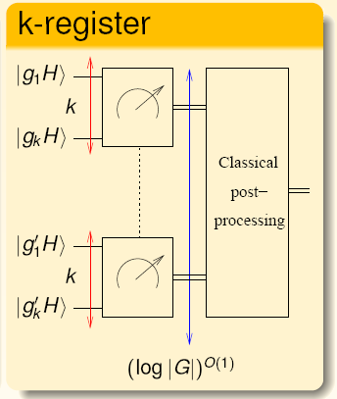
Limitations on Graph Isomorphism
Reduction from GI to HSP over the symmetric group is known.
From single-register to multi-register quantum algorithms:
Result [Hallgren, Moore, R., Russell, Sen, J. ACM’10]:
For GI, the measurement has to be a joint measurement of registers. It is unclear how design such highly entangling measurements.
Uses Fourier analysis over non-abelian groups, simple properties of geometry of Hilbert space, and the probabilistic method.
X
X

Slide 48
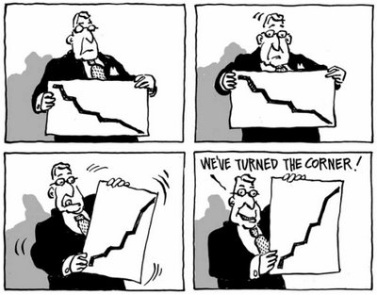
How to use these negative results?

Slide 49

Turning Lemons Into Lemonade
Quantum resistant 1-way function [Moore,Russell,Vazirani ’07]
  Fix m random vectors V = {v₁, … , v_{m}} in GF(p)^{n}
  The secret information is an n × n matrix M.
  Output the unordered set {M v₁, … , M v_{m}}.
  Choose m = n + O(log² n): maps n² bits to nm bits.
Properties of this function:
  Efficiently computable: map is matrix multiplication.
  Reconstructing M is at least as hard as graph isomorphism due to [Petrank, Roth ’97]. This holds true even for a polynomial fraction of whole space.
  For V and M uniform at random this corresponds to a HSP that is hard in the sense of [Hallgren, Moore, R., Russell, Sen, STOC’06/J.ACM’11].
  Construction closely related to McEliece cryptosystem. See [Dinh, Moore, Russell, arXiv:1008.2390] for quantum attacks on McEliece.

Slide 50
“Post-Quantum” Cryptography?
If a scalable quantum computer exists:
  RSA is broken [Shor’94].
  Elliptic curve systems are broken.
  Buchmann-Williams system is broken [Hallgren’02].
Cryptosystems that possibly are still secure:
  McEliece public key system, HFE, etc.
  Regev’s lattice based public key system.
Quantum-resilient classical cryptography:
  One-way function secure against quantum attacks was introduced in [Moore, Russell, Vazirani ’07].
  Relies on various limitations for quantum algorithms for the graph isomorphism problem.
… and then there is quantum cryptography / QKD
  Uses quantum mechanics to generate a secret key.

Slide 51
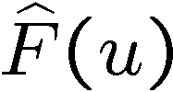
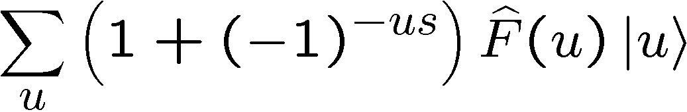
More open problems
“Coherent” way to uncompute in ?
  In other words: for a function given by an oracle, can we implement its
  Fourier transform? Or even just approximate it? If not, then why not?
Show advantages of applying PGM approach to hidden shift problem.
Can we turn the algorithm into zero-error algorithm?
  Generalizations to larger (i.e., non-binary) alphabets?
  Applications of hidden shifts for Boolean functions?
  Quantum cryptanalysis?
Implement QFTs for some families of finite groups. Open: can we do all finite solvable (or even: super-solvable) groups in poly-logarithmic time? Also open: can we do QFT over GL(2,p) or PGL(2,p) or PSL(2,p) efficiently,
i.e., in poly-logarithmic time?

Slide 52
Further reading (Part 2)
Hidden subgroup problem:
  Abelian case: arXiv:quant-ph/9704027
  Application to ECC dlog: arXiv:1209.6348
  Connections to graph isomorphism: arXiv:quant-ph/0511148
  Connections to lattice problems: link
Hidden shift problem:
  Legendre symbol: arXiv:quant-ph/0211140
  Bent functions: arXiv:0811.3208
  General Boolean functions: arXiv:1304.4642
  Nonabelian instances: arXiv:1111.4382
LIQUi|>: arXiv:1402.4467

