Slide 1
Quantum Algorithms III
Shor’s algorithms for dlog and factoring
Martin Roetteler
Quantum Architectures and Computation Group
Microsoft Research
Redmond, WA, U.S.A.
CROSSING Winter School on Quantum Security
TU Darmstadt
January 26 2016
Notes:
Material to add: QFT factorization
Other Fourier transforms
Cosine transform?
Shor: dlog stuff from DIMACS talk
LIQUID stuff about Shor dlog

Slide 2
Overview
Part III: Circuits, quantum Fourier transform (20min)
  Shor’s algorithms: factoring + dlog (20 min)
Part IV: Hidden subgroups, hidden shifts (30 min)
    Quantum programming in LIQui|> (10 min)
Q&A (please ask questions during the lecture also!)

Slide 3

The power of quantum computing

Slide 4
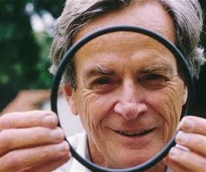
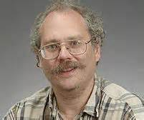
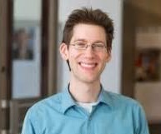
Useful quantum algorithms exist!
Quantum simulation (1982)
Simulate physical systems in a quantum mechanical device
Exponential speedups
Shor’s Algorithm (1994)
Breaks RSA, elliptic curve signatures, DSA, El-Gamal
Exponential speedups
Solving Linear Systems of Equations (2010)
Applications shown for electromagnetic wave scattering
Exponential speedups

Slide 5
Universal quantum gates

Slide 6
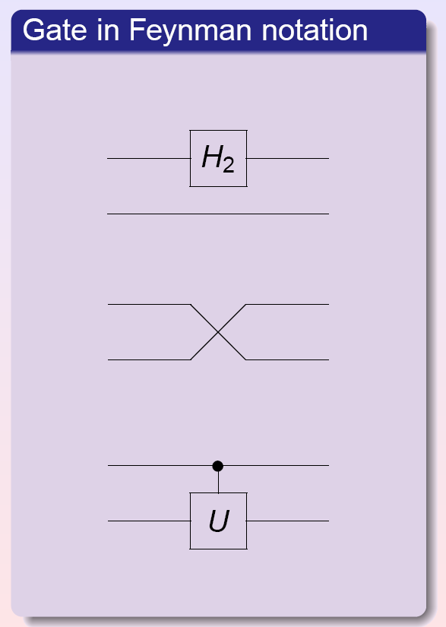
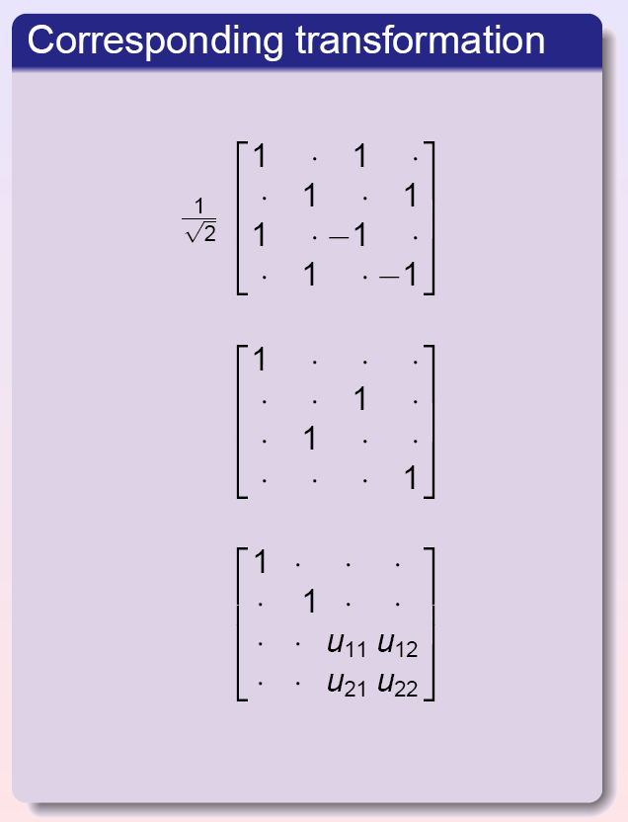
Notation for unitary matrices
Wire = qubit

Slide 7
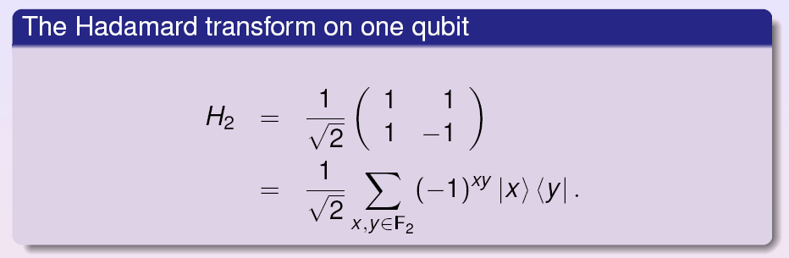
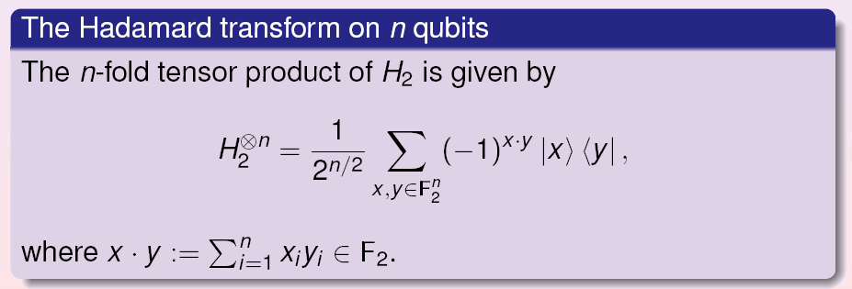
Example: Hadamard transform

Slide 8
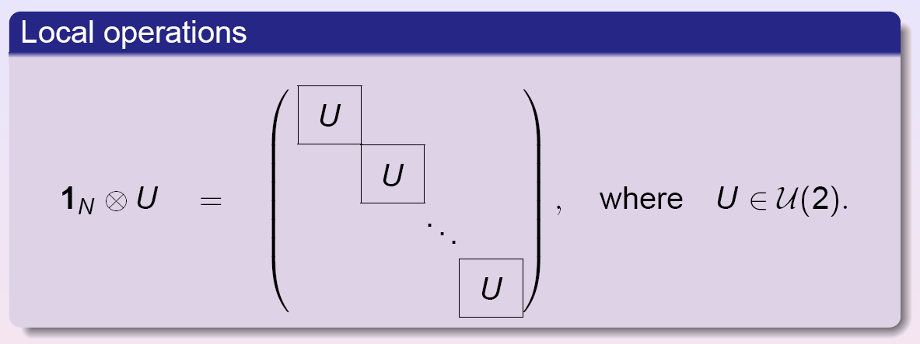
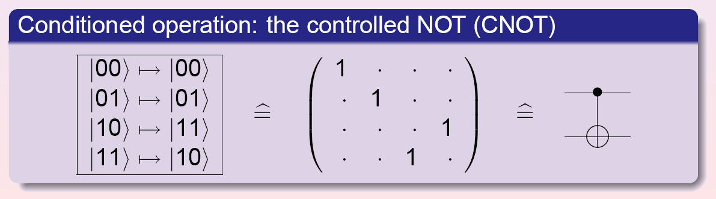
Examples: local operations and CNOT

Slide 9
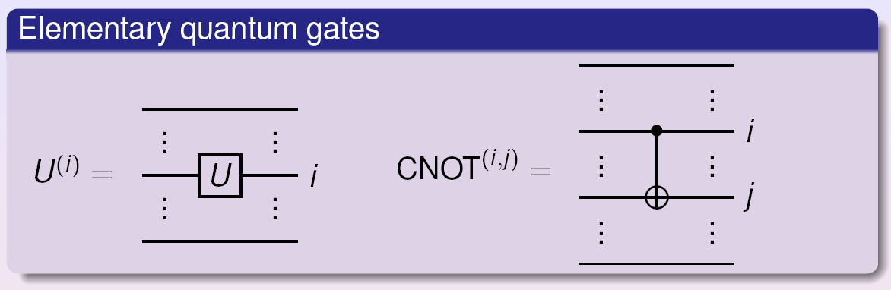
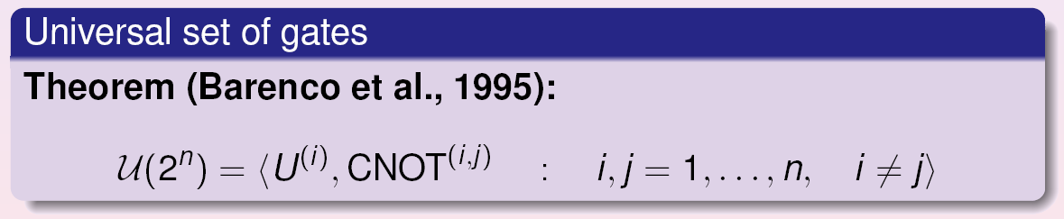
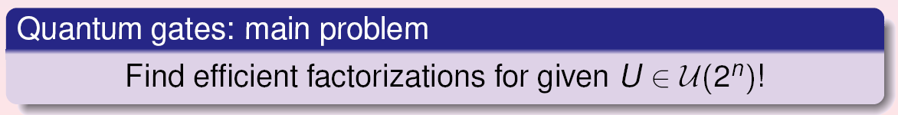
Universality: arbitrary rotations

Slide 10
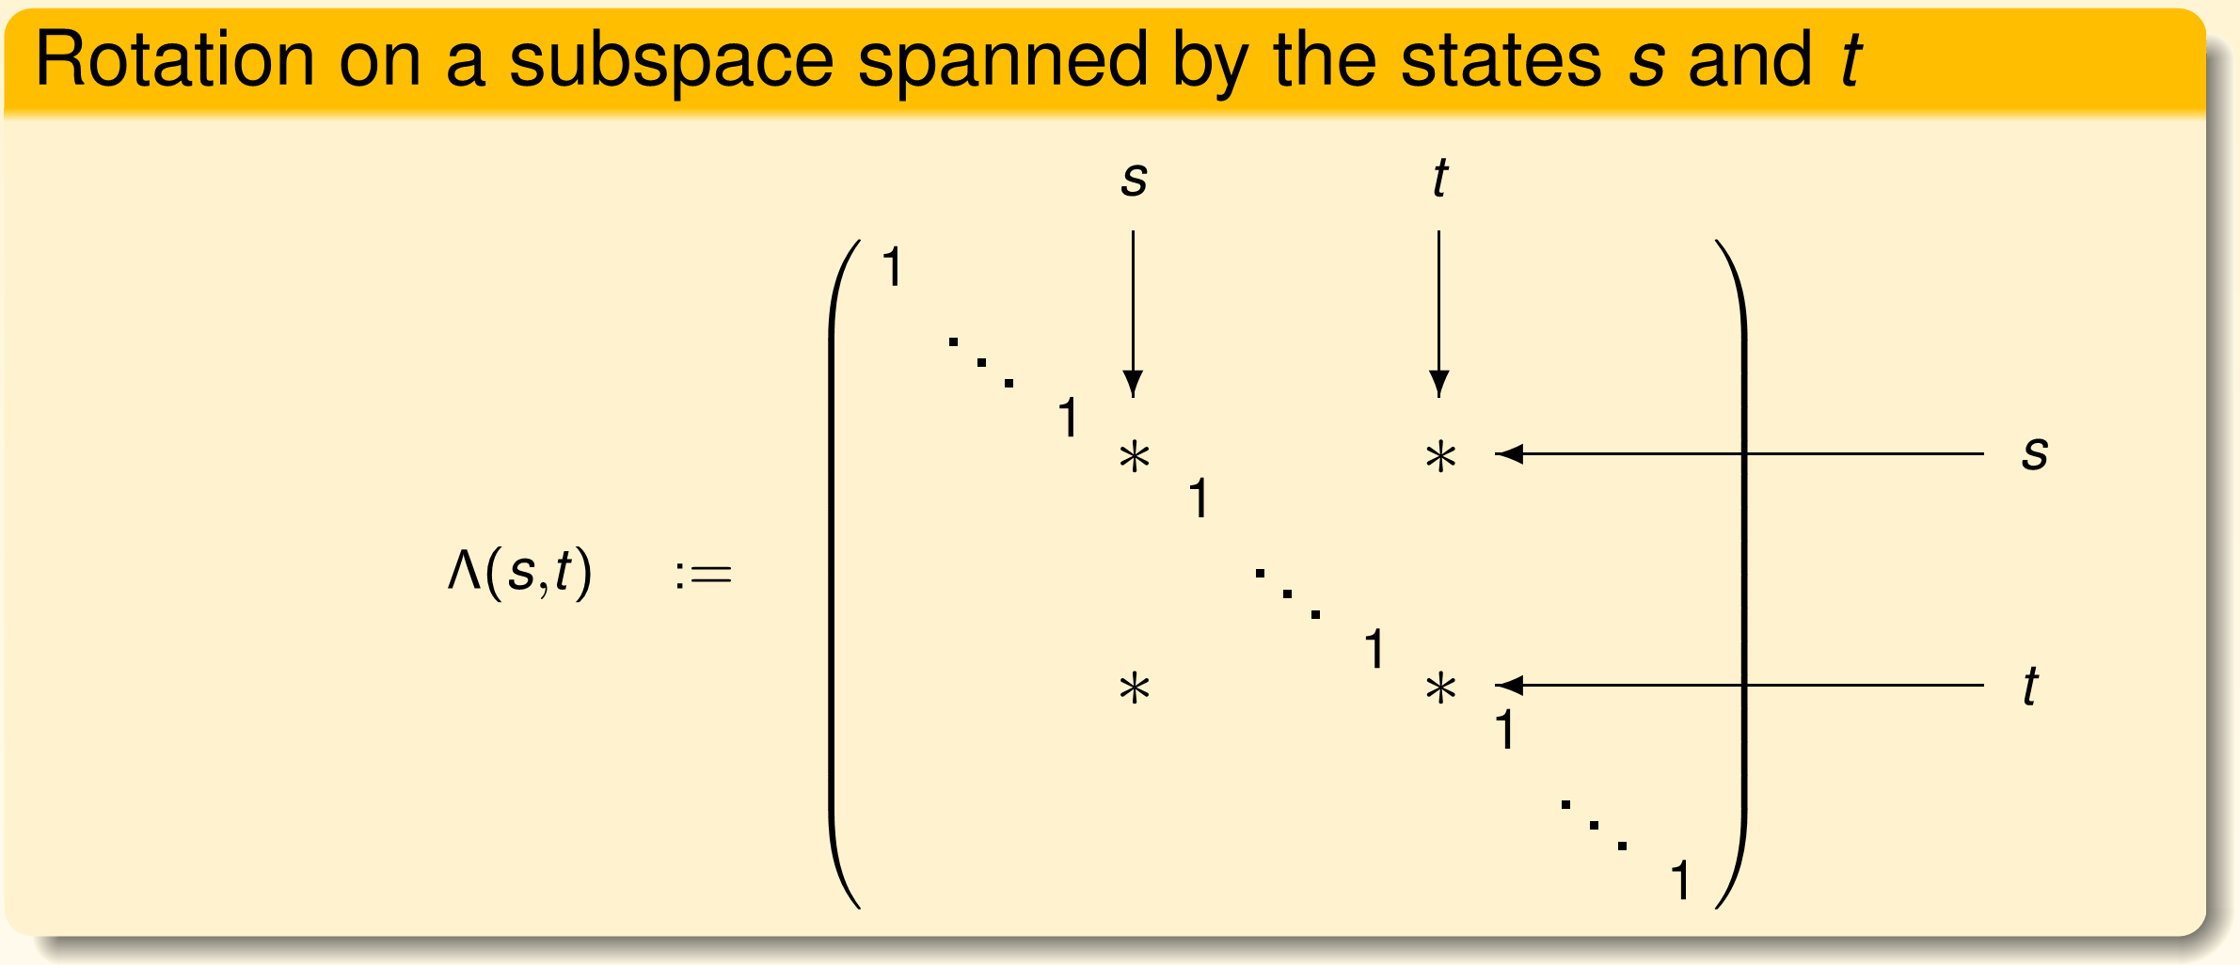
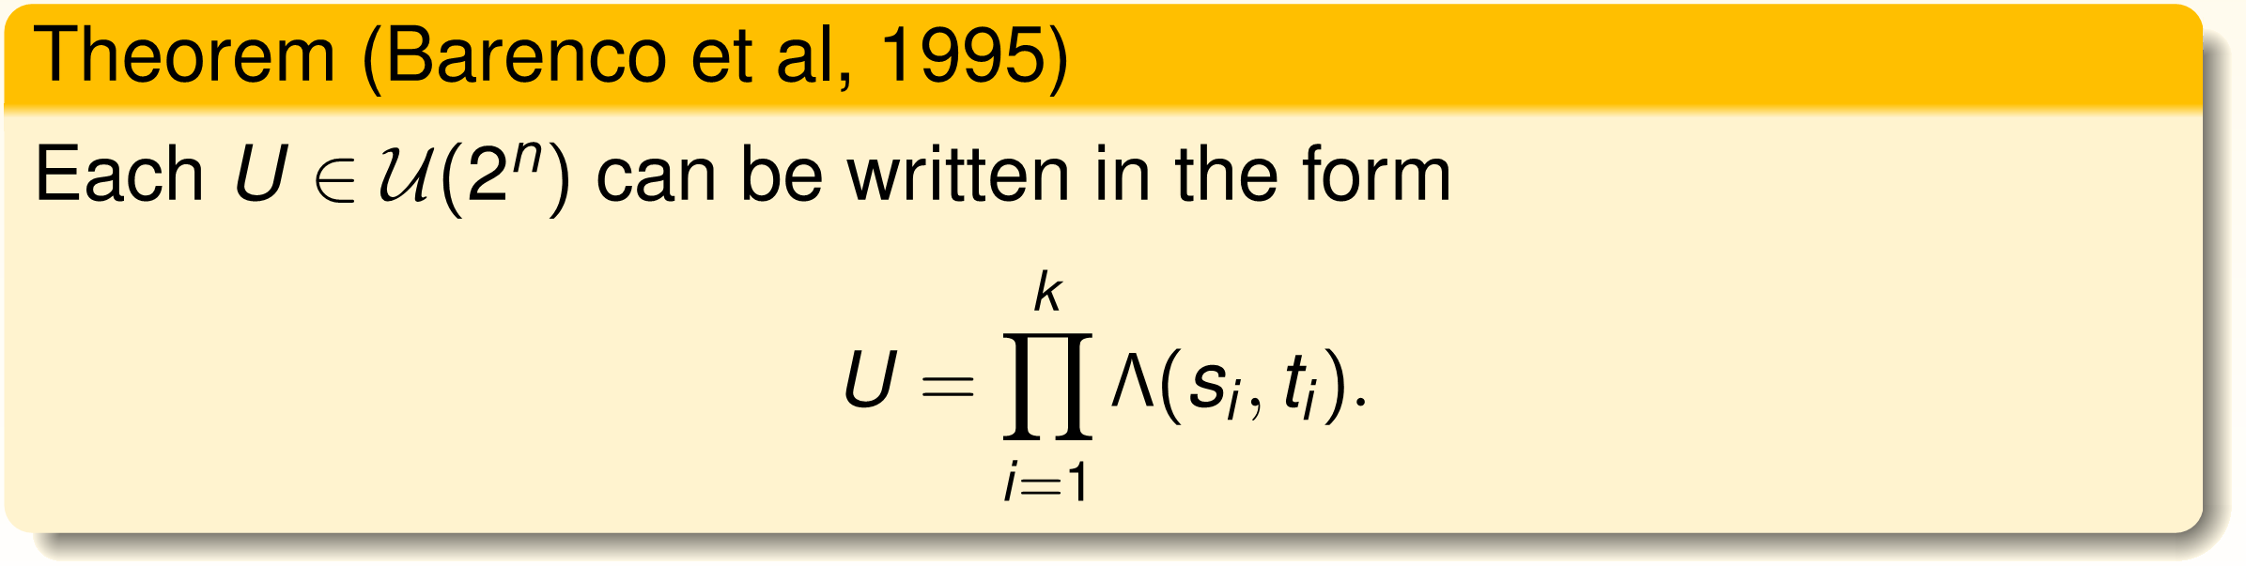
Operations on subspaces

Slide 11
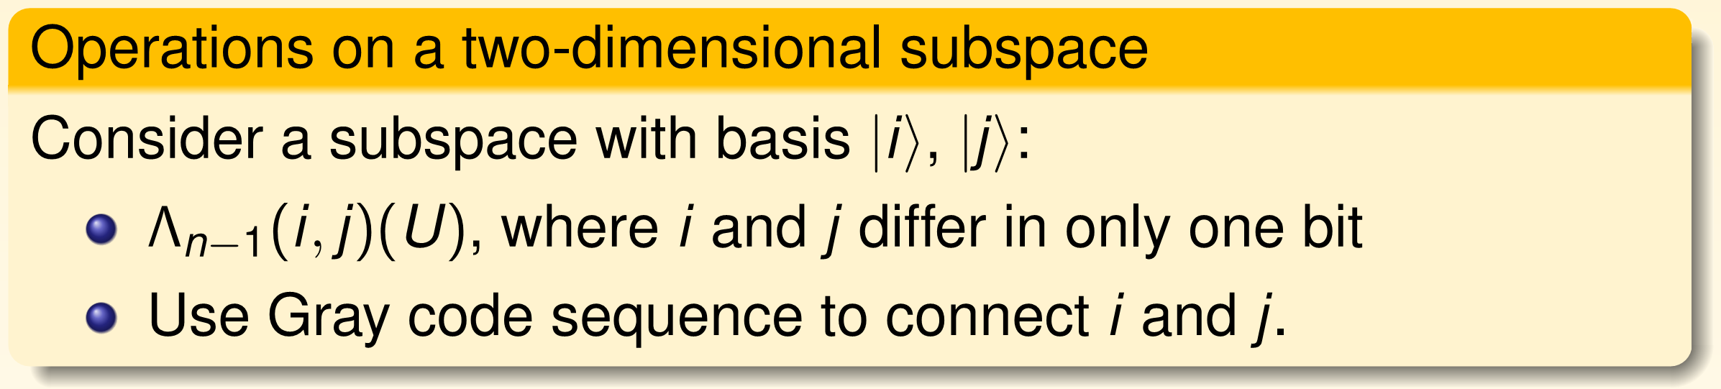
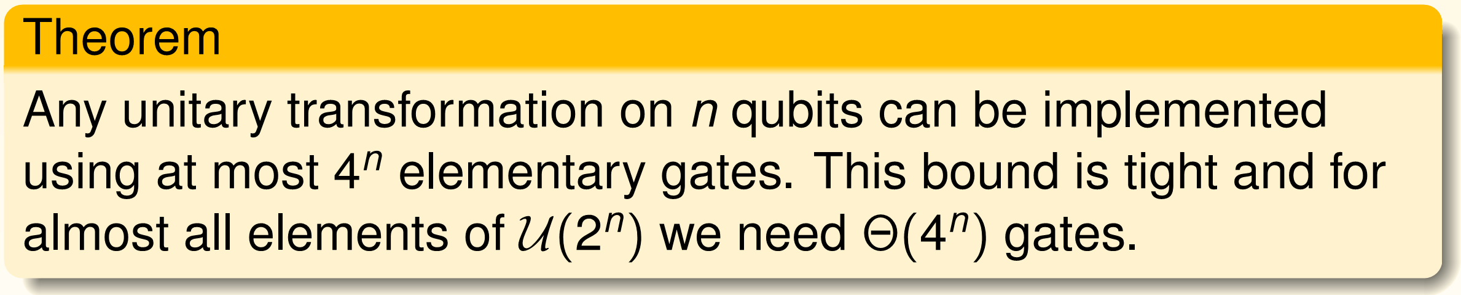
Universality: a tight bound
References:
Barenco et al, Elementary gates for quantum computation, Phys Rev A, vol. 52(5),
pp. 3457-3467, 1995.
G. Cybenko, Reducing quantum computations to elementary unitary operations,
Comp. Sc. and Engineering, Vol. 3, No. 2, pp. 27-32, 2001.
A. Aho, K. Svore, Compiling quantum circuits using the palindrome transform,
arXiv:quant-ph/0311008.

Slide 12
Discrete universal gate sets
Important universal gate sets for logical operations: e.g. “Hadamard + Toffoli” (see M. Mosca’s talk) and “Clifford + T”:
Consists of all Clifford operations on n qubits and the T gates,
i.e., a rotation by π/8 around the Z-axis.
Arises naturally for fault-tolerant quantum computing for several
quantum codes, e.g., Steane code, surface code, etc.
T gate usually implemented via magic state distillation and very
expensive. Much more expensive than Clifford gates.
Logical single-qubit rotations
account for most of the cost!

Slide 13
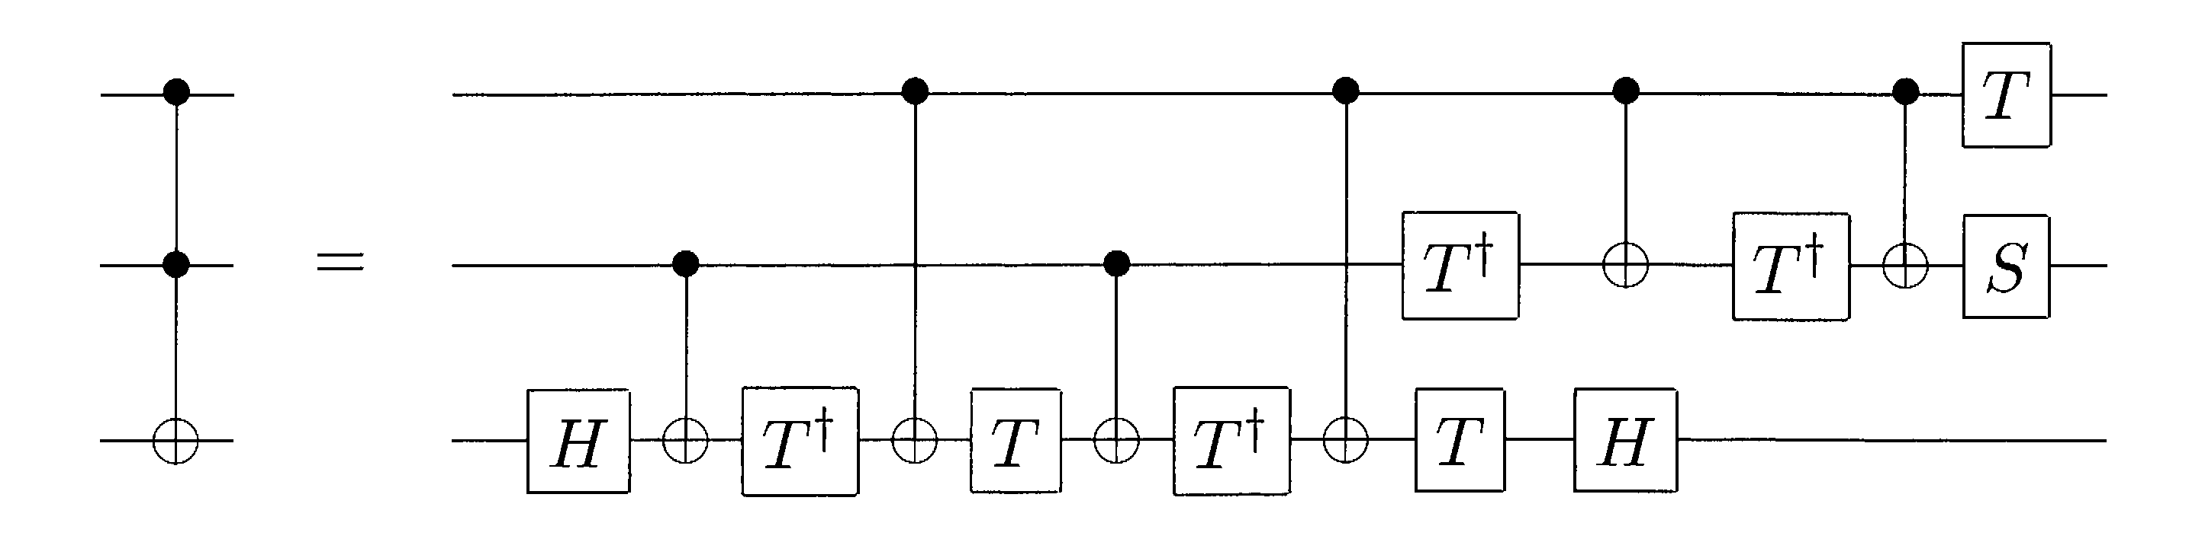
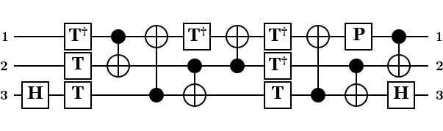

Bounding resources: T gates
A useful factorization:
Lemma: If a unitary U can be implemented exactly over Clifford+T,
then also Λ(U) can be implemented exactly. [arxiv.org:1206.0758]
This Lemma be used in some situations to avoid all errors due to
single qubit approximations.
Cost of controlled unitaries:
Tracking v=[#loc, #CNOT,#H, #P, #T]
From U to Λ(U): matrix vector multiplication Mv.

Slide 14
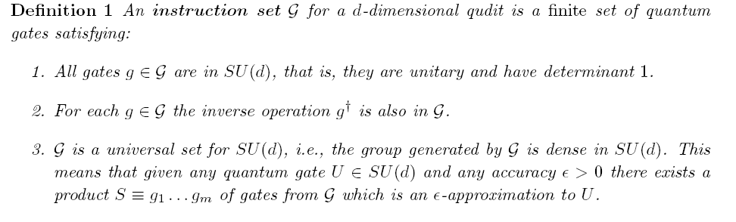
Universality: discrete gate sets
Note: two different complexities implied by this, namely
Cost for finding the factorization, i.e., computation time
Length of the factorization, i.e., as a word over the generators
[Source: Dawson, Nielsen, quant-ph/0505030]

Slide 15
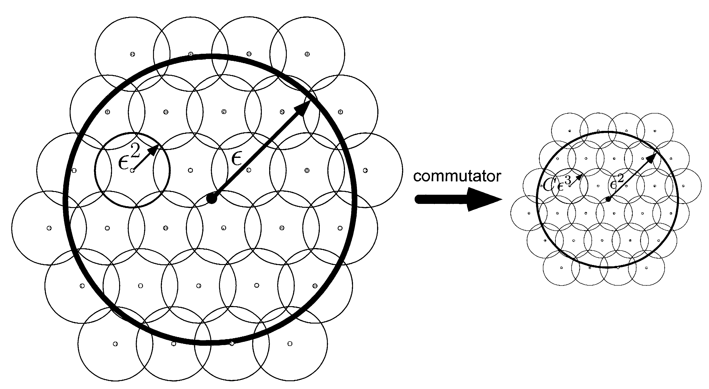
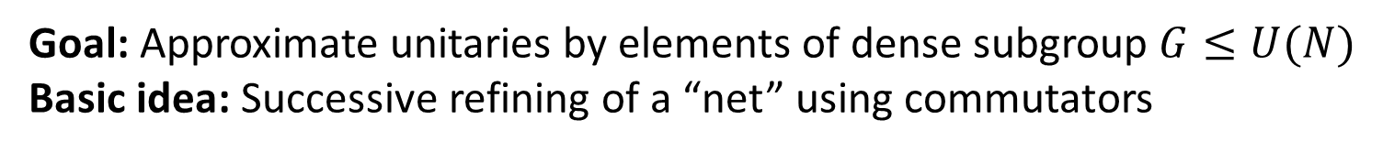
Solovay-Kitaev algorithm
Goal: Approximate unitaries by elements of dense subgroup $G≤U(N)$
Basic idea: Successive refining of a “net” using commutators
[Image source: Nielsen/Chuang, CUP 2000]
Implementations:
[Kitaev, Shen, Vyialyi, AMS 2002]: log^{3+δ} (1/ε) time, log^{3+δ}(1/ε) length
[Dawson, Nielsen, quant-ph/0505030]: log^{2.71} (1/ε) time, log^{3.97} (1/ε) length
[Harrow, Recht, Chuang, quant-ph/0111031]: non-constructive, log (1/ε) length

Slide 16
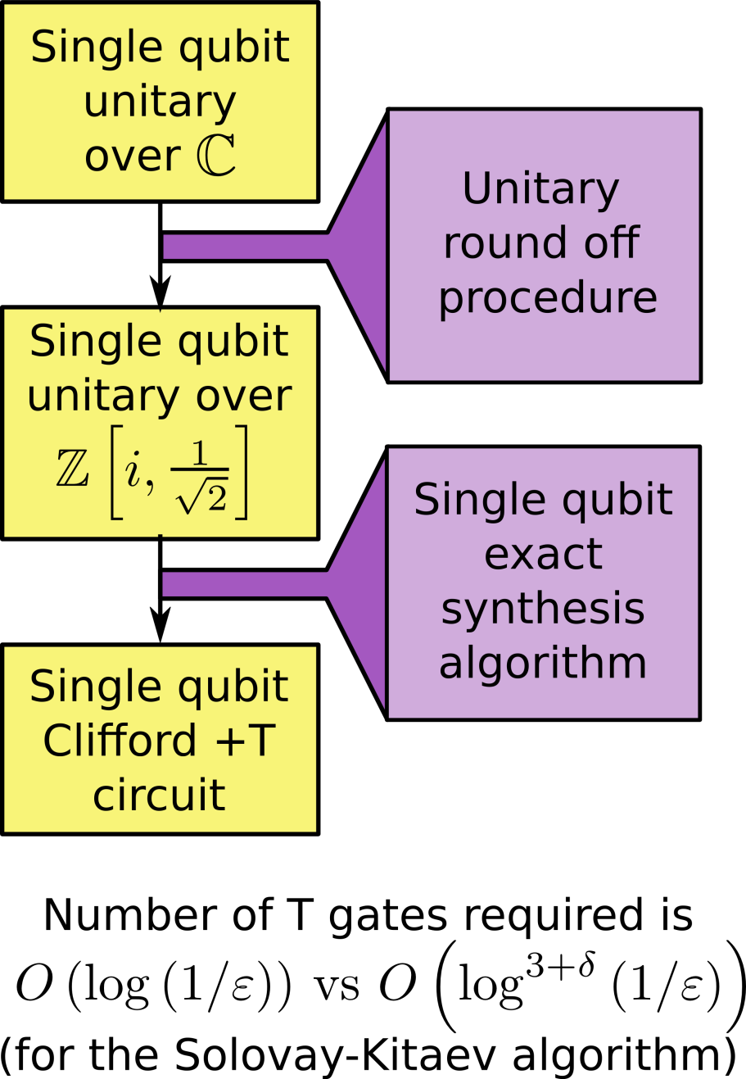
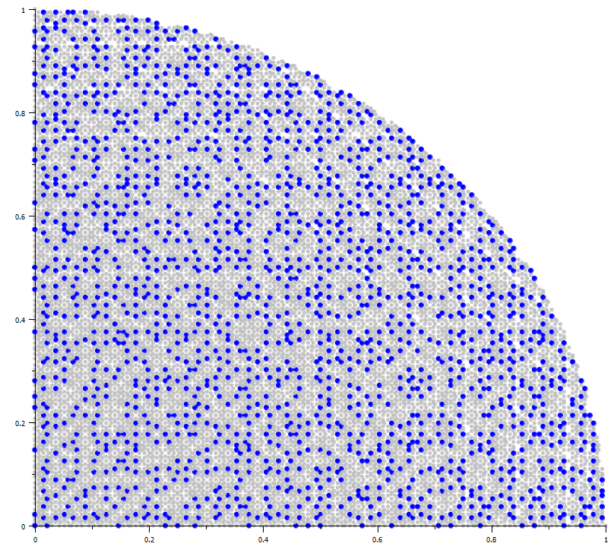
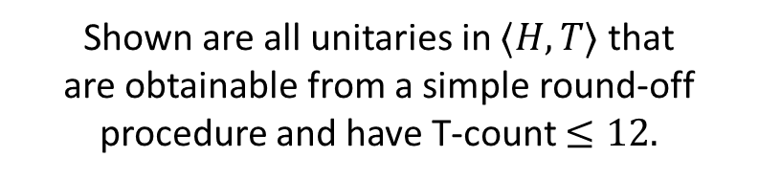
Single qubit gates: synthesis methods
Basic idea:
[Kliuchnikov/Maslov/Mosca 2012], [Selinger 2012]
Shown are all unitaries in $〈H, T〉$ that
are obtainable from a simple round-off procedure and have T-count $≤12.$
[Slide concept by V. Kliuchnikov]

Slide 17

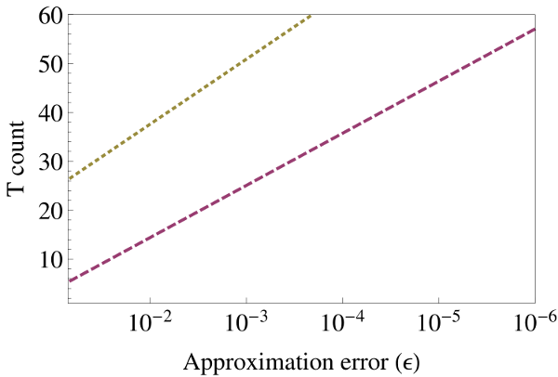
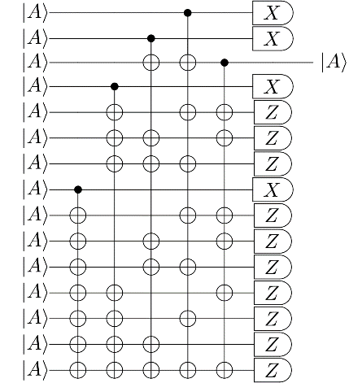
Quantum compiling
Quantum algorithm
Axial rotations
[Selinger 2012]
[Kliuchnikov,Maslov, Mosca 2012]
worst case
“average” case
≈ HTHTHTHTHTHTHTH
THTHTHTHTHTHTH...
Quantum computer
repeat-until-success
Quantum computer
Error correction
{ ,H,T}
Notes:
What's worse is that, for many QECs, the T gates are implemented using state distillation, a protocol which requires a very large number of physical resources. Many estimates place the cost of a T gate at about 10x that of CNOT or H gates, for example.

Slide 18
Quantum Fourier transform

Slide 19
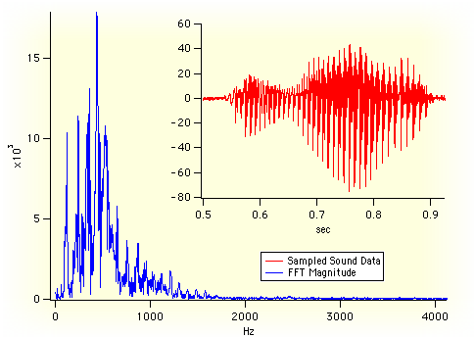

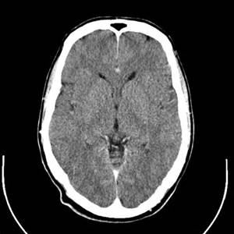

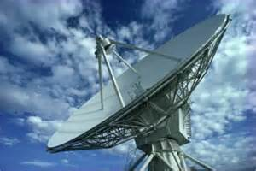
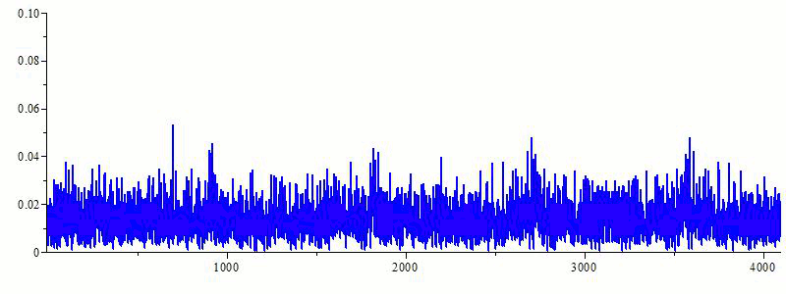
Quantum power unleashed: super-fast FFT
# ops = N log N
FFT
Example:
1GB of data =
10 Billion ops
Quantum FFT
# ops = log N
Example:
1GB of data =
27 ops (!!!)
Notes:
Mention commonly used N in JPEG, MPEG. Mention that classically we have flops, in the quantum case the ops are elementary quantum gates.

Slide 20
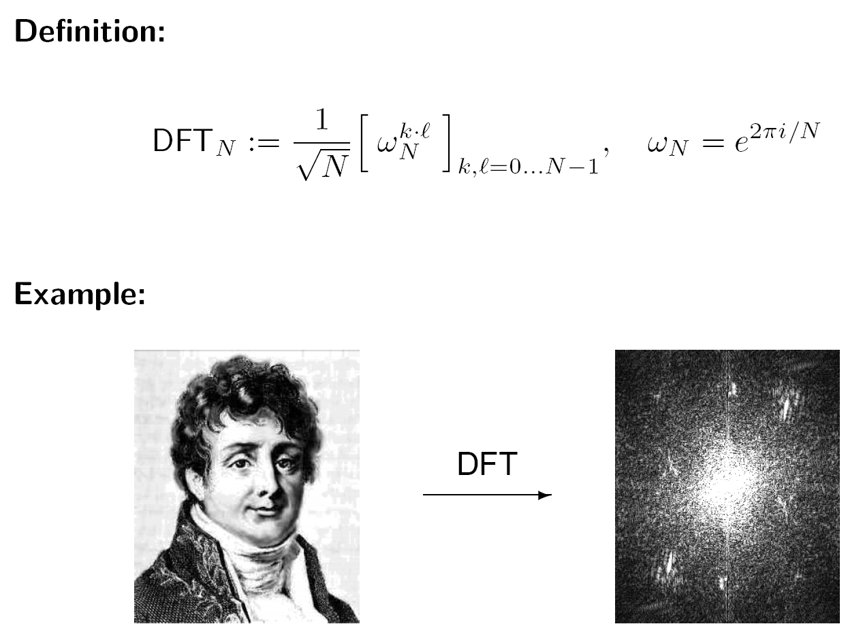
Discrete Fourier Transforms

Slide 21
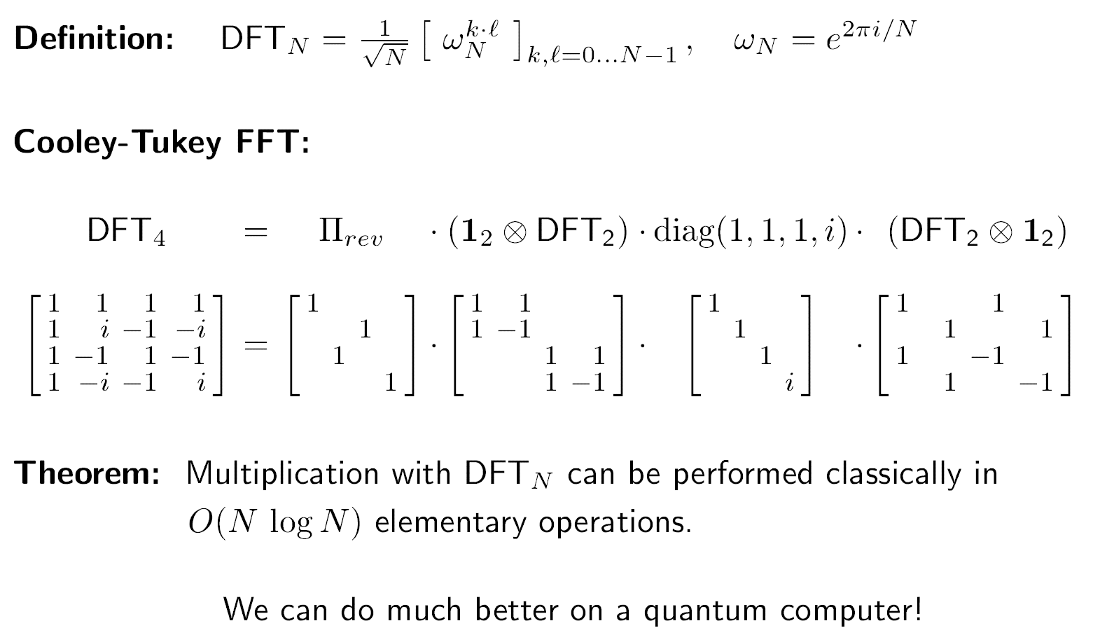
Discrete Fourier Transform (DFT/QFT)

Slide 22
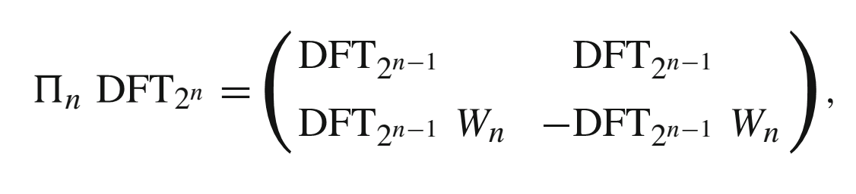

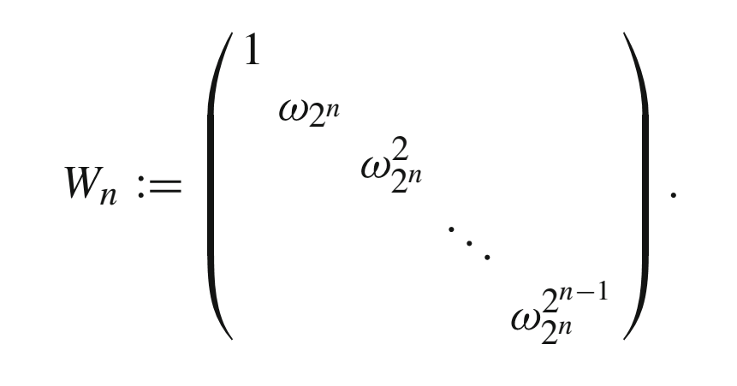



Cooley Tukey FFT
Recursion:
$$=$$
“Twiddle factors”:

Slide 23
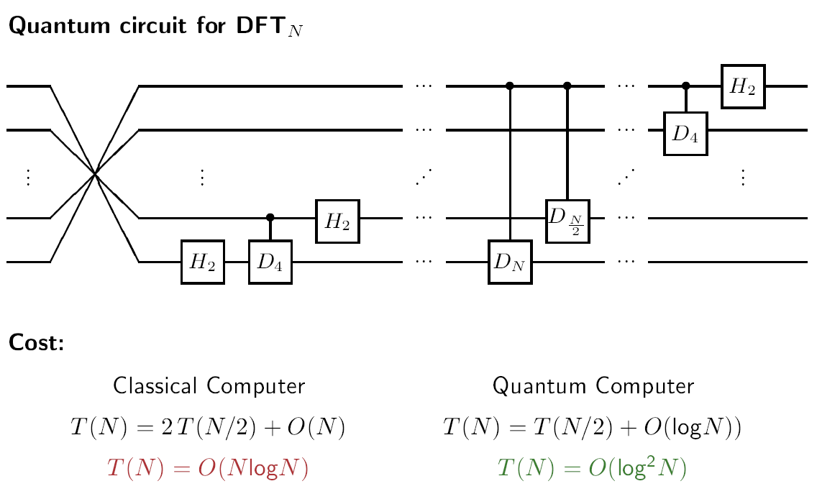
Quantum Fast Fourier Transform

Slide 24
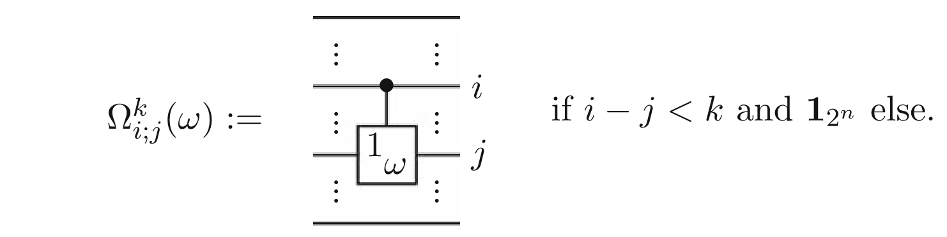
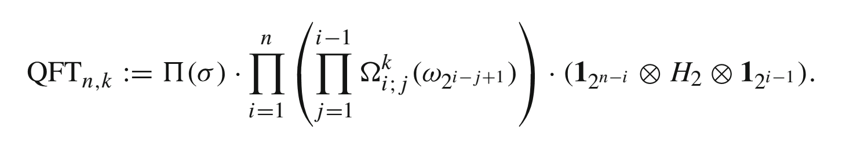
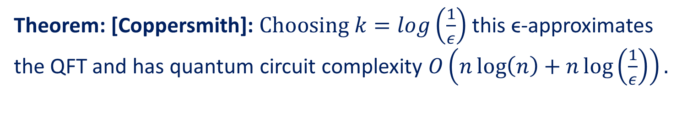
“Pruning” the small rotations
Set a threshold k for rotations:
Approximate QFT:
Theorem: [Coppersmith]: $Choosing k=log\left(\frac{1}{ε}\right)$this ϵ-approximates
the QFT and has quantum circuit complexity $O\left(n\log\left(n\right)+n\log\left(\frac{1}{ε}\right)\right).$

Slide 25
Shor: factoring

Slide 26
The integer factorization problem
Basic problem:
  Given a natural number N. Find a (prime) factor of N.
Best known classical algorithm:
  The number field sieve has a complexity of
which is (sub)exponential in the number n = log N of bits.
Factoring seems to be difficult:
  Problem has long tradition, many people tried…
  RSA challenge (1991–2007)
  But: there is no proof known that there is no polynomial time algorithm for factoring!

Slide 27
Reducing factoring to period finding
Modular exponentiation: Let N be an integer and let a be in Z_{N}. Modular exponentiation is the map f(x) := a^{x} mod N.
Fact: The map f can be implemented in O(poly(log N)) ops.
Fact: It can be shown that it can also be implemented efficiently on a quantum computer.
More facts:
  Recall that the order of a is defined as the smallest integer r such that a^{r} = 1 mod N.
  The function f(x) := a^{x} mod N is periodic with period r equal to the order of a, i. e., f (x) = f (x + r) for all x.
  The problem of factoring N can be reduced to period finding for modular exponentiation f (for random a).

Slide 28
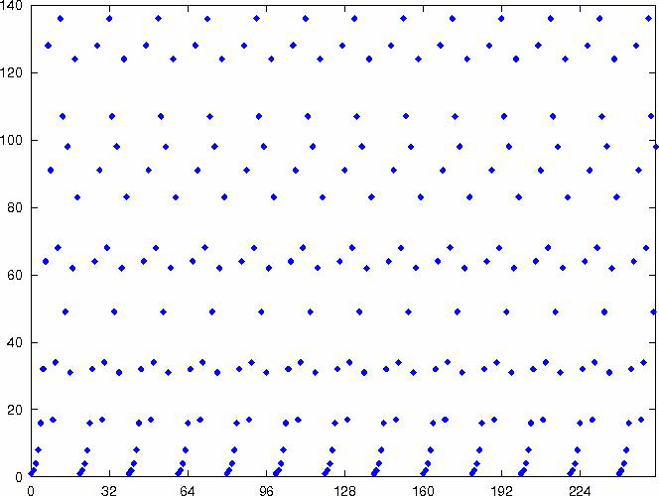
Setting up a periodic state
Observation: The function f(x) = a^{x} mod N is periodic and has period length r, i. e., f (x) = f (x + r) for all inputs x.
Example: graph of the function f (x) = 2^{x} mod 165:

Slide 29
Shor’s algorithm for period finding

Slide 30
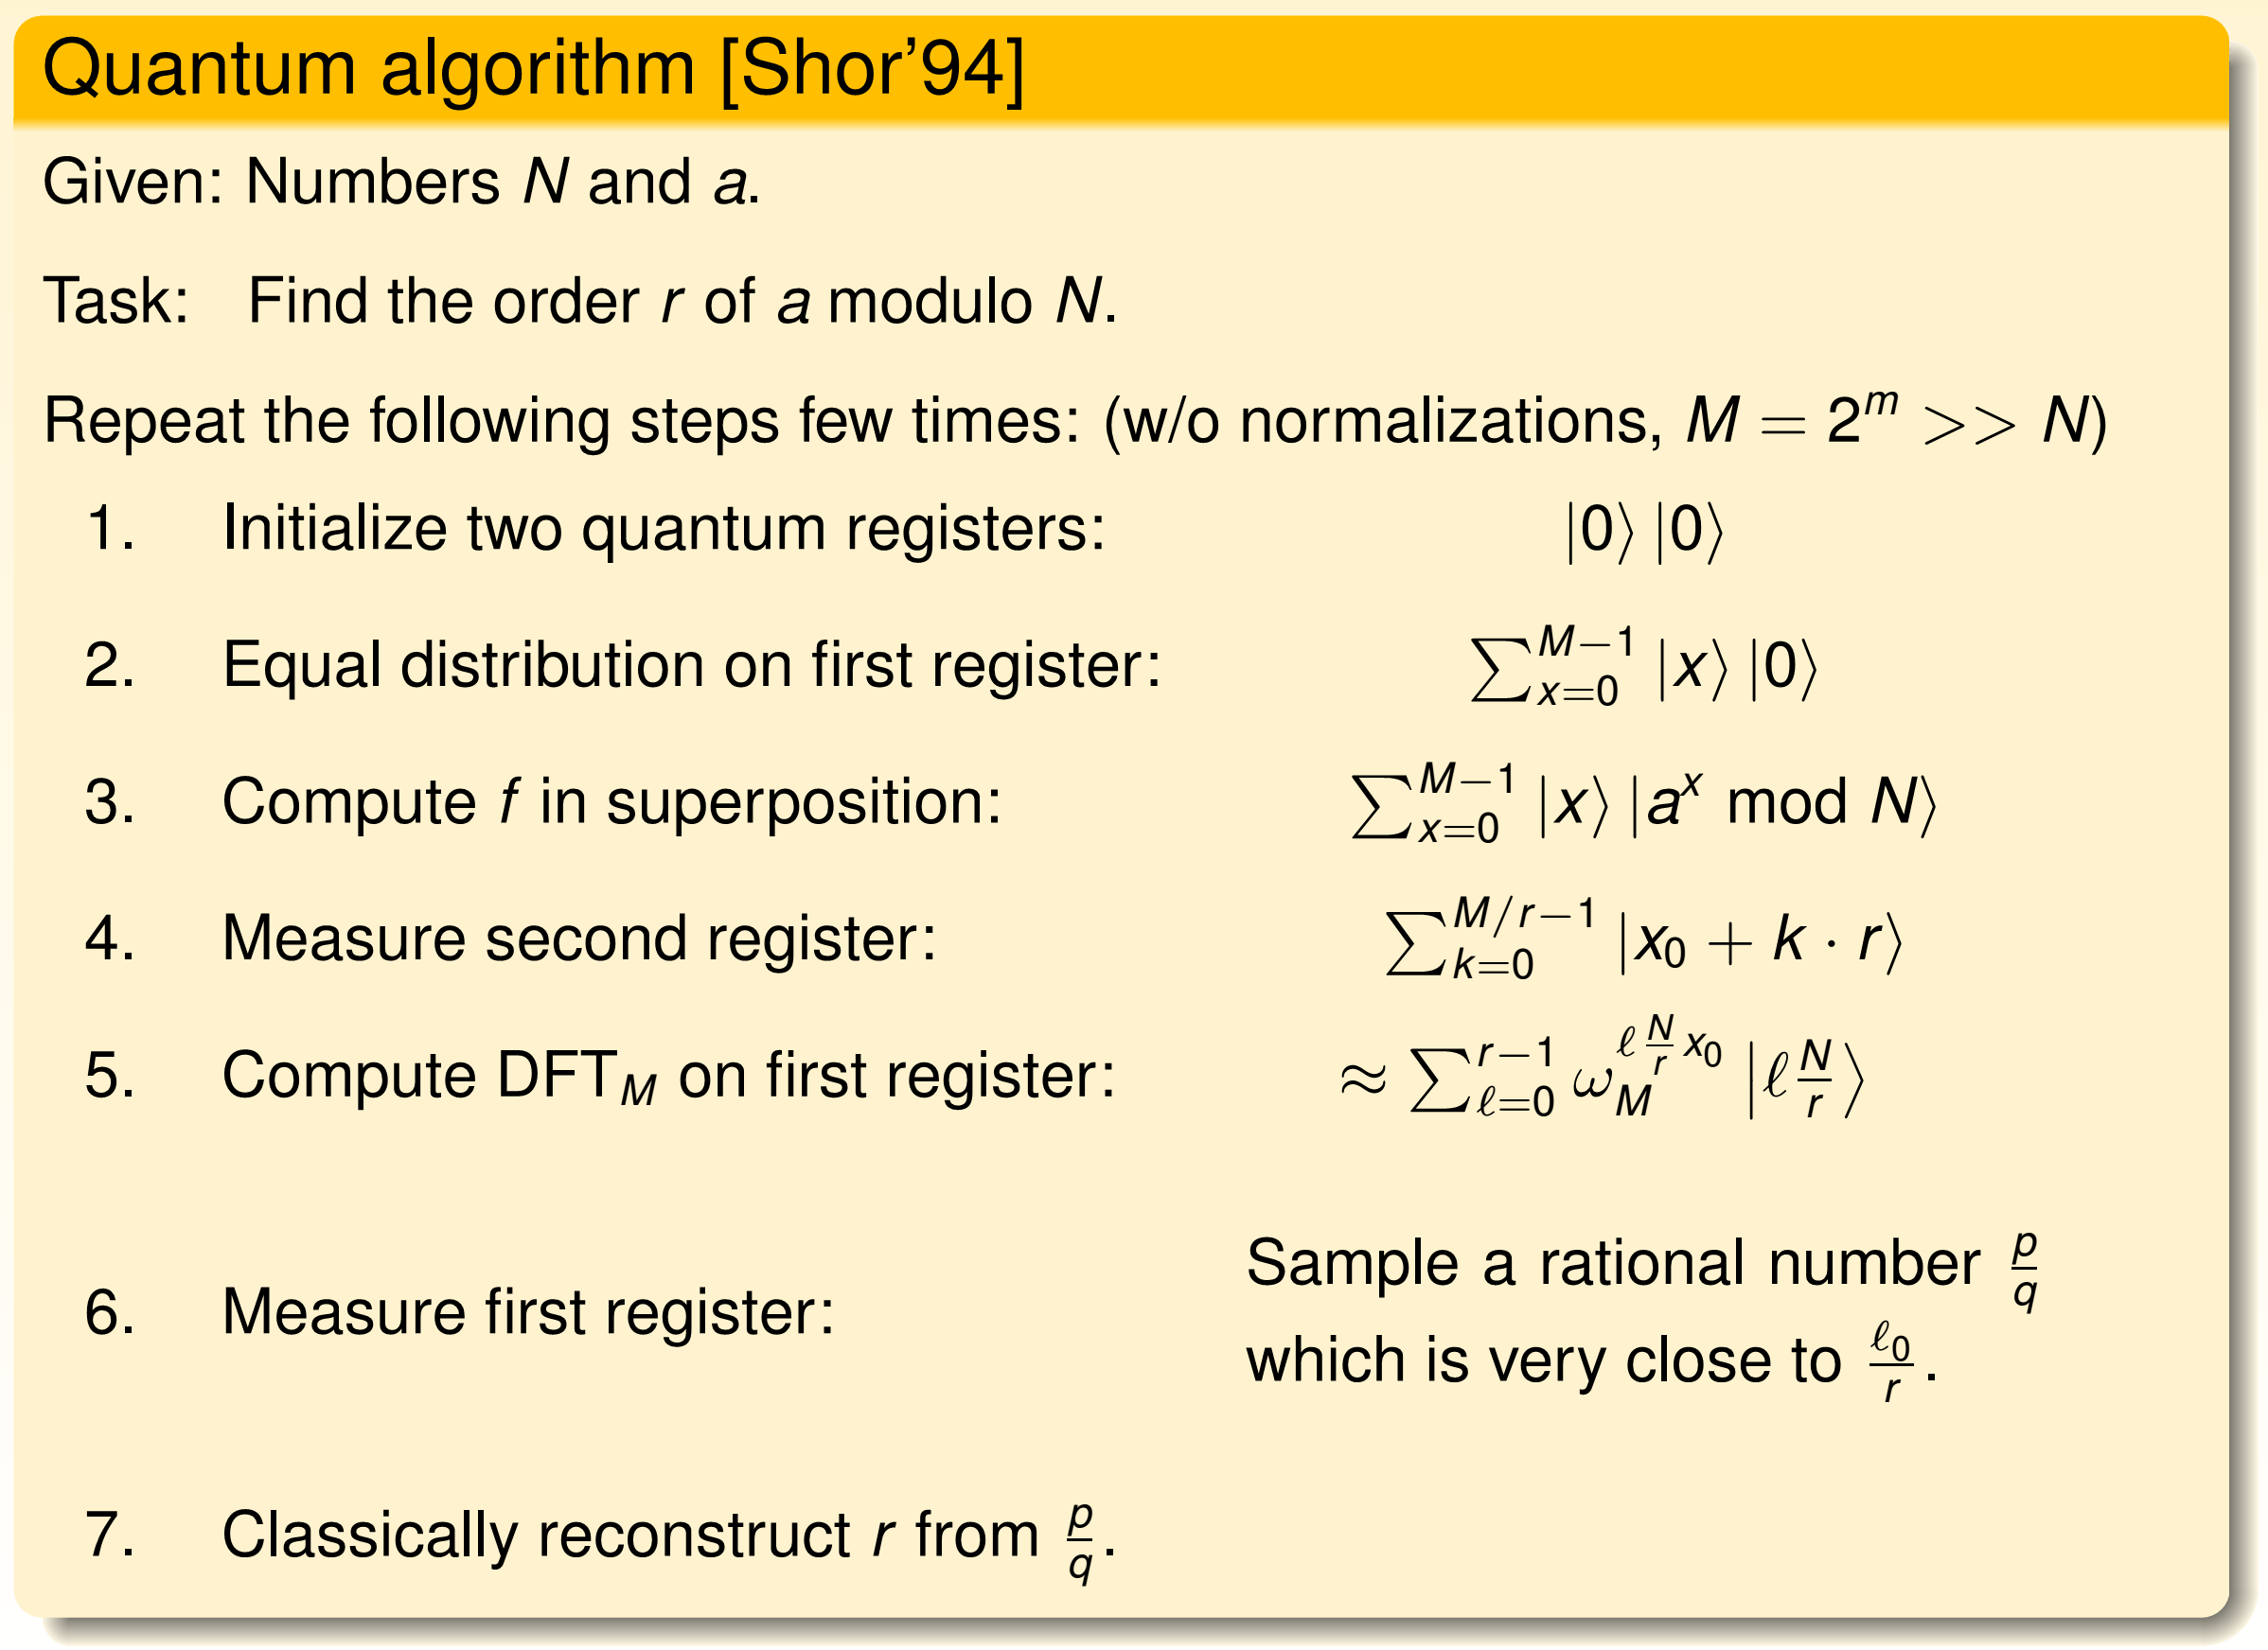
Shor’s factoring algorithm

Slide 31
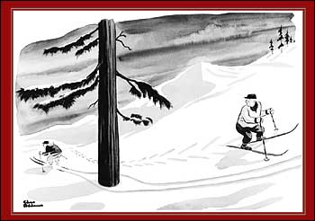
Quantum parallelism, Chuck Norris style

Slide 32
Resource Requirements: Shor’s Quantum Algorithm
Number of qubits: optimistically, for n bit number, about 2n qubits are required (w/o error correction). Under a simple error correction scheme (2 levels concatenation of [[7,1,3]] qecc), this becomes 100n.
Number of operations:
  Modular exponentiation: for n bit number, using a simple implementation, 400 n³ ops are required, reducing the gates to T-gates
  Quantum Fourier transform: for n bit number, about 15 n log n ops are needed.
Example ballpark figures:
Task | #qubits | #operations
Factor 128 bit number | 256 25600 (w/qecc) | 8.4 x 10⁸
Factor 1024 bit number | 2048 204800 (w/qecc) | 4.3 x 10¹¹
Search list of 2¹⁰⁰ items | 100 10000 (w/qecc) | 10¹⁵

Slide 33
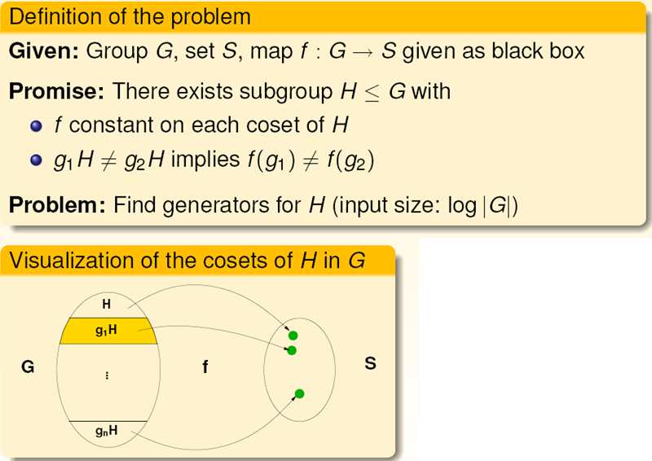
Hidden Subgroup Problem
Standard approach:
ignore the values of f.
Open: Can we use the
“right hand side”?

Slide 34
Hidden Subgroup Problems: Examples

Slide 35

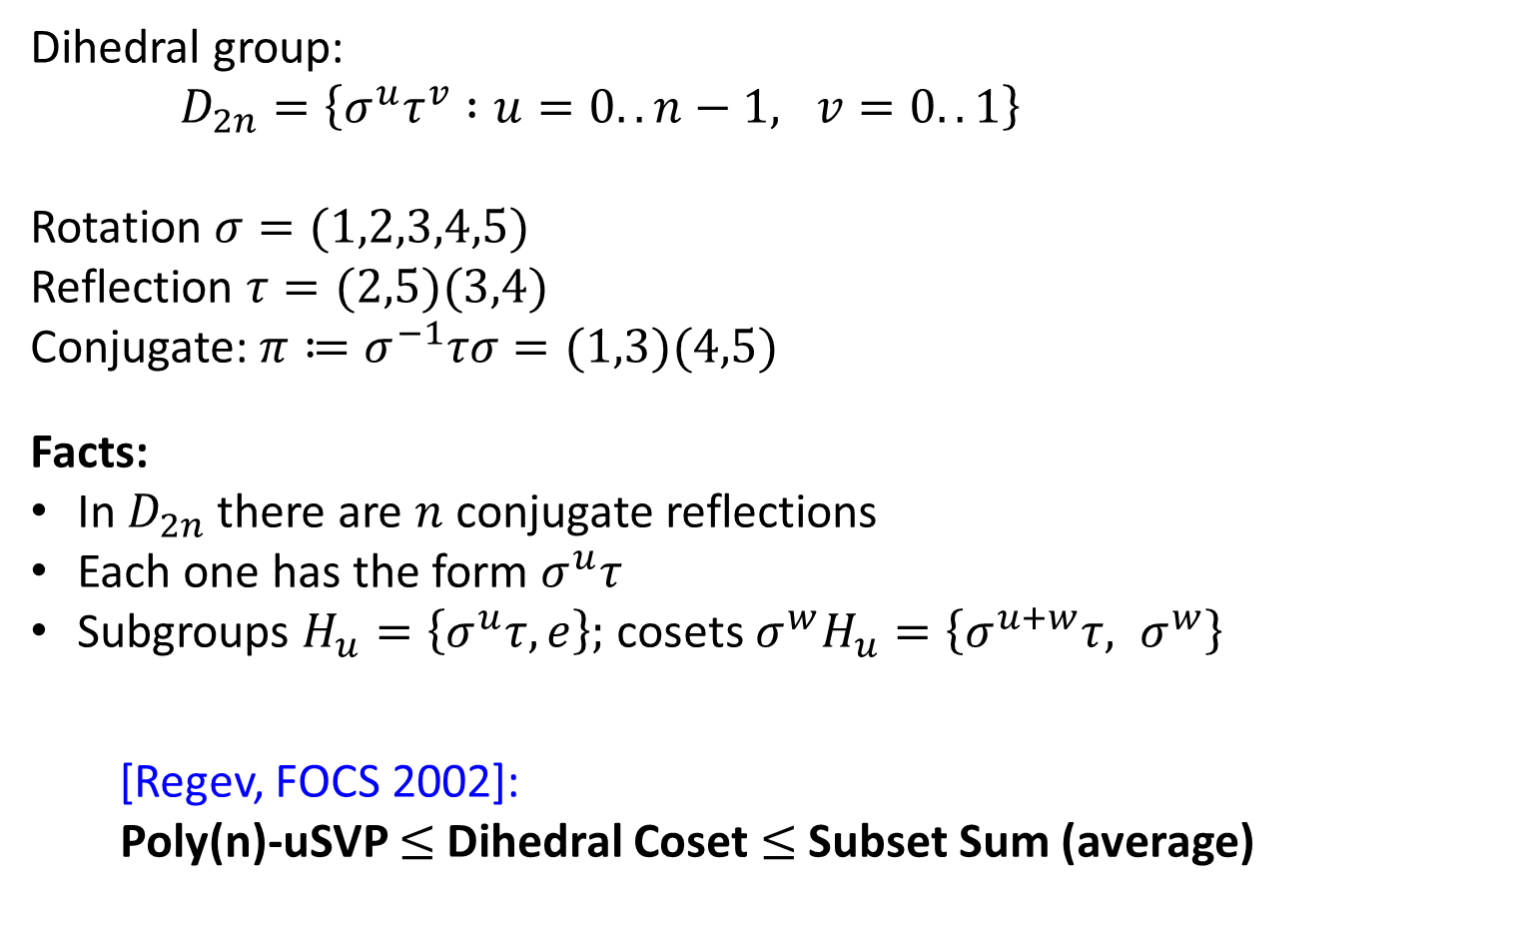

Dihedral group
Dihedral group:
$D_{2n}=\left\{σ^{u}τ^{v} :u=0..n−1, v=0..1\right\}$
Rotation $σ=(1,2,3,4,5)$
Reflection $τ=(2,5)(3,4)$
Conjugate: ${π≔σ}^{−1}τσ=(1,3)(4,5)$
Facts:
In $D_{2n}$ there are $n$ conjugate reflections
Each one has the form $σ^{u}τ$
Subgroups $H_{u}=\left\{σ^{u}τ, e\right\};$ cosets ${σ^{w}H}_{u}=\left\{σ^{u+w}τ, σ^{w}\right\}$
[Regev, FOCS 2002]:
Poly(n)-uSVP $≤$Dihedral Coset $≤$Subset Sum (average)
1
5
2
$$π$$
4
3
$$τ$$

Slide 36
Shor: dlog

Slide 37

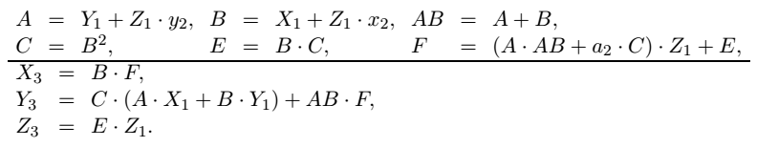
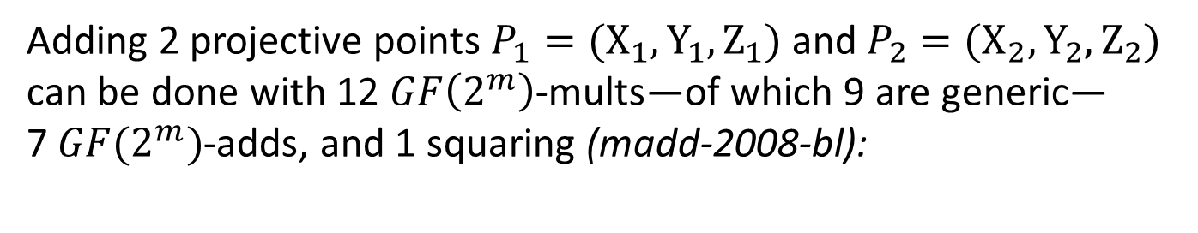
Example: ECC point addition
Consider elliptic curve in short Weierstrass form over $GF(2^{m})$
Adding 2 projective points $P_{1}={(X}_{1},Y_{1},Z_{1})$ and $P_{2}={(X}_{2},Y_{2},Z_{2})$
can be done with 12 $GF\left(2^{m}\right)$-mults—of which 9 are generic—
7 $GF(2^{m})$-adds, and 1 squaring (madd-2008-bl):
[Bernstein, Lange: http://www.hyperelliptic.org/EFD/]

Slide 38
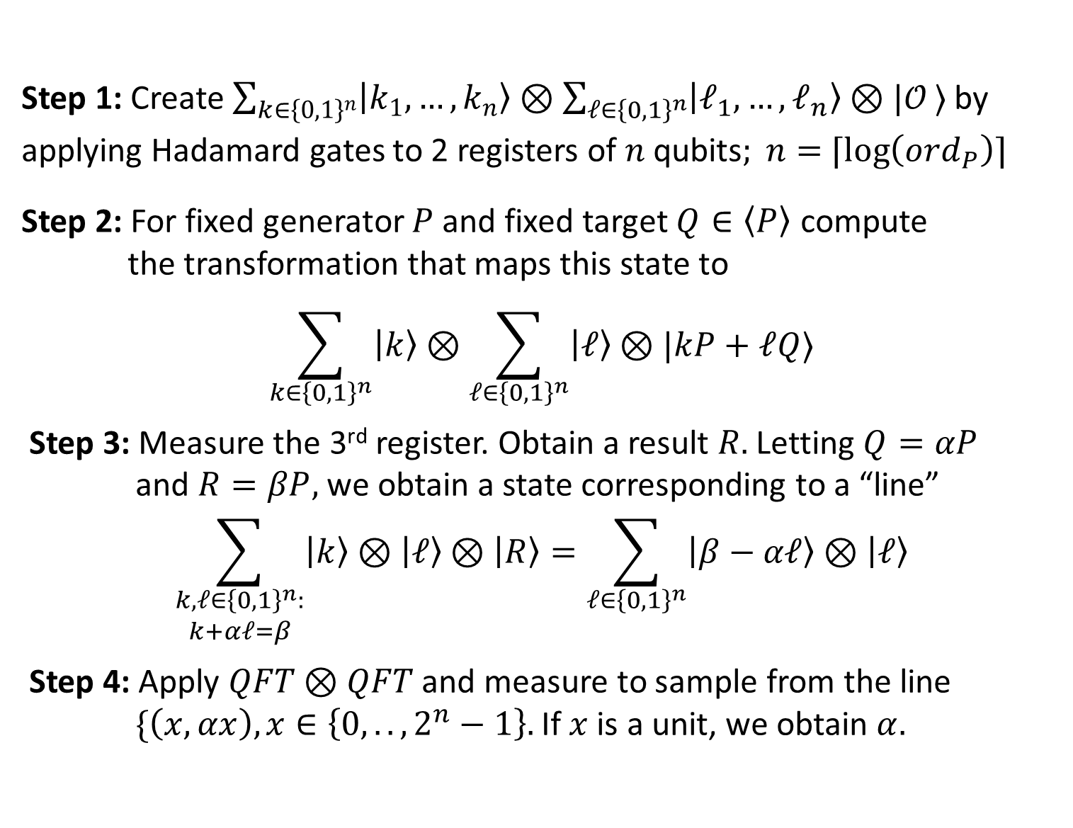
Shor’s algorithm for dlogs:
Step 1: Create ${\sum_{k∈{\left\{0,1\right\}}^{n}}{|k_{1}, …, k_{n}〉}⊗\sum_{ℓ∈{\left\{0,1\right\}}^{n}}{|ℓ_{1}, …, ℓ_{n}〉}⊗{|𝒪}_{ }〉}_{ }$by applying Hadamard gates to 2 registers of $n$ qubits$; n=$ $⌈\log\left(ord_{P}\right)⌉$
Step 2: For fixed generator $P$ and fixed target $Q∈〈P〉$ compute
the transformation that maps this state to
$$\sum_{k∈{\left\{0,1\right\}}^{n}}{|k〉}⊗\sum_{ℓ∈{\left\{0,1\right\}}^{n}}{|ℓ〉}⊗|kP+ℓQ〉$$
Step 3: Measure the 3rd register. Obtain a result $R.$ Letting $Q=αP$
and $R=βP,$ we obtain a state corresponding to a “line”
$$\sum_{\begin{aligned}k,ℓ∈{\left\{0,1\right\}}^{n}: \\ k+αℓ=β\end{aligned}}{|k〉}⊗|ℓ〉⊗|R〉=\sum_{\begin{aligned}ℓ∈{\left\{0,1\right\}}^{n} \\ \end{aligned}}{|β−αℓ〉}⊗|ℓ〉$$
Step 4: Apply $QFT⊗QFT$ and measure to sample from the line
$\{\left(x,αx\right),x∈\left\{0,..,2^{n}−1\right\}.$If $x$ is a unit, we obtain $α.$

Slide 39
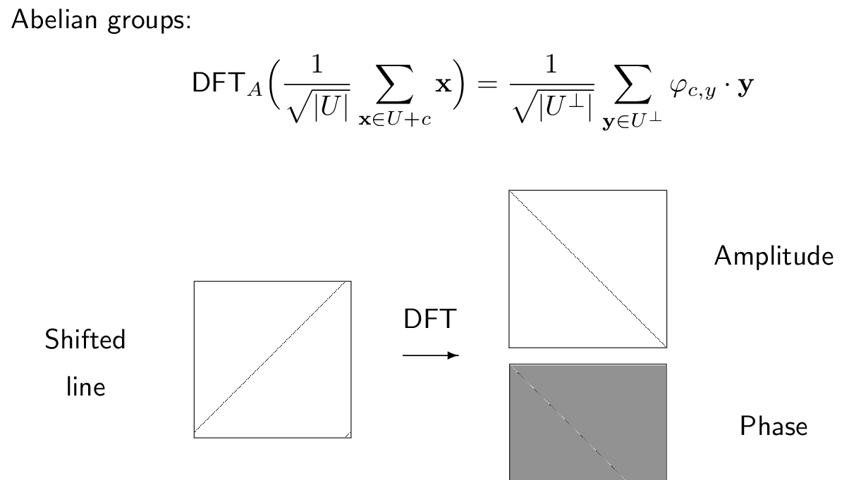
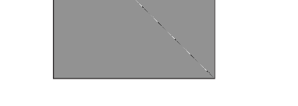


Visualizing Fourier duality
$$| 〉$$
$$| 〉$$

Slide 40
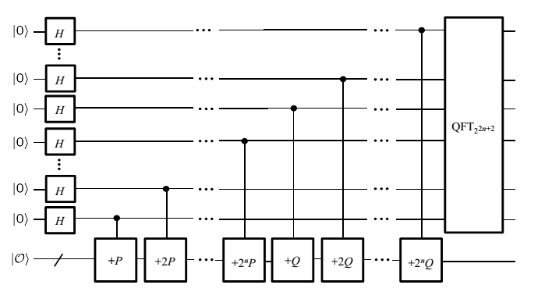
Circuit for Shor’s dlog algorithm
Phase estimation circuit layout:

Slide 41
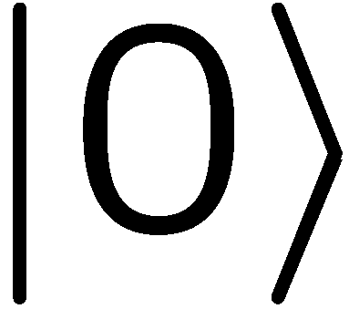



Semi-classical QFT
measure
Equivalent protocol:
H
Z($θ)$
H
measure
$$|A〉$$
+P/+Q
Saves a lot of qubits!

Slide 42
Further reading (Part 1)
Textbooks:
  M. Nielsen, I. Chuang: “Quantum Computation and quantum information”, Cambridge Univ. Press, 2001
  A. Kitaev, A. Shen, M. Vyalyi: “Classical and quantum computation”, AMS Press, 2002
  Ph. Kaye, M. Mosca, R. Laflamme: “An introduction to quantum computing”, Oxford Univ. Press, 2007
Quantum gates and circuits (most papers available from arxiv.org)
  Elementary gates: arXiv:quant-ph/9503016
  Quantum Fourier transform: arXiv:quant-ph/0201067
  Shor’s algorithm: arXiv:quant-ph/9508027
  Phase estimation: arXiv:quant-ph/9511026

Slide 43
Backup: Quantum arithmetic what is the problem? why is this non-trivial? who cares?

Slide 44

Adders
This is a space optimized adder. Runs in T-depth 2n-1. Quite poor load factor,
i.e., most qubits in the computation are idle. Explore time/space trade-offs.

Slide 45


Controlled quantum adder
Resource estimate:
$14n−11$ Toffoli gates
[Draper, Kutin, Rains, Svore, 2004]

Slide 46

Multipliers
Wallace tree multiplier. T-count of $n2+4n log2(n)$ and T-depth $O(\log_{2}⁡(n))$. Shown is an
implementation in .qc/QCViewer of a circuit generated dynamically by a Haskell library.

Slide 47

Modular Inverse a la Fermat
Basic idea:
Let $p$ be prime, let $x∈\left\{1, …, p−2\right\}.$
Recall that in any finite group: $x^{|G|}=e.$
When applied to $GF{\left(p\right)}^{×}$ this implies
        $x^{p−1}≡1 \left(p\right)$
Or in other words: $x^{p−2 }⋅x≡1 \left(p\right)$
Or in other words: $x^{−1}≡x^{p−2} \left(p\right)$
That means we can compute the inverse by exponentiation of the (unknown) $x$ for the (known, fixed) exponent $p.$

Slide 48










Square & multiply by unrolling
$$|x〉$$
A
$$|x〉$$
-
$$|x〉$$
MUL
A
$$|x^{2}〉$$
+
-
$$|0〉$$
MUL
$$|x^{4}〉$$
+
$$|x^{8}〉$$
…
$$|x^{16}〉$$
Depth: $2n×depth\left(MUL\right)+2depth\left(ADD\right))+n$
Width: $2n×n=n^{2}$
…
Here $n$is the bit-size of $x$
Use binary representation of $p−2$to compute $x^{p−2}$
Open: can this be done in circuit width O(n)?

Slide 49

Shor for factoring vs ECC dlog
[Proos, Zalka, quant-ph/0301141]
Suggests that quantum attacks on ECC/dlog can be done more efficiently than RSA/factoring with comparable level of security.
Circuits are somewhat non-trivial to implement and to layout.
Only short Weierstrass forms considered, unclear how classical
optimizations of point additions can be leveraged.
Leaves open how to optimize depth for Shor ECC.

