Slide 1
I. Primitives
CROSSING Winter School 2016
TU Darmstadt
Foundations of Cryptography
in the Quantum World
Gorjan Alagic
Department of Mathematical Sciences
University of Copenhagen

Slide 2
Outline
I. Primitives
  Motivation
  Modern crypto: classical vs quantum
  Notation, conventions
  One-way functions
  Pseudorandomness
II. Schemes
  Perfect secrecy
  Private-key encryption
  Public-key encryption
  Open problems
Gorjan Alagic :: Foundations of Cryptography in the Quantum World :: Primitives

Slide 3
1. Motivation
Gorjan Alagic :: Foundations of Cryptography in the Quantum World :: Primitives

Slide 4
1. Motivation
What do we want?
securely transmit data over completely insecure channels;
adversary can never learn our messages;
A
B
E
Gorjan Alagic :: Foundations of Cryptography in the Quantum World :: Primitives

Slide 5
1. Motivation
What do we want?
securely transmit data over completely insecure channels;
adversary can never learn our messages;
possible with
“perfect security”
A
B
E
m
Enc_{k}
Dec_{k}
m
k
Gorjan Alagic :: Foundations of Cryptography in the Quantum World :: Primitives

Slide 6
1. Motivation
What do we want?
securely transmit data over completely insecure channels;
adversary can never learn our messages;
one key for transmitting many messages;
ideally, don’t need to exchange keys in person;
high efficiency;
rigorous security proofs.
possible with
“perfect security”
A
B
E
m
Enc_{k}
Dec_{k}
m
k
Gorjan Alagic :: Foundations of Cryptography in the Quantum World :: Primitives

Slide 7
Outline
How do we achieve this?
start with a well-motivated “hardness assumption” (ala P ≠ NP);
give a clear definition of the security requirements;
design a scheme together with a rigorous security proof: if hardness assumption holds, then scheme is secure.
assumption
security
proof
encryption
scheme
Gorjan Alagic :: Foundations of Cryptography in the Quantum World :: Primitives

Slide 8
Outline
How do we achieve this?
start with a well-motivated “hardness assumption” (ala P ≠ NP);
give a clear definition of the security requirements;
design a scheme together with a rigorous security proof: if hardness assumption holds, then scheme is secure.
Why is this the right approach?
schemes are not “mysterious:” weaknesses known;
easier adversarial testing;
leverage rigor of mathematical proof to establish security;
“plug and play” with different hardness assumptions;
easier to plug schemes into other constructions.
assumption
security
proof
encryption
scheme
Gorjan Alagic :: Foundations of Cryptography in the Quantum World :: Primitives

Slide 9
1. Motivation
How does quantum computation come into play?
some hardness assumptions do not hold for quantum adversaries (e.g., RSA);
others appear to be ok for now (e.g., lattices, LWE, code-based);
what about the security proofs?
- it’s quantum
A
B
E
m
Enc_{k}
Dec_{k}
m
k
k
Gorjan Alagic :: Foundations of Cryptography in the Quantum World :: Primitives

Slide 10
1. Motivation
How does quantum computation come into play?
some hardness assumptions do not hold for quantum adversaries (e.g., RSA);
others appear to be ok for now (e.g., lattices, LWE, code-based);
what about the security proofs?
Thinking more generally…
quantum data, communication, computation are more fundamental;
do we need to redo the whole theory?
- it’s quantum
A
B
E
m
Enc_{k}
Dec_{k}
m
k
k
Gorjan Alagic :: Foundations of Cryptography in the Quantum World :: Primitives

Slide 11
2. Modern crypto
Gorjan Alagic :: Foundations of Cryptography in the Quantum World :: Primitives

Slide 12
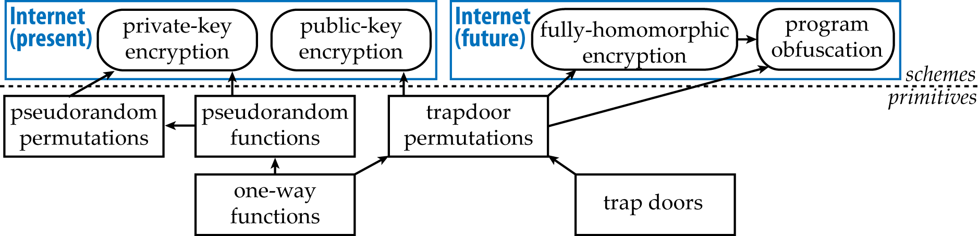
2. Modern crypto
What does this theory look like classically (no quantum)?
assumptions only go here
“Classical cryptography”
Gorjan Alagic :: Foundations of Cryptography in the Quantum World :: Primitives

Slide 13
2. Modern crypto
What does this theory look like quantumly?
quantum
assumptions go here
“Post-quantum cryptography”
classical cryptography using classical computers;
secure against quantum adversaries.
Gorjan Alagic :: Foundations of Cryptography in the Quantum World :: Primitives

Slide 14
2. Modern crypto
What does this theory look like quantumly?
encrypt quantum data
quantum functionality
quantum
assumptions go here
“Fully-quantum cryptography”
quantum cryptography using quantum computers;
secure against quantum adversaries.
Gorjan Alagic :: Foundations of Cryptography in the Quantum World :: Primitives

Slide 15
3. Notation, conventions
Gorjan Alagic :: Foundations of Cryptography in the Quantum World :: Primitives

Slide 16
3. Notation, conventions
Computation
everything is an algorithm: encryption, decryption, adversaries, etc.
A
B
E
m
Enc_{k}
Dec_{k}
m
k
Gorjan Alagic :: Foundations of Cryptography in the Quantum World :: Primitives

Slide 17
3. Notation, conventions
Computation
everything is an algorithm: encryption, decryption, adversaries, etc.
we care about asymptotics:
  doable (e.g., encrypt, decrypt with key) : polynomial-time algorithm;
  impossible (e.g., discovering the key) : requires superpolynomial time.
why asymptotics?
  short answer: in practice, most constants are small;
  long answer: ask a complexity theorist.
A
B
E
m
Enc_{k}
Dec_{k}
m
k
Gorjan Alagic :: Foundations of Cryptography in the Quantum World :: Primitives

Slide 18
3. Notation, conventions
What is an algorithm?
[think: a program in your favorite language, e.g., Java, C++, Python, etc. ]
To use an algorithm on input x: 1. run M(|x|); 2. plug x into circuit output by M.
If M runs in time polynomial in n, then we say the algorithm is polynomial-time.
Definition. An algorithm consists of:
  an infinite family C of circuits {C_{n}}, one for each input size n;
  a deterministic Turing Machine M which, on input 1^{n}, outputs a description of C_{n}.
Gorjan Alagic :: Foundations of Cryptography in the Quantum World :: Primitives

Slide 19
3. Notation, conventions
What is an algorithm?
[think: a program in your favorite language, e.g., Java, C++, Python, etc. ]
To use an algorithm on input x: 1. run M(|x|); 2. plug x into circuit output by M.
If M runs in time polynomial in n, then we say the algorithm is polynomial-time.
PT: polynomial-time algorithm where the circuits are boolean.
PPT: PT + circuits are also allowed to ask for some random input bits.
QPT: PPT + circuits are now quantum + can measure and/or discard qubits.
Definition. An algorithm consists of:
  an infinite family C of circuits {C_{n}}, one for each input size n;
  a deterministic Turing Machine M which, on input 1^{n}, outputs a description of C_{n}.
Gorjan Alagic :: Foundations of Cryptography in the Quantum World :: Primitives

Slide 20
3. Notation, conventions
Polynomial and negligible functions
the notation “poly(n)” will mean “some polynomial function of n,” e.g.,
  [think: a reasonable number of steps for a computer to take]
Gorjan Alagic :: Foundations of Cryptography in the Quantum World :: Primitives

Slide 21
3. Notation, conventions
Polynomial and negligible functions
the notation “poly(n)” will mean “some polynomial function of n,” e.g.,
  [think: a reasonable number of steps for a computer to take]
the notation “negl(n)” will mean “some function of n which is smaller than all inverse-polynomials,” e.g.,
    [think: an event that occurs with negligible probability cannot be witnessed in a reasonable amount of time.]
Gorjan Alagic :: Foundations of Cryptography in the Quantum World :: Primitives

Slide 22
4. One-way functions
Gorjan Alagic :: Foundations of Cryptography in the Quantum World :: Primitives

Slide 23
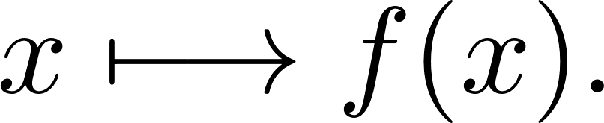

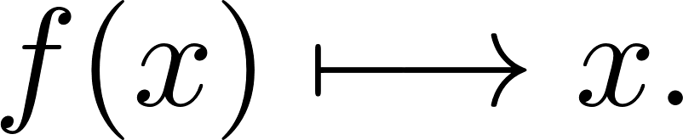

4. One-way functions
one-way functions
Step 1: assume one-way functions exist.
What is a one-way function?
for all inputs, easy to compute in one direction:
for (almost) all inputs, impossible to invert in poly(n) time:
pseudorandom generators
pseudorandom functions
private-key encryption
Gorjan Alagic :: Foundations of Cryptography in the Quantum World :: Primitives

Slide 24
4. One-way functions
one-way functions
Step 1: assume one-way functions exist.
What is a one-way function?
for all inputs, easy to compute in one direction:
for (almost) all inputs, impossible to invert in poly(n) time:
why assume this and not something else?
  for encryption, need something to be hard, and often;
  sufficient: OWFs can be used to build encryption schemes;
  necessary: existence of encryption implies existence of OWFs!
pseudorandom generators
pseudorandom functions
private-key encryption
Gorjan Alagic :: Foundations of Cryptography in the Quantum World :: Primitives

Slide 25
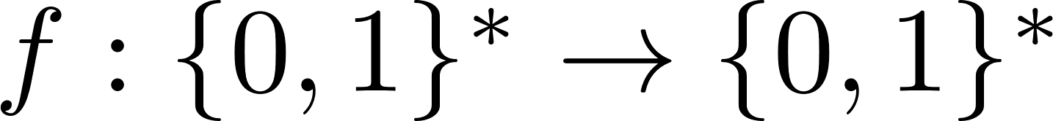
4. One-way functions
one-way functions
What is a one-way function?
Definition. A PT-computable function
is quantum-secure one-way (OWF) if for every QPT A,
pseudorandom generators
pseudorandom functions
private-key encryption
Gorjan Alagic :: Foundations of Cryptography in the Quantum World :: Primitives

Slide 26
4. One-way functions
one-way functions
What is a one-way function?
Other, equivalent formulations:
weakly one-way: there is a fixed polynomial p such that all adversaries succeed with probability no more than 1 – 1/p(n);
distributional one-way: the distributions (x, f(x)) and (A(f(x)), f(x)) are statistically indistinguishable.
Definition. A PT-computable function
is quantum-secure one-way (OWF) if for every QPT A,
pseudorandom generators
pseudorandom functions
private-key encryption
Gorjan Alagic :: Foundations of Cryptography in the Quantum World :: Primitives

Slide 27
4. One-way functions
one-way functions
Where to find quantum-secure one-way functions?
Construct specific examples: SVP, LWE, code equivalence, …?
pseudorandom generators
pseudorandom functions
private-key encryption
Gorjan Alagic :: Foundations of Cryptography in the Quantum World :: Primitives

Slide 28
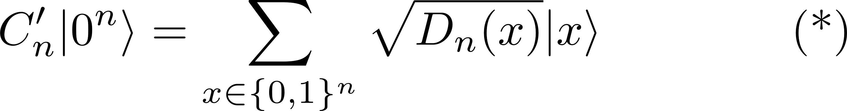
4. One-way functions
one-way functions
Where to find quantum-secure one-way functions?
Construct specific examples: SVP, LWE, code equivalence, …?
From circuit quantum sampling [AT03, KK05]:
easy, right? Measuring (*) just samples from D_{n}, which the PT already does!
not so fast: what are some other things we can do with the state (*)?
pseudorandom generators
Problem (CQS). Given a PT with circuits {C_{n}}, specify a QPT with circuits {C’_{n}} such that
where
pseudorandom functions
private-key encryption
Gorjan Alagic :: Foundations of Cryptography in the Quantum World :: Primitives

Slide 29
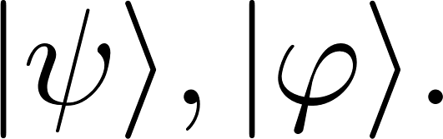
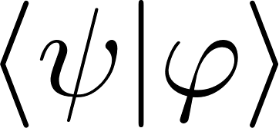
4. One-way functions
one-way functions
Swap test.
Suppose you can prepare states
Exercise: show that this circuit lets you approximate to within inverse-polynomial additive error.
pseudorandom generators
pseudorandom functions
private-key encryption
Gorjan Alagic :: Foundations of Cryptography in the Quantum World :: Primitives

Slide 30
4. One-way functions
one-way functions
Swap test.
Suppose you can prepare states
Exercise: show that this circuit lets you approximate to within inverse-polynomial additive error.
if you could solve CQS, then you could use the above to determine if two probability distributions are close or far;
this is very powerful! (SZK-complete, to be exact.)
could solve GI, CVP, etc.
pseudorandom generators
pseudorandom functions
private-key encryption
Gorjan Alagic :: Foundations of Cryptography in the Quantum World :: Primitives

Slide 31
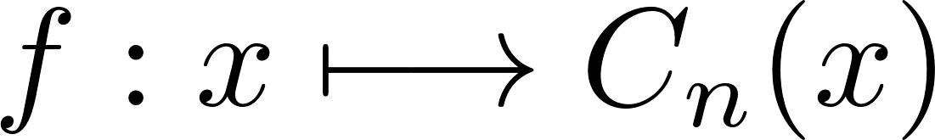
4. One-way functions
one-way functions
One-way functions from CQS.
Theorem [KK05]. If the PT with circuits {C_{n}} is a quantum-hard instance of CQS, then
is a quantum-secure one-way function (OWF).
pseudorandom generators
pseudorandom functions
private-key encryption
Gorjan Alagic :: Foundations of Cryptography in the Quantum World :: Primitives

Slide 32
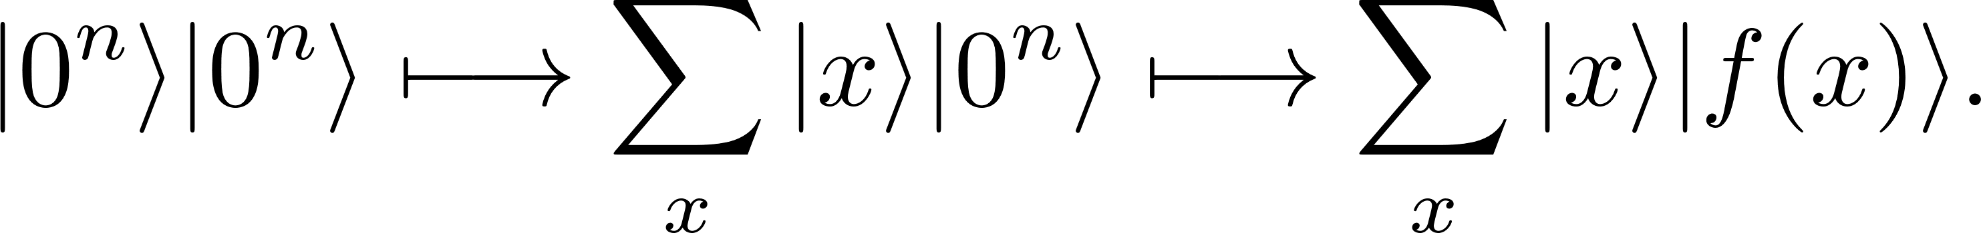
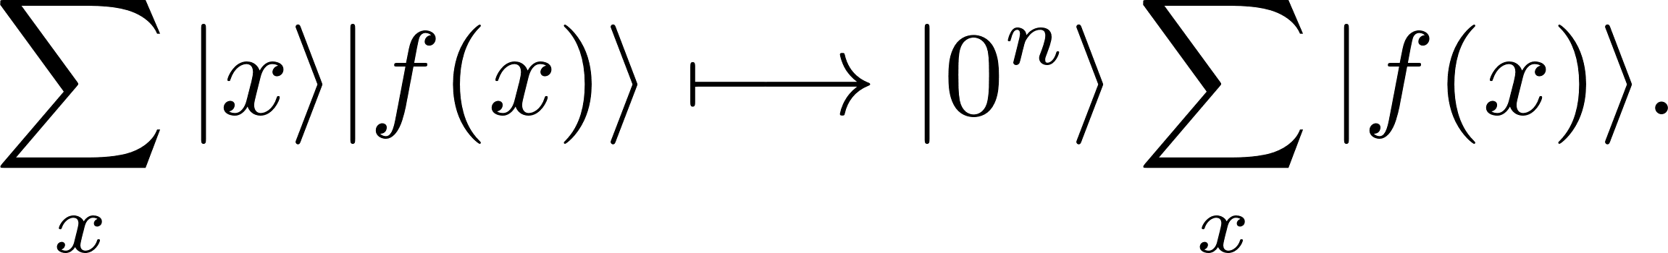
4. One-way functions
one-way functions
One-way functions from CQS.
Proof idea (for OWPs):
since f is computable via PT, we can prepare the state
if f is not one-way, then some QPT can compute inverse into first register:
since f is a permutation, the last state above is the CQS state: contradiction!
Theorem [KK05]. If the PT with circuits {C_{n}} is a quantum-hard instance of CQS, then
is a quantum-secure one-way function (OWF).
pseudorandom generators
pseudorandom functions
private-key encryption
Gorjan Alagic :: Foundations of Cryptography in the Quantum World :: Primitives

Slide 33
4. Pseudorandomness
Gorjan Alagic :: Foundations of Cryptography in the Quantum World :: Primitives

Slide 34
5. Pseudorandomness
one-way functions
Step 2: make pseudorandom generators out of OWFs.
Why do we need pseudorandomness?
recall: want to use the same key for many long messages;
Exercise: deterministic encryption algorithms can be broken.
ok, so we need randomness; why not use perfect randomness?
so we can undo it (i.e., decrypt) if we’re the intended recipient!
pseudorandom generators
pseudorandom functions
private-key encryption
Gorjan Alagic :: Foundations of Cryptography in the Quantum World :: Primitives

Slide 35
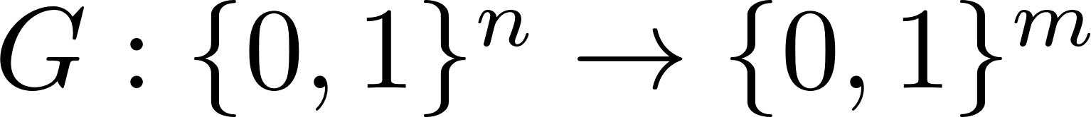
5. Pseudorandomness
one-way functions
Pseudorandom generators
Definition. A PT-computable function
is a quantum-secure pseudorandom generator (PRG) if for all QPTs A,
pseudorandom generators
pseudorandom functions
private-key encryption
Gorjan Alagic :: Foundations of Cryptography in the Quantum World :: Primitives

Slide 36
5. Pseudorandomness
one-way functions
Pseudorandom generators
Note:
m can be any fixed polynomial in n;
so long as the input is random, QPTs cannot distinguish output from random;
step in the right direction: Alice and Bob now only need to share n bits in order to send a message of length m.
Definition. A PT-computable function
is a quantum-secure pseudorandom generator (PRG) if for all QPTs A,
pseudorandom generators
pseudorandom functions
private-key encryption
Gorjan Alagic :: Foundations of Cryptography in the Quantum World :: Primitives

Slide 37
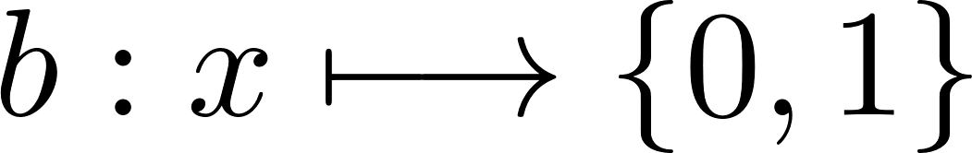
5. Pseudorandomness
one-way functions
Pseudorandom generators
Proof idea:
note: in OWF definition, adversary loses if he outputs even one incorrect bit; rest could be easy!
to get something useful, we need to identify a “hard bit” which captures what is hard to compute about x from f(x).
Theorem [GL89, AC01]. If OWF exist which are also permutations, then so do PRGs.
pseudorandom generators
pseudorandom functions
private-key encryption
Gorjan Alagic :: Foundations of Cryptography in the Quantum World :: Primitives

Slide 38
5. Pseudorandomness
one-way functions
Pseudorandom generators
Proof idea:
note: in OWF definition, adversary loses if he outputs even one incorrect bit; rest could be easy!
to get something useful, we need to identify a “hard bit” which captures what is hard to compute about x from f(x).
show: this “hard bit” is indistinguishable from random to QPTs;
concatenate with f to get poly-many bits:
Exercise: learn about the “hybrid argument” and use it to finish the proof. How does your proof ensure that quantum adversaries are unsuccessful too?
Theorem [GL89, AC01]. If OWF exist which are also permutations, then so do PRGs.
pseudorandom generators
pseudorandom functions
private-key encryption
Gorjan Alagic :: Foundations of Cryptography in the Quantum World :: Primitives

Slide 39
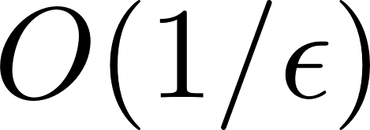
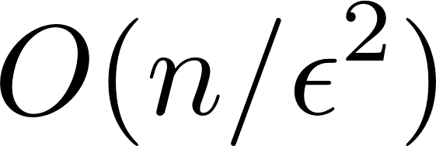
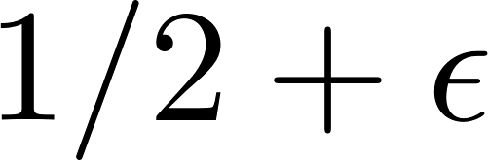
5. Pseudorandomness
one-way functions
Pseudorandom generators
Proof idea:
note: in OWF definition, adversary loses if he outputs even one incorrect bit; rest could be easy!
to get something useful, we need to identify a “hard bit” which captures what is hard to compute about x from f(x).
show: this “hard bit” is indistinguishable from random to QPTs;
concatenate with f to get poly-many bits:
Theorem [GL89, AC01]. If OWF exist which are also permutations, then so do PRGs.
pseudorandom generators
pseudorandom functions
private-key encryption
AC01: quantumly the reduction is more efficient: vs where is the probability of inverting the hard core bit.
Gorjan Alagic :: Foundations of Cryptography in the Quantum World :: Primitives

Slide 40
5. Pseudorandomness
one-way functions
Step 3: make pseudorandom functions out of PRGs.
What is a pseudorandom function?
a pseudorandom generator outputs only a fixed amount of pseudorandomness;
a pseudorandom function can be evaluated over and over again, each time extracting more pseudorandomness;
this is really useful in building encryption schemes (see next lecture!)
pseudorandom generators
pseudorandom functions
private-key encryption
Gorjan Alagic :: Foundations of Cryptography in the Quantum World :: Primitives

Slide 41
5. Pseudorandomness
one-way functions
What is a pseudorandom function?
Definition. A PT-computable function family
is a quantum-secure pseudorandom function (PRF) if for every QPT A,
pseudorandom generators
oracle access
pseudorandom functions
private-key encryption
Gorjan Alagic :: Foundations of Cryptography in the Quantum World :: Primitives

Slide 42
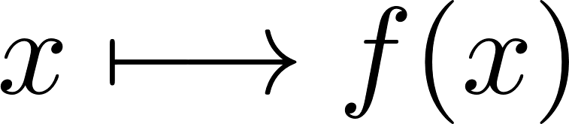
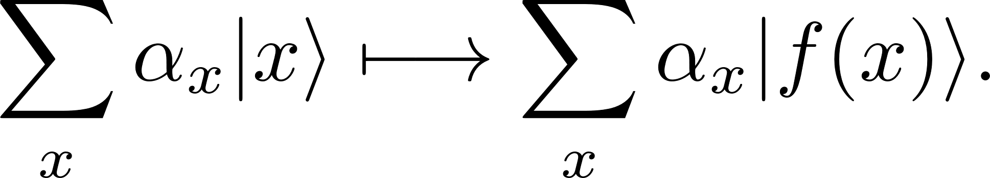
5. Pseudorandomness
one-way functions
What is a pseudorandom function?
if the index k is random, QPTs cannot distinguish f_{k} from perfectly random function;
ambiguity in definition: what does oracle access mean?
  Classical access:
  Quantum access:
Definition. A PT-computable function family
is a quantum-secure pseudorandom function (PRF) if for every QPT A,
pseudorandom generators
oracle access
pseudorandom functions
private-key encryption
Gorjan Alagic :: Foundations of Cryptography in the Quantum World :: Primitives

Slide 43
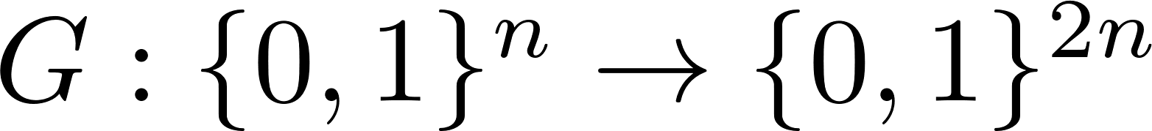
5. Pseudorandomness
one-way functions
Pseudorandom functions from PRGs.
Proof idea [GGM86]:
start with a length-doubling PRG
to compute f_{k}(x) where x = x₀x₁x₂…x_{n}:
Theorem [GGM86, HILL99, Z12]. If PRGs exist, then so do PRFs.
pseudorandom generators
pseudorandom functions
k
private-key encryption
G
Gorjan Alagic :: Foundations of Cryptography in the Quantum World :: Primitives

Slide 44
5. Pseudorandomness
one-way functions
Pseudorandom functions from PRGs.
Proof idea [GGM86]:
start with a length-doubling PRG
to compute f_{k}(x) where x = x₀x₁x₂…x_{n}:
Theorem [GGM86, HILL99, Z12]. If PRGs exist, then so do PRFs.
pseudorandom generators
pseudorandom functions
k
private-key encryption
G
x₀=0
x₀=1
Gorjan Alagic :: Foundations of Cryptography in the Quantum World :: Primitives

Slide 45
5. Pseudorandomness
one-way functions
Pseudorandom functions from PRGs.
Proof idea [GGM86]:
start with a length-doubling PRG
to compute f_{k}(x) where x = x₀x₁x₂…x_{n}:
Theorem [GGM86, HILL99, Z12]. If PRGs exist, then so do PRFs.
pseudorandom generators
pseudorandom functions
k
private-key encryption
G
x₀=0
x₀=1
G
G
Gorjan Alagic :: Foundations of Cryptography in the Quantum World :: Primitives

Slide 46
5. Pseudorandomness
one-way functions
Pseudorandom functions from PRGs.
Proof idea [GGM86]:
start with a length-doubling PRG
to compute f_{k}(x) where x = x₀x₁x₂…x_{n}:
Theorem [GGM86, HILL99, Z12]. If PRGs exist, then so do PRFs.
pseudorandom generators
pseudorandom functions
k
private-key encryption
G
x₀=0
x₀=1
G
G
x₁=0
x₁=1
x₁=0
x₁=1
Gorjan Alagic :: Foundations of Cryptography in the Quantum World :: Primitives

Slide 47
5. Pseudorandomness
one-way functions
Pseudorandom functions from PRGs.
Proof idea [GGM86]:
start with a length-doubling PRG
define G₀ (resp. G₁) to be the first half (resp. second half) of G;
define
now you need a hybrid argument that works over a binary tree;
caution: extra work needed if adversary has quantum access [Z12].
Theorem [GGM86, HILL99, Z12]. If PRGs exist, then so do PRFs.
pseudorandom generators
pseudorandom functions
private-key encryption
Gorjan Alagic :: Foundations of Cryptography in the Quantum World :: Primitives

Slide 48
What’s next?
one-way functions
In the next lecture:
How to use the primitives we discussed to construct encryption schemes.
II. Schemes
  Perfect secrecy
  Private-key encryption
  Public-key encryption
  Open problems
  Thanks
pseudorandom generators
pseudorandom functions
private-key encryption
Gorjan Alagic :: Foundations of Cryptography in the Quantum World :: Primitives

Slide 50
II. Schemes
CROSSING Winter School 2016
TU Darmstadt
Foundations of Cryptography
in the Quantum World
Gorjan Alagic
Department of Mathematical Sciences
University of Copenhagen

Slide 51
Outline
I. Primitives
  Motivation
  Modern crypto: classical vs quantum
  Notation, conventions
  One-way functions
  Pseudorandomness
II. Schemes
  Perfect secrecy
  Private-key encryption
  Public-key encryption
  Open problems
Gorjan Alagic :: Foundations of Cryptography in the Quantum World :: Schemes

Slide 52
0. Reminder
Gorjan Alagic :: Foundations of Cryptography in the Quantum World :: Schemes

Slide 53
0. Reminder
What do we want:
securely transmit data over completely insecure channels;
one key for many messages (ideally, not exchange keys in person);
adversaries (and maybe everything) can be quantum;
rigorous security proofs.
A
B
E
m
Enc_{k}
Dec_{k}
m
k
Gorjan Alagic :: Foundations of Cryptography in the Quantum World :: Schemes

Slide 54
0. Reminder
What does this theory look like quantumly?
encrypt quantum data
quantum functionality
quantum
assumptions go here
“Fully-quantum cryptography”
quantum cryptography using quantum computers;
secure against quantum adversaries.
Gorjan Alagic :: Foundations of Cryptography in the Quantum World :: Schemes

Slide 55
0. Reminder
Notation.
algorithm: a program in any programming language (formally, circuit model);
  PT: polynomial-time algorithm where the circuits are boolean;
  PPT: PT + circuits are also allowed to ask for some random input bits;
  QPT: PPT + circuits are quantum + can measure and/or discard qubits;
poly(n): some polynomial function of n;
negl(n): some function which is smaller than all inverse-polynomials.
Gorjan Alagic :: Foundations of Cryptography in the Quantum World :: Schemes

Slide 56
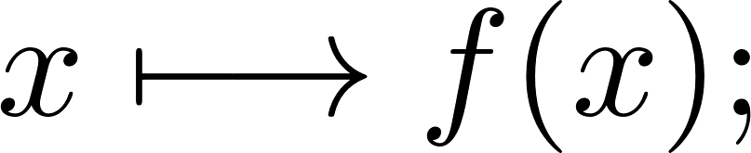
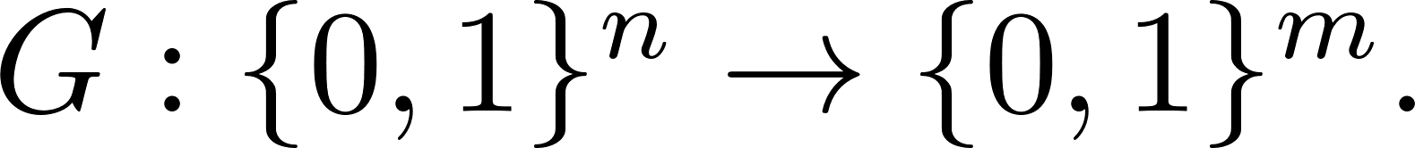
0. Reminder
one-way functions
Primitives.
Assumption: quantum-secure one-way functions (OWFs) exist easy: hard:
Theorem: OWFs imply pseudorandom generators (PRGs):
pseudorandom generators
PRG
pseudorandom functions
private-key encryption
Gorjan Alagic :: Foundations of Cryptography in the Quantum World :: Schemes

Slide 57
0. Reminder
one-way functions
Primitives.
Assumption: quantum-secure one-way functions (OWFs) exist easy: hard:
Theorem: OWFs imply pseudorandom generators (PRGs):
Theorem: PRGs imply pseudorandom functions (PRFs):
security against quantum adversaries maintained for all of the above;
in the case of PRFs, there’s a choice: classical vs quantum oracle access.
pseudorandom generators
PRG
pseudorandom functions
private-key encryption
PRF
Gorjan Alagic :: Foundations of Cryptography in the Quantum World :: Schemes

Slide 58
1. Perfect secrecy
Gorjan Alagic :: Foundations of Cryptography in the Quantum World :: Primitives

Slide 59
1. Perfect secrecy
Encryption schemes, informally
Definition. An encryption scheme consists of three polynomial-time algorithms:
  KeyGen: key generation;
  Enc_{k}: encrypt with key k;
  Dec_{k}: decrypt with key k.
such that Dec_{k} (Enc_{k} (m)) = m for all messages m and keys k.
Gorjan Alagic :: Foundations of Cryptography in the Quantum World :: Schemes

Slide 60
1. Perfect secrecy
Encryption schemes, informally
we assume that Alice and Bob share the key after key generation;
the message m is called the plaintext;
the encrypted message Enc_{k} (m) is called the ciphertext;
notice: no security requirement yet—only correctness!
Definition. An encryption scheme consists of three polynomial-time algorithms:
  KeyGen: key generation;
  Enc_{k}: encrypt with key k;
  Dec_{k}: decrypt with key k.
such that Dec_{k} (Enc_{k} (m)) = m for all messages m and keys k.
Gorjan Alagic :: Foundations of Cryptography in the Quantum World :: Schemes

Slide 61
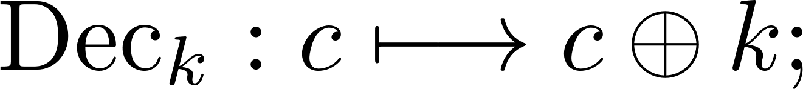
1. Perfect secrecy
One-time pad encryption.
to encrypt, flip each bit of message with probability ½, as determined by k;
to decrypt, undo the flips (easy since you know k);
Definition. The one-time pad scheme consists of the algorithms:
addition modulo 2
Gorjan Alagic :: Foundations of Cryptography in the Quantum World :: Schemes

Slide 62
1. Perfect secrecy
One-time pad encryption.
to encrypt, flip each bit of message with probability ½, as determined by k;
to decrypt, undo the flips (easy since you know k);
Exercise: the ciphertext is perfectly random to parties completely ignorant of k (perfect secrecy);
Exercise: if you try to use the same key twice, Eve will be able to extract information about the plaintexts.
Definition. The one-time pad scheme consists of the algorithms:
addition modulo 2
Gorjan Alagic :: Foundations of Cryptography in the Quantum World :: Schemes

Slide 63
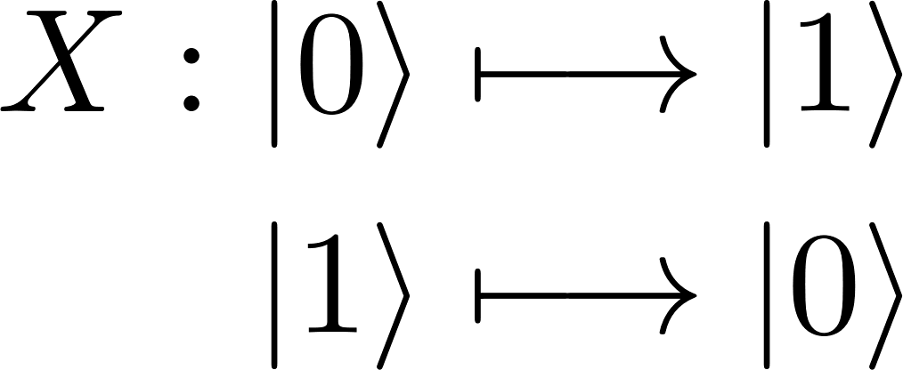
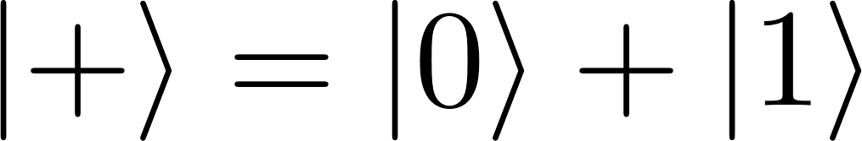
1. Perfect secrecy
One-time pad encryption, quantumly.
Does one-time pad encryption work for quantum states? Look at one qubit:
one-time pad applies the X gate with probability ½:
what happens to ? Problem: we’re not hiding phases;
Gorjan Alagic :: Foundations of Cryptography in the Quantum World :: Schemes

Slide 64
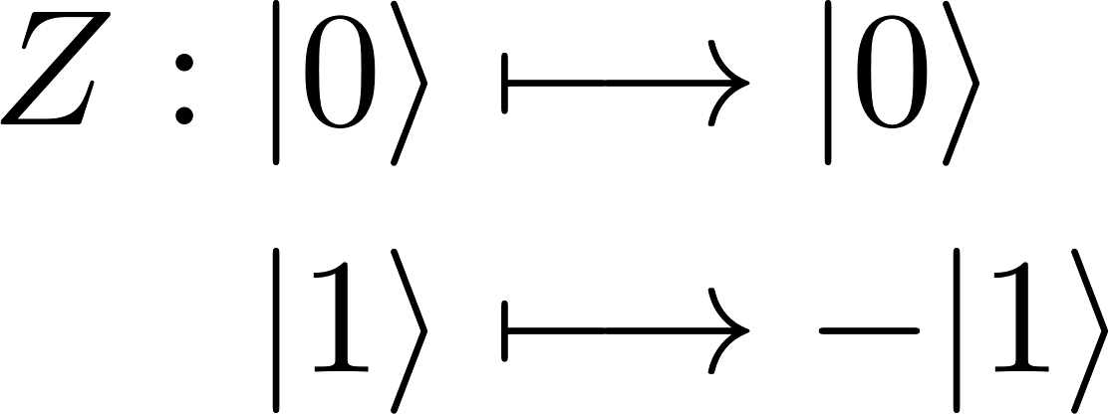
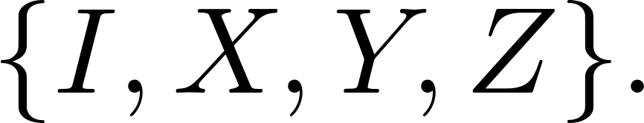
1. Perfect secrecy
One-time pad encryption, quantumly.
Does one-time pad encryption work for quantum states? Look at one qubit:
one-time pad applies the X gate with probability ½:
what happens to ? Problem: we’re not hiding phases;
solution: with probability ½, also apply a Z:
really, we apply a uniformly random element of
(note: we needed two bits of randomness.)
Gorjan Alagic :: Foundations of Cryptography in the Quantum World :: Schemes

Slide 65
1. Perfect secrecy
One-time pad encryption, quantumly.
Given two bits a and b, let P_{ab} be the corresponding element of
Definition. The quantum one-time pad (QOTP) scheme consists of
Gorjan Alagic :: Foundations of Cryptography in the Quantum World :: Schemes

Slide 66
1. Perfect secrecy
One-time pad encryption, quantumly.
Given two bits a and b, let P_{ab} be the corresponding element of
Exercise: the ciphertext is perfectly random to parties completely ignorant of k (perfect secrecy).
Exercise: if you try to use the same key twice, Eve will be able to extract information about the plaintexts (try classical plaintexts.)
Definition. The quantum one-time pad (QOTP) scheme consists of
Gorjan Alagic :: Foundations of Cryptography in the Quantum World :: Schemes

Slide 67
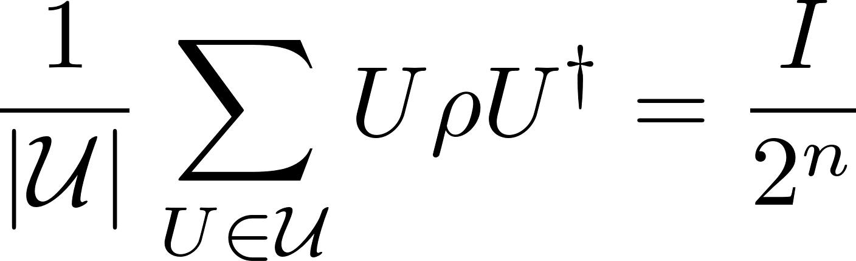
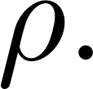
1. Perfect secrecy
How do I do the first exercise (security of QOTP)?
How do you prove that the one-time pad is secure? How do you do it classically?
In the density matrix formalism, the desired property is that
for any n-qubit input state
fully mixed state
(no information)
Gorjan Alagic :: Foundations of Cryptography in the Quantum World :: Schemes

Slide 68
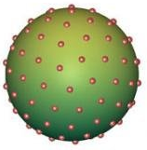
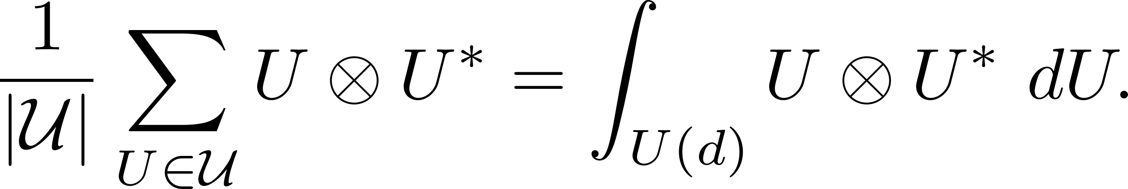
1. Perfect secrecy
How do I do the first exercise (security of QOTP)?
How do you prove that the one-time pad is secure? How do you do it classically?
In the density matrix formalism, the desired property is that
for any n-qubit input state Exercise: the Pauli matrices are a one-design.
So, any 1-design can be used to encrypt quantum states perfectly.
fully mixed state
(no information)
Definition. A unitary 1-design is a finite set of unitaries satisfying
Gorjan Alagic :: Foundations of Cryptography in the Quantum World :: Schemes

Slide 69
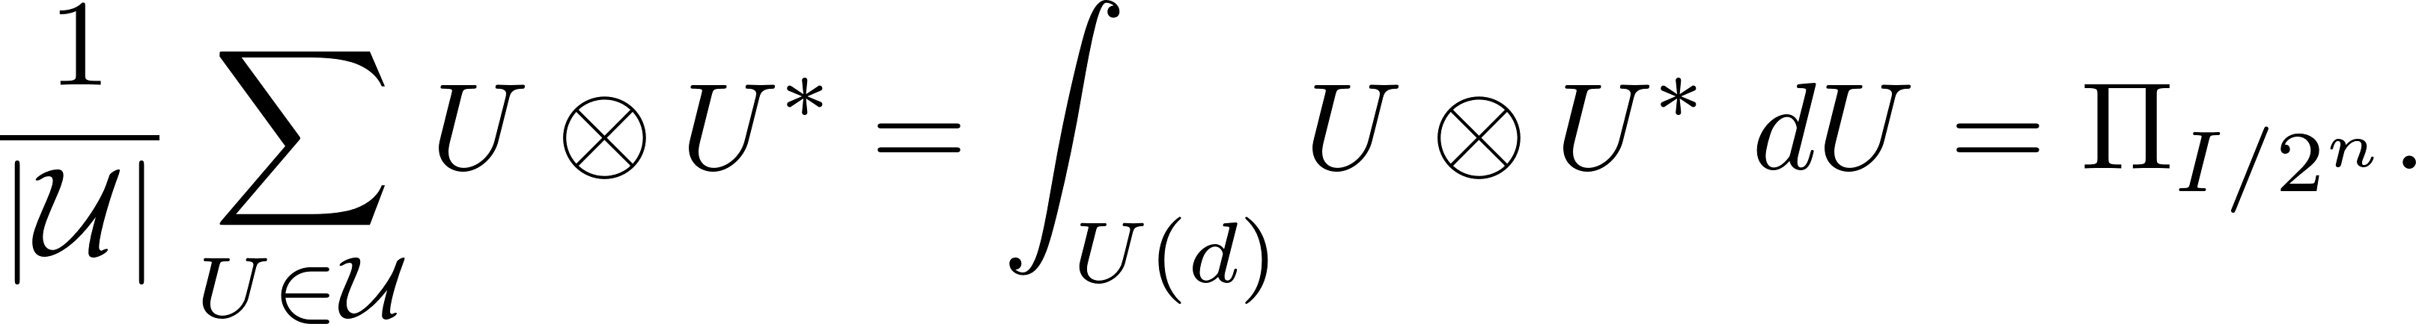
1. Perfect secrecy
How do I do the first exercise (security of QOTP)?
How do you prove that the one-time pad is secure? How do you do it classically?
In the density matrix formalism, the desired property is that
for any n-qubit input state Exercise: the Pauli matrices are a one-design.
So, any 1-design can be used to encrypt quantum states perfectly.
fully mixed state
(no information)
Definition. A unitary 1-design is a finite set of unitaries satisfying
Gorjan Alagic :: Foundations of Cryptography in the Quantum World :: Schemes

Slide 70
1. Perfect secrecy
Aside: non-malleable encryption.
problem with OTP: adversary can flip the bits of plaintext, just by flipping the corresponding bits of the ciphertext.
disastrous: attacker can intercept bank transmissions and change amounts!
Gorjan Alagic :: Foundations of Cryptography in the Quantum World :: Schemes

Slide 71
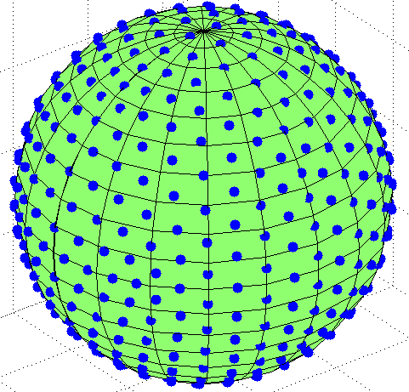
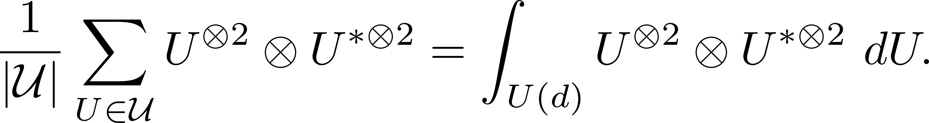
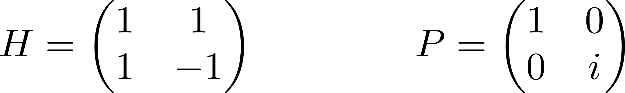
1. Perfect secrecy
Aside: non-malleable encryption.
problem with OTP: adversary can flip the bits of plaintext, just by flipping the corresponding bits of the ciphertext.
disastrous: attacker can intercept bank transmissions and change amounts!
Example: Clifford group:
(very important in quantum error correction)
Definition. A unitary 2-design is a finite set of unitaries satisfying
Gorjan Alagic :: Foundations of Cryptography in the Quantum World :: Schemes

Slide 72
1. Perfect secrecy
Aside: non-malleable encryption.
problem with OTP: adversary can flip the bits of plaintext, just by flipping the corresponding bits of the ciphertext.
disastrous: attacker can intercept bank transmissions and change amounts!
[nontrivial: the output is a non-constant function of the input.]
Definition. A unitary 2-design is a finite set of unitaries satisfying
Theorem [ABW08] (informal). If we encrypt with random elements of a 2-design, then Eve cannot apply nontrivial CPTP maps on the plaintexts.
Gorjan Alagic :: Foundations of Cryptography in the Quantum World :: Schemes

Slide 73
2. Private-key encryption
Gorjan Alagic :: Foundations of Cryptography in the Quantum World :: Schemes

Slide 74
2. Private-key encryption
Private-key encryption scheme.
Definition. An encryption scheme consists of three polynomial-time algorithms:
  KeyGen: key generation;
  Enc_{k}: encrypt with key k;
  Dec_{k}: decrypt with key k.
such that Dec_{k} (Enc_{k} (m)) = m for all messages m and keys k.
Gorjan Alagic :: Foundations of Cryptography in the Quantum World :: Schemes

Slide 75
2. Private-key encryption
Private-key encryption scheme.
Suppose that we now try to send multiple large messages with same key k.
How do we argue about security?
Semantic: “regardless of their prior knowledge or their goals, QPT adversaries cannot benefit from possession of ciphertext.”
Indistinguishability: “QPT adversaries cannot distinguish encryptions of different plaintexts.”
Definition. An encryption scheme consists of three polynomial-time algorithms:
  KeyGen: key generation;
  Enc_{k}: encrypt with key k;
  Dec_{k}: decrypt with key k.
such that Dec_{k} (Enc_{k} (m)) = m for all messages m and keys k.
Gorjan Alagic :: Foundations of Cryptography in the Quantum World :: Schemes

Slide 76
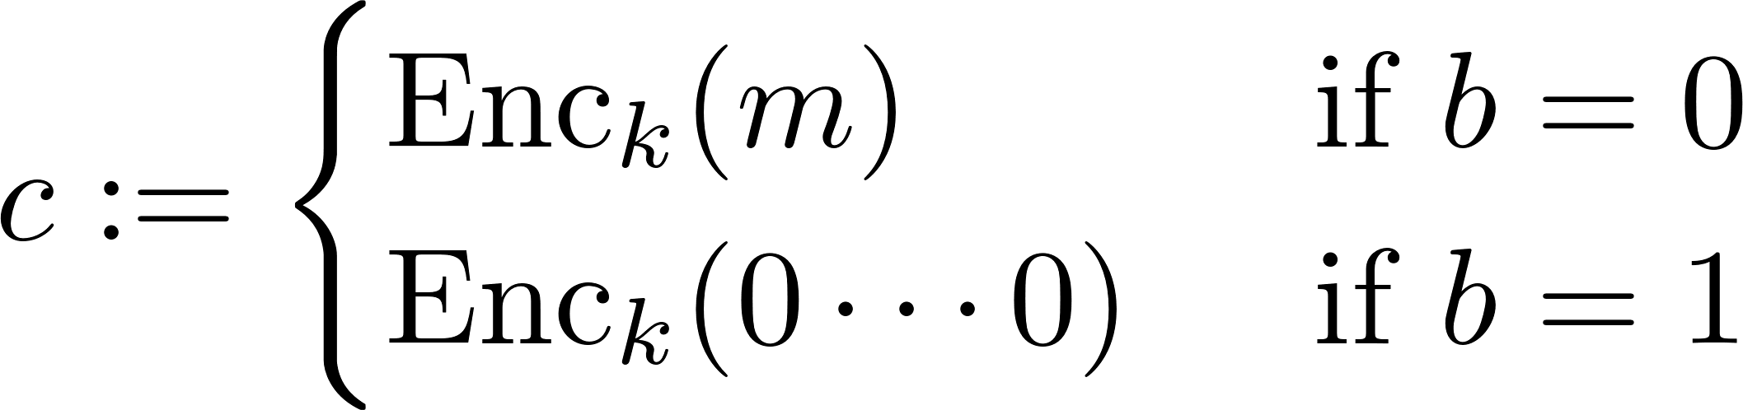
2. Private-key encryption
Indistinguishability.
Defined in terms of a game between a QPT challenger C and a QPT adversary A:
C chooses a key k of length n;
A chooses a plaintext m, and sends it to C;
C chooses a random bit b, and sends
back to A;
A outputs a guess b’.
We say that scheme is secure if b’ = b with probability ½ + negl(n);
Gorjan Alagic :: Foundations of Cryptography in the Quantum World :: Schemes

Slide 77
2. Private-key encryption
Indistinguishability.
Defined in terms of a game between a QPT challenger C and a QPT adversary A:
C chooses a key k of length n;
A chooses a plaintext m, and sends it to C;
C chooses a random bit b, and sends
back to A;
A outputs a guess b’.
We say that scheme is secure if b’ = b with probability ½ + negl(n);
Flexible definition: works in the purely classical setting, can be adapted to the post-quantum setting, and to the fully-quantum setting.
Gorjan Alagic :: Foundations of Cryptography in the Quantum World :: Schemes

Slide 78
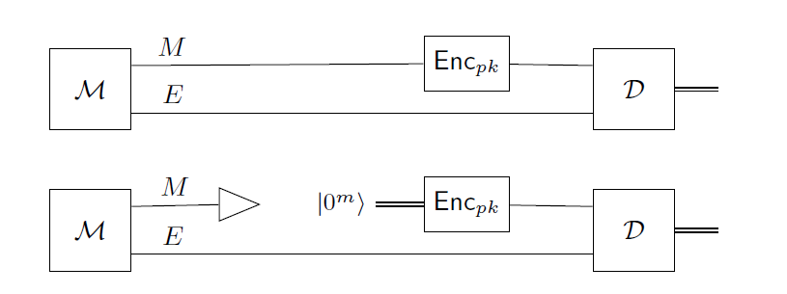
2. Private-key encryption
Indistinguishability.
Defined in terms of a game between a QPT challenger C and a QPT adversary A:
C chooses a key k of length n;
A chooses a plaintext m, and sends it to C;
C chooses a random bit b, and sends
back to A;
A outputs a guess b’.
We say that scheme is secure if b’ = b with probability ½ + negl(n);
adversary A
generate plaintext
and some side info
discard plaintext
with prob. 1/2
encrypt
did we
discard?
Gorjan Alagic :: Foundations of Cryptography in the Quantum World :: Schemes

Slide 79
2. Private-key encryption
Indistinguishability.
Defined in terms of a game between a QPT challenger C and a QPT adversary A:
adversary A
generate plaintext
and some side info
discard plaintext
with prob. 1/2
encrypt
did we
discard?
Gorjan Alagic :: Foundations of Cryptography in the Quantum World :: Schemes

Slide 80
2. Private-key encryption
Indistinguishability.
Defined in terms of a game between a QPT challenger C and a QPT adversary A:
Strengthening #1: chosen plaintext attack (CPA).
A gets oracle access to Enc_{k}.
adversary A
generate plaintext
and some side info
discard plaintext
with prob. 1/2
encrypt
did we
discard?
Gorjan Alagic :: Foundations of Cryptography in the Quantum World :: Schemes

Slide 81
2. Private-key encryption
Indistinguishability.
Defined in terms of a game between a QPT challenger C and a QPT adversary A:
Strengthening #1: chosen plaintext attack (CPA).
A gets oracle access to Enc_{k}.
Strengthening #2: chosen ciphertext attack (CCA).
A gets oracle access to Enc_{k}.
A gets oracle access to Dec_{k} prior to challenge (step 3.)
adversary A
generate plaintext
and some side info
discard plaintext
with prob. 1/2
encrypt
did we
discard?
Gorjan Alagic :: Foundations of Cryptography in the Quantum World :: Schemes

Slide 82
2. Private-key encryption
one-way functions
IND-CCA: indistinguishability under chosen ciphertext attack.
Can this very strong definition be met?
pseudorandom generators
pseudorandom functions
private-key encryption
Gorjan Alagic :: Foundations of Cryptography in the Quantum World :: Schemes

Slide 83
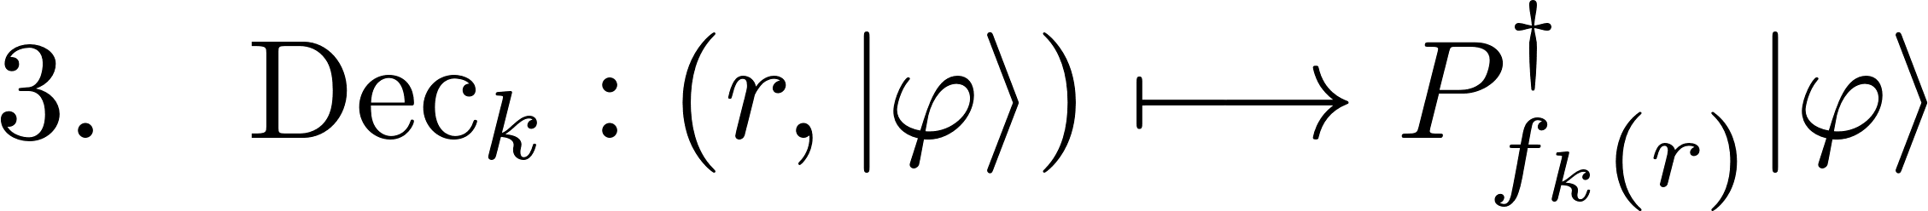
2. Private-key encryption
one-way functions
IND-CCA: indistinguishability under chosen ciphertext attack.
Can this very strong definition be met?
pseudorandom generators
Definition. Let be a PRF. Define an encryption scheme:
pseudorandom functions
private-key encryption
Gorjan Alagic :: Foundations of Cryptography in the Quantum World :: Schemes

Slide 84
2. Private-key encryption
one-way functions
IND-CCA: indistinguishability under chosen ciphertext attack.
Can this very strong definition be met?
pseudorandom generators
Definition. Let be a PRF. Define an encryption scheme:
pseudorandom functions
private-key encryption
one-time pad
quantum one-time pad
1-design
2-design
…
Gorjan Alagic :: Foundations of Cryptography in the Quantum World :: Schemes

Slide 85
2. Private-key encryption
one-way functions
IND-CCA: indistinguishability under chosen ciphertext attack.
Can this very strong definition be met?
Theorem: the above scheme is IND-CCA secure.
pseudorandom generators
Definition. Let be a PRF. Define an encryption scheme:
pseudorandom functions
private-key encryption
one-time pad
quantum one-time pad
1-design
2-design
…
Gorjan Alagic :: Foundations of Cryptography in the Quantum World :: Schemes

Slide 86
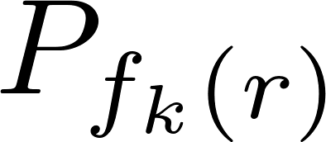
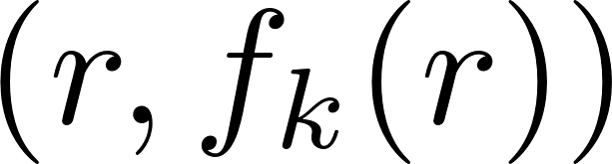
2. Private-key encryption
one-way functions
IND-CCA: indistinguishability under chosen ciphertext attack.
Theorem: the above scheme is IND-CCA secure.
Exercise: prove this theorem!
Hints:
Prove that it’s secure when is perfectly randomizing;
Reduce each encryption query to learning for random r;
Reduce each decryption query to learning for A’s choice of r;
From adversary that breaks scheme, produce adversary that breaks PRF.
Definition. Let be a PRF. Define an encryption scheme:
pseudorandom generators
pseudorandom functions
private-key encryption
Gorjan Alagic :: Foundations of Cryptography in the Quantum World :: Schemes

Slide 87
3. Public-key encryption
Gorjan Alagic :: Foundations of Cryptography in the Quantum World :: Schemes

Slide 88
3. Public-key encryption
What do we want:
all the stuff we wanted before, plus…
Alice can send messages to Bob without exchanging keys first;
(by symmetry, can do other direction as well.)
my public key is pk
A
B
E
sk
Gorjan Alagic :: Foundations of Cryptography in the Quantum World :: Schemes

Slide 89
3. Public-key encryption
What do we want:
all the stuff we wanted before, plus…
Alice can send messages to Bob without exchanging keys first;
(by symmetry, can do other direction as well.)
my public key is pk
A
B
E
m
Enc_{pk}
Dec_{sk}
m
sk
Gorjan Alagic :: Foundations of Cryptography in the Quantum World :: Schemes

Slide 90
3. Public-key encryption
Public-key encryption scheme.
Definition (informal). A public-key encryption scheme consists of three polynomial-time algorithms:
  KeyGen: output (pk, sk);
  Enc_{pk}: encrypt with public key pk;
  Dec_{sk}: decrypt with private key sk.
such that Dec_{sk} (Enc_{pk} (m)) = m for all messages m, keys (pk, sk).
Gorjan Alagic :: Foundations of Cryptography in the Quantum World :: Schemes

Slide 91
3. Public-key encryption
Public-key encryption scheme.
security notions: as before, i.e., indistinguishability, semantic, CPA/CCA;
applicability:
  classical: all algorithms are PPTs;
  post-quantum: adversary can be QPT;
  fully-quantum: all algorithms are QPTs.
Definition (informal). A public-key encryption scheme consists of three polynomial-time algorithms:
  KeyGen: output (pk, sk);
  Enc_{pk}: encrypt with public key pk;
  Dec_{sk}: decrypt with private key sk.
such that Dec_{sk} (Enc_{pk} (m)) = m for all messages m, keys (pk, sk).
Gorjan Alagic :: Foundations of Cryptography in the Quantum World :: Schemes

Slide 92
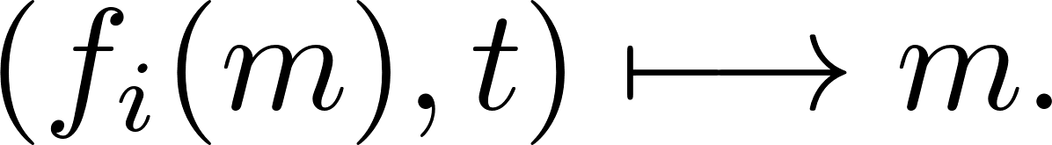
3. Public-key encryption
How to construct public-key schemes?
not known how to do it with just the OWF assumption;
stronger assumption: OWPs with trapdoors.
lattice-based quantum-secure candidates are known [PW08, GPV08].
Definition (informal). A one-way trapdoor permutation is a family of indexed functions f_{i} such that:
  the family { f_{i} } is a OWF;
  each f_{i} is a permutation;
  PPT algorithm generates index i together with trapdoor t;
  PPT algorithm for sampling from domain of f_{i} ;
  PPT algorithm for inversion:
Gorjan Alagic :: Foundations of Cryptography in the Quantum World :: Schemes

Slide 93
3. Public-key encryption
How to construct public-key schemes? Start with a trapdoor OWP.
by previous lecture, we get a PRG (just from OWP property);
use the (index, trapdoor) generation algorithm to generate keys;
Gorjan Alagic :: Foundations of Cryptography in the Quantum World :: Schemes

Slide 94
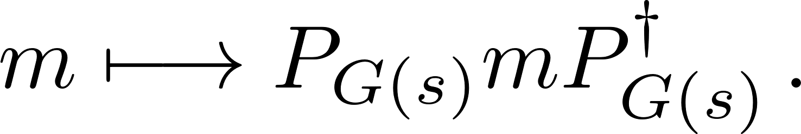
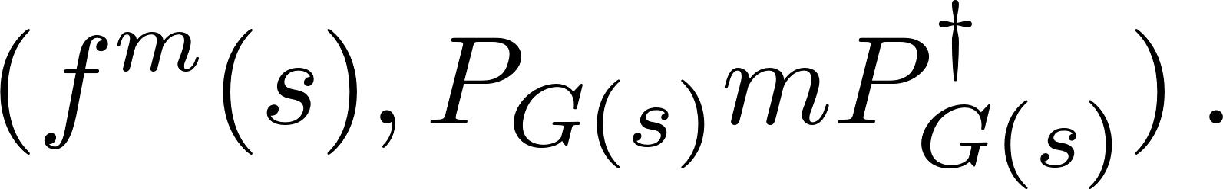
3. Public-key encryption
How to construct public-key schemes? Start with a trapdoor OWP.
by previous lecture, we get a PRG (just from OWP property);
use the (index, trapdoor) generation algorithm to generate keys;
to encrypt:
  run PRG with random s:
  encrypt using OTP/QOTP keyed by G(s):
  output
one-time pad
quantum one-time pad
1-design
2-design
…
Gorjan Alagic :: Foundations of Cryptography in the Quantum World :: Schemes

Slide 95
3. Public-key encryption
How to construct public-key schemes? Start with a trapdoor OWP.
by previous lecture, we get a PRG (just from OWP property);
use the (index, trapdoor) generation algorithm to generate keys;
to encrypt:
  run PRG with random s:
  encrypt using OTP/QOTP keyed by G(s):
  output
to decrypt:
  repeatedly use trapdoor to compute
  compute hard core bit for all of the above, and undo the OTP/QOTP.
one-time pad
quantum one-time pad
1-design
2-design
…
Gorjan Alagic :: Foundations of Cryptography in the Quantum World :: Schemes

Slide 96
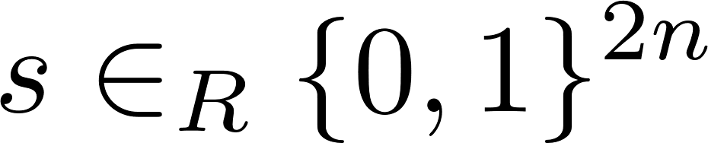
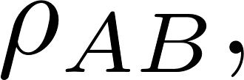
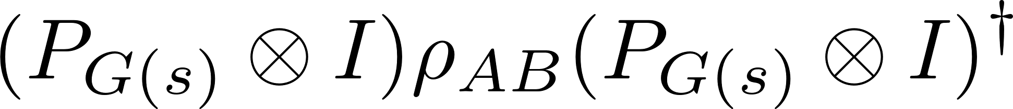
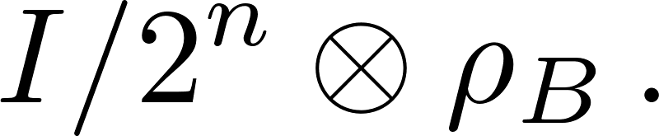
3. Public-key encryption
Security of public-key scheme.
Theorem: this scheme is IND-CPA secure.
Proof idea:
Exercise: prove the following Lemma:
Now you need a hybrid argument again, which needs to run over the randomized message as well as the “trapdoor advice” f^{m}(s).
Lemma. If G is a PRG, then for and any state
is computationally indistinguishable from
quantum one-time pad
1-design
2-design
…
Gorjan Alagic :: Foundations of Cryptography in the Quantum World :: Schemes

Slide 97
4. Summary
Lecture I: Primitives.
the computationally-secure encryption model;
basic assumption: one-way functions
possible sources of OWFs (Circuit Quantum Sampling problem);
pseudorandomness from OWFs: generators and functions.
Lecture II: Schemes.
perfect security: classical, quantum one-time pads, non-malleability;
private-key encryption from pseudorandom functions;
public-key encryption from trapdoor one-way permutations.
We covered all these things in a generic way, which includes the purely classical setting, the post-quantum setting, and the fully-quantum setting.
Gorjan Alagic :: Foundations of Cryptography in the Quantum World :: Schemes

Slide 98
4. Open problems
The big open problems in this area:
Find quantum algorithms for breaking known cryptosystems (e.g., by inverting some one-way function);
Give evidence that existing quantum techniques are insufficient for #1 (e.g., lower bounds for generalizations of Shor);
Find more cryptographic schemes that can only work quantumly (e.g., black-box obfuscation);
Find schemes for quantum versions of:
  fully-homomorphic encryption;
  functional encryption;
  indistinguishability obfuscation;
  …
  Thanks
Gorjan Alagic :: Foundations of Cryptography in the Quantum World :: Schemes

