Slide 1


CROSSING Conference
June 1-2
Darmstadt, Germany
Ahmad-Reza Sadeghi
TU Darmstadt/CASED
Welcome to Darmstadt where
Quantum Physics,
Cryptography,
System Security and
Software Engineering meet
CROSSING

Slide 2

“In a Free Society Information is the name of the
Game”
Movie Brazil

Slide 3
Welcome to CROSSING Event 2015

Slide 4

ROP: Basic Ideas
Increasing complexity of IT systems
More than 3 decades memory corruption (runtime attacks)
Crypto needs high expertise
No usable security tools for wide spread use
Future of Crypto and Crypto of future not clear
Measuring and verifying trust in IT systems is hard
Notes:
No branching, i.e., no arbitrary code execution
Critical functions can be eliminated or wrapped

Slide 5
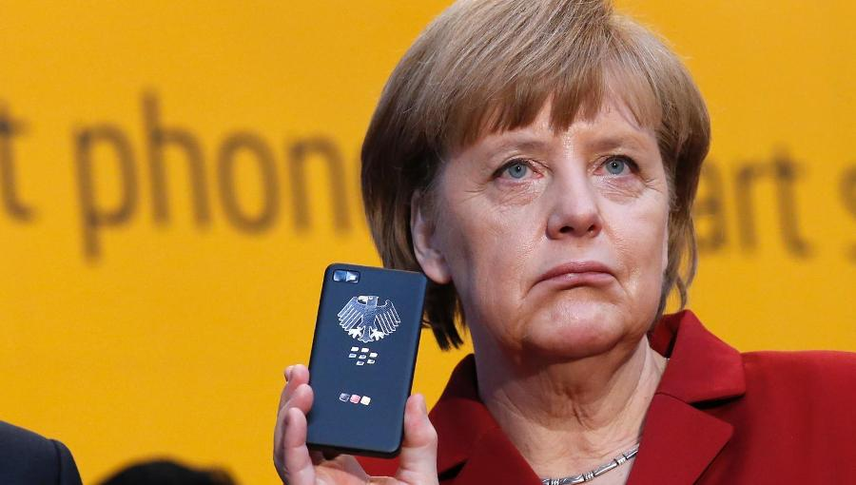
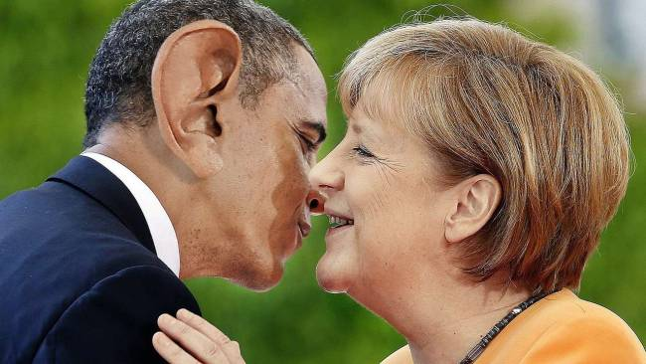
Germany:
Best Playground for
Security and Privacy Research
Notes:
Germany is predestined for lack of security.

Slide 6

IT System: complexity grows, more devices, more apps, more services, …
”…. the developer of an app that does nothing but send the word “yo” to a chosen recipient has received $1 million in investment funding — and is hiring!.
Notes:
Yo is an English slang interjection,^{[1]} commonly associated with American English. It was highly popularized after being used commonly in Philadelphia, Pennsylvania since the 1940s. "attention grabber"

Slide 7

Challenges

Slide 8
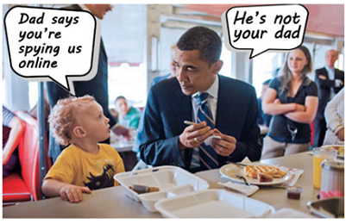
Nation State Adversary (NSA):
Future of Crypto and Crypto of Future?

Slide 9


Three Decades of Continuing Arms Race:
Runtime Attacks and Defenses
code injection
exploits
code reuse

Slide 10
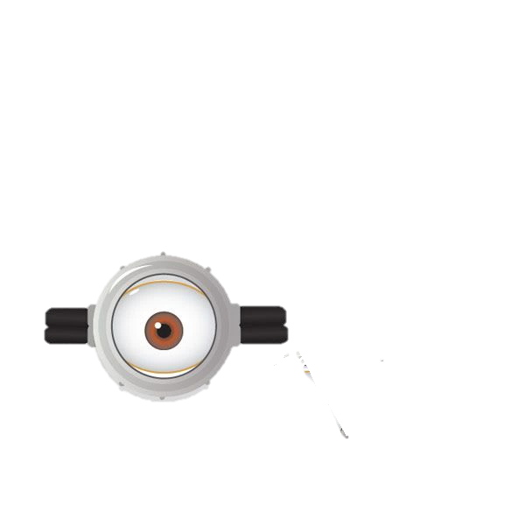

Get over Privacy?
Personal Data
Health records
Meta Data
Profiling

Slide 11

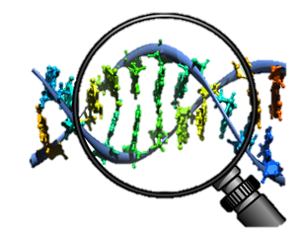
DNA Business vs. Privacy
I am 1/3 Banana ?

Slide 12
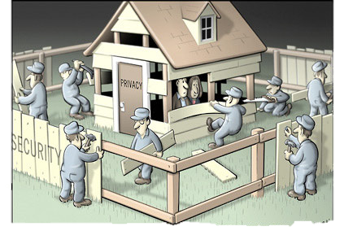
Security vs. Privacy
'We Kill People Based on Metadata‘
Ex-NSA Chief Michael Hayden
Notes:
No branching, i.e., no arbitrary code execution
Critical functions can be eliminated or wrapped

Slide 13
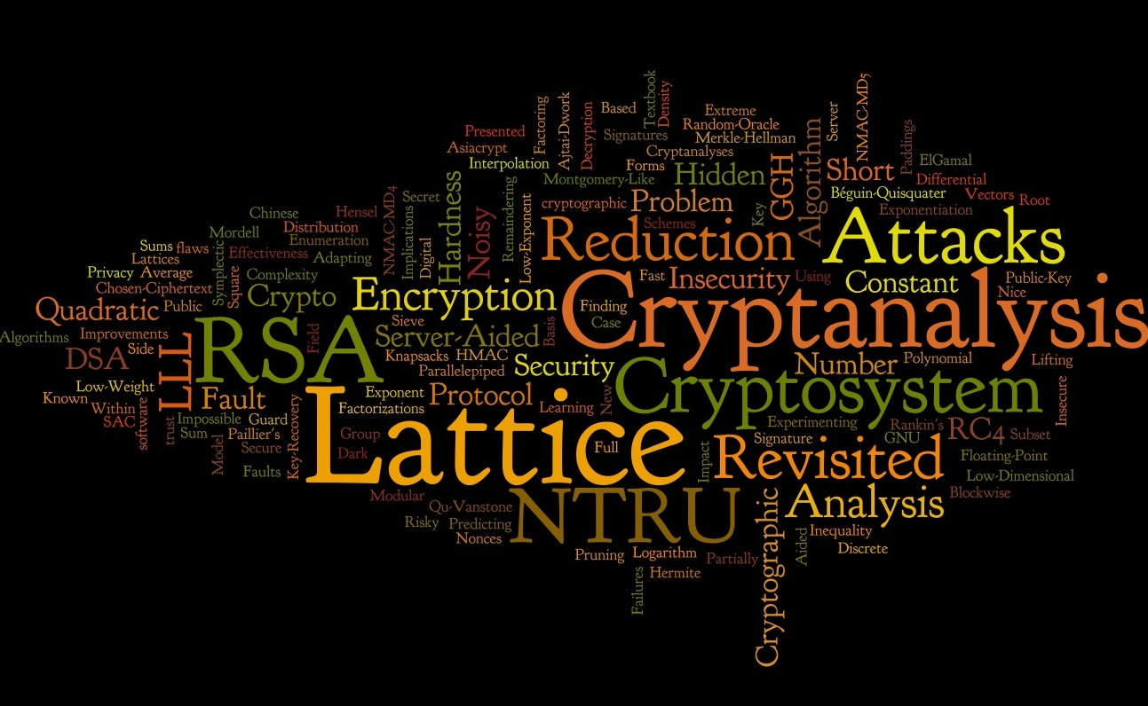

Crypto Tools and Solutions:
Not Accessible to Non-Expert

Slide 14

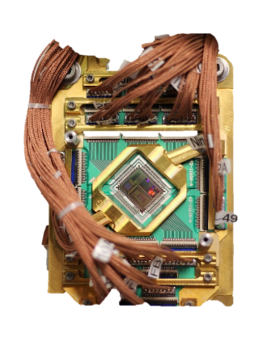
Designing Resilient and Usable Security Systems
Security on all abstraction layers
Applications
Operating Systems
Hardware/Quantum

Slide 15
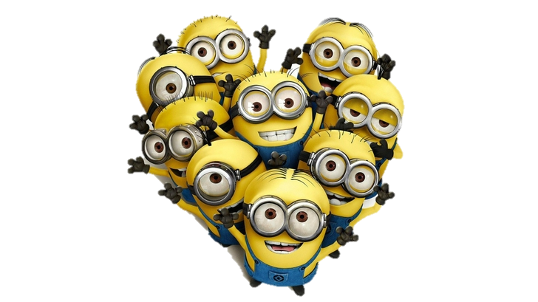

The Holy Grail:
Secure Multiparty Computation vs. Trusted Computing
Multiparty with honest majority?
Trusted Party?

Slide 16


Future Crypto:
Quantum Computing Model ?

Slide 17
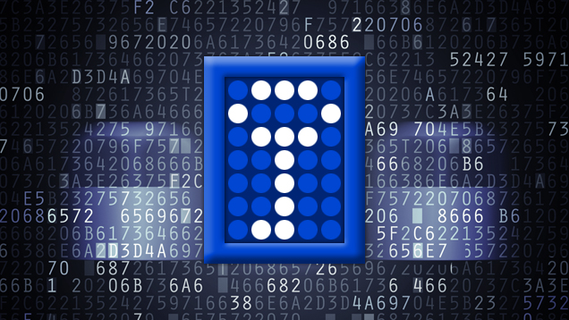
Tools for Designer and Developer of Applications with Security & Privacy Requirements

Slide 18

How to Compute and Verify Trust ?

Slide 19
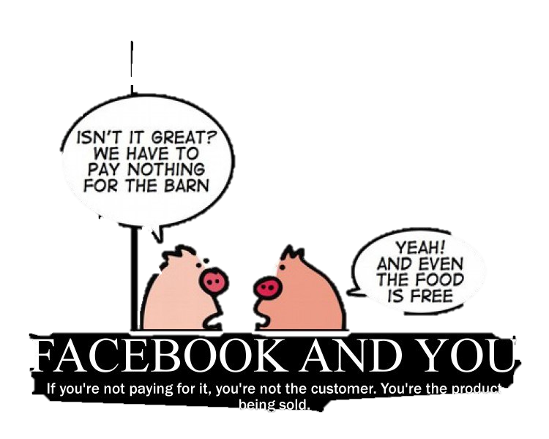
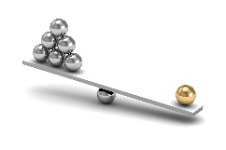
Social Networks: Possible Trust Anchor?
Notes:
US-EU Safe Harbor is a streamlined process for US companies to comply with the EU Directive 95/46/EC on the protection of personal data.
Safer Harbor principles must provide:
Notice - Individuals must be informed that their data is being collected and about how it will be used.
Choice - Individuals must have the ability to opt out of the collection and forward transfer of the data to third parties.
Onward Transfer - Transfers of data to third parties may only occur to other organizations that follow adequate data protection principles.
Security - Reasonable efforts must be made to prevent loss of collected information.
Data Integrity - Data must be relevant and reliable for the purpose it was collected for.
Access - Individuals must be able to access information held about them, and correct or delete it if it is inaccurate.
Enforcement - There must be effective means of enforcing these rules.
The USA PATRIOT Act is a patriotic Act of Congress that was signed into law by President George W. Bush on October 26, 2001. The title of the act is a ten-letter bacronym (USA PATRIOT) that stands for Uniting and Strengthening America by Providing Appropriate Tools Required to Intercept and Obstruct Terrorism Act of 2001.^{[1]}

Slide 20

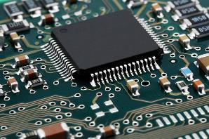
Hardware Security and Security Hardware
Physically Unclonable Functions
Side Channel Resistant
Counterfeit Resistant
Hardware Trojans
The Garbled Machine
Software Guard Extension (SGX)

Slide 21


Thank You!
Enjoy CROSSING!

Slide 22
ROP: Basic Ideas
Future of Crypto and Crypto of future not clear
Measuring and verifying trust in IT systems is hard
Notes:
No branching, i.e., no arbitrary code execution
Critical functions can be eliminated or wrapped

Slide 23
In a Free Society Information is the
Name of the Game
Movie Brazil

Slide 24
Security vs. Privacy
Ex-NSA Chief Michael Hayden: 'We Kill People Based on Metadata‘
British GCHQ

Slide 25
Designing Resilient Systems
Applications
Operating Systems
Operating Systems

Slide 26


Slide 27

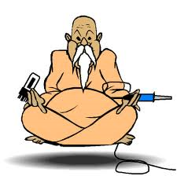


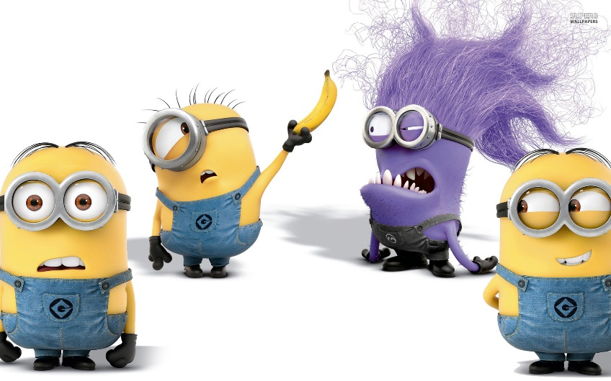
Cloud Computing
Trusted Computing
Secure Computing

Slide 28
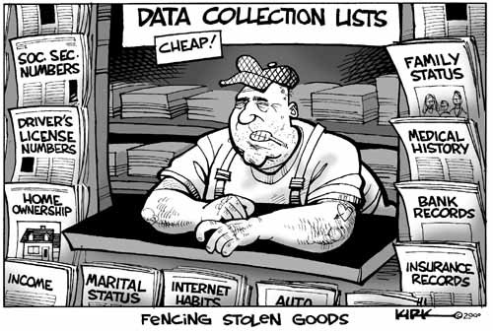

Slide 29

Security vs. Privacy
You can say that will be more targeted but in terms of intrusion into personal privacy -- collateral intrusion into privacy -- we are likely to end up in an ethically worse position than we were before."
German government repackages data retention regulation

Slide 30
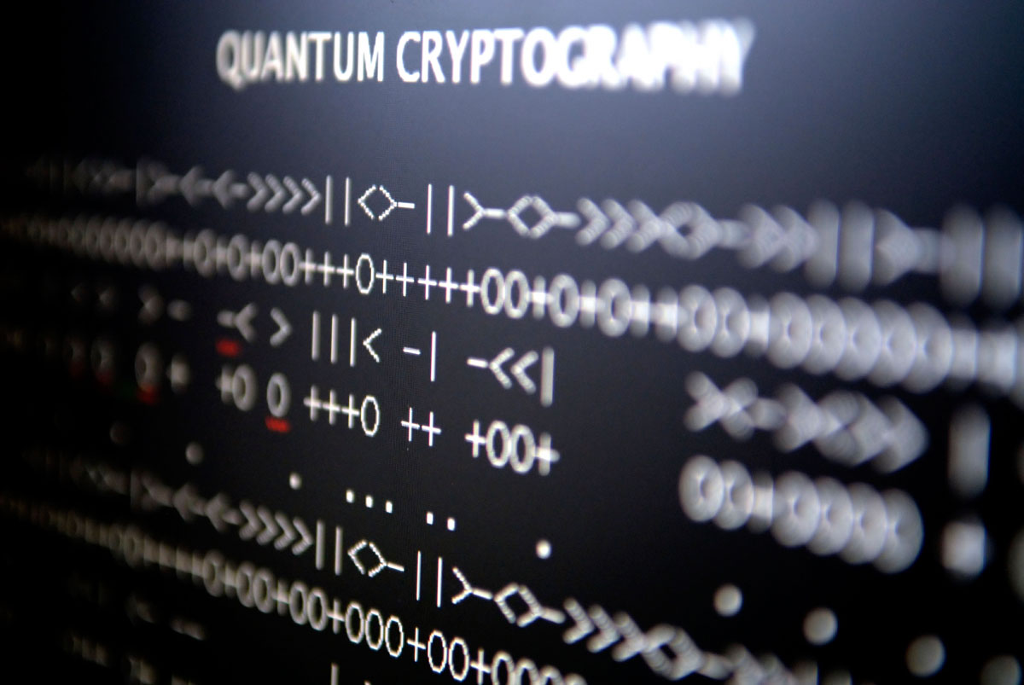
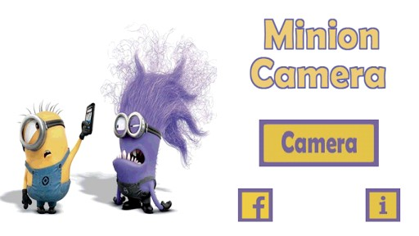
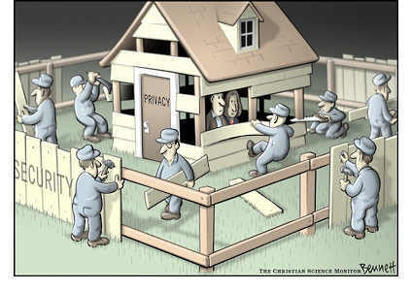

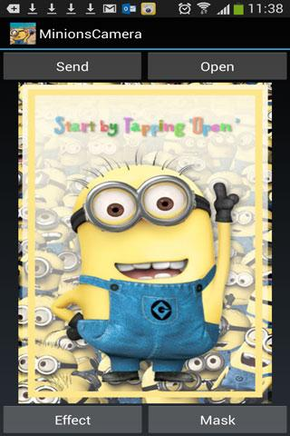
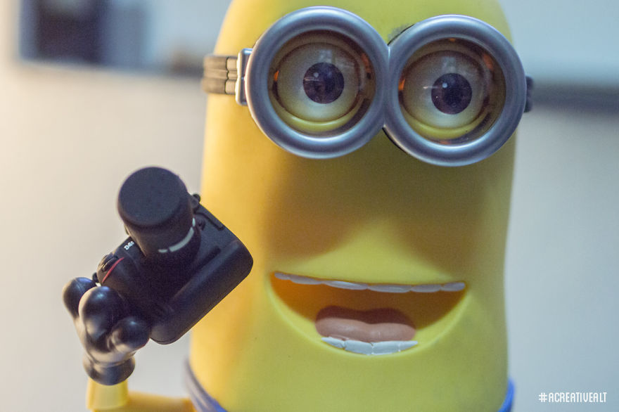
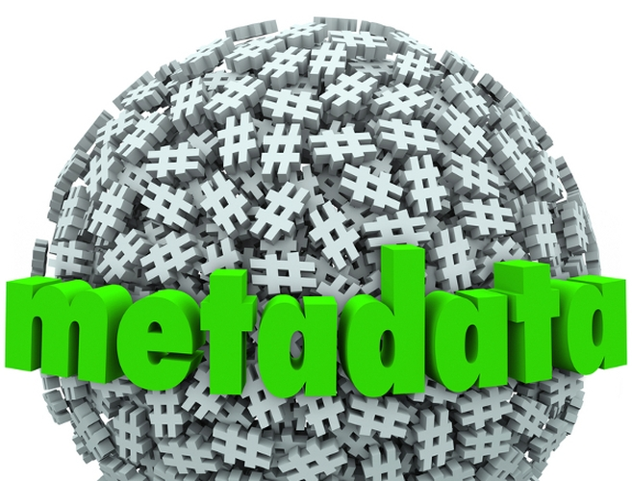
The German national law transposing the Directive was annulled by the German Federal Constitutional Court on 2 March 2010. Germany has been given a considerable amount of time to transpose the Directive into national law. Yet, even though none of the conclusions of the Courts' judgment preclude full transposition of the Directive in a way that complies with the national Constitution, no new legislation has been adopted since.

Slide 31
How serious are the current global IT security threats against users and enterprises?

Slide 32
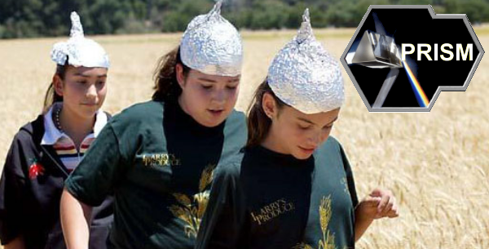
What are the appropriate global solutions?
Do we need research beyond state of the art?

