Slide 1
Building secure computing infrastructure for extensible and distributed software systems
Frank Piessens, KU Leuven
CROSSING 2015 CONFERENCE
June 1-2, Darmstadt, Germany
This work has been supported by the Intel Lab’s University Research Office
Notes:
Our ICT Infrastructure has suffered a bit from lack of heterogeneity and among other things this has impeded “big” changes. We have been running Windows or Unix-style operating systems on Intel x86 or ARM processors for decades.
With (1) the extended reach of the Internet to a variety of embedded devices, and (2) the increased awareness on security aspects, there is an opportunity to rethink some aspects of this infrastructure.
BUT of course compatibility with the past will remain an important conditio-sine-qua-non.
This talk proposes a “design objective” that we believe should be a driving objective for the redesign of our computing infrastructure. Essentially that objective is: the ICT infrastructure should make it possible to reason about security of distributed applications at source code level.
I will first explain and motivate that design objective. This will be a non-technical, partly subjective, “vision”-style part.
Then I will discuss concrete technical results that realize this vision in a specific limited but concrete setting.

Slide 2
Introduction
We have strong but complex and evolving security primitives:
  Cryptographic primitives:
    Security notions are intricate
    New primitives are designed over time
  Hardware security primitives:
    Many different ways of achieving isolation:
      Privilege levels and virtual memory
      Capability based hardware
      Execution-Aware Memory Protection or PCBAC
  Hence: we need to build practical usable abstractions for engineering secure systems
Notes:
Examples:
- “security against existential forgery under an adaptive chosen message attack”
- Authenticated encryption as a new primitive

Slide 3
Introduction
Key question: what are the right abstractions?
  Secure channels?
  Virtual private networks?
  Isolated virtual machines (e.g. in the cloud)?
  Authentication / authorization services?
Our answer (wearing software engineer hat):
  ICT infrastructure should offer a secure abstraction of a source-level programming language
    Because it seems reasonable to require software engineers to understand the programming language they use
Notes:
Limitations of these abstractions:
- coarse grained
- hard to define/understand the exact security guarantees precisely

Slide 4

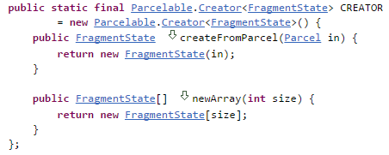
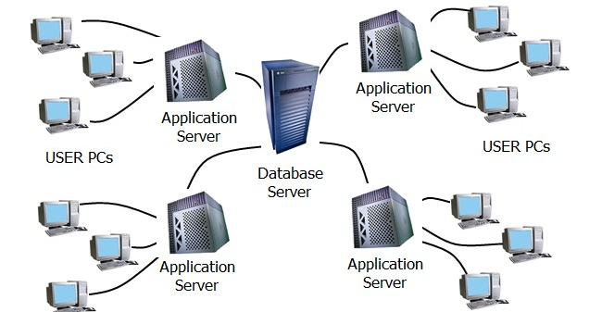
A source code centric approach
This is the abstraction level at
which the system is developed /
analyzed / debugged
Source code
Compilation and deployment
Runtime
system
Notes:
Example of a source code level security property:
- information about chat messages in a private chat room should only flow to members of the chat room. Example vulnerability: a search functionality that also reports hits in private chat messages

Slide 5
A source code centric approach
This is the abstraction level at
which the system is developed /
analyzed / debugged
Source code
Compilation and deployment
code
injection
attacks
tampering
attacks
This is the abstraction level at
which the system is attacked
Runtime
system
network
attacks
Notes:
Example of attacks breaking previous security property:
- a script injection attack against the browser
- a network sniffing attack

Slide 6
A source code centric approach
This is the abstraction level at
which the system is developed /
analyzed / debugged
Source code
Challenge 1: How to support
sound and modular reasoning
about security at source code level
Compilation and deployment
code
injection
attacks
tampering
attacks
This is the abstraction level at
which the system is attacked
Runtime
system
Challenge 2: How to compile and
deploy such that this source level
reasoning is valid with a small TCB
network
attacks
Notes:
Our belief: the overall “security problem” should be split in two sub-problems.

Slide 7
A source code centric approach
These are broad challenges:
  Different variants of Challenge 1 for each choice of:
    Programming language
    Class of security requirements
    Example: JIF from Cornell for Java + Information Flow
      http://www.cs.cornell.edu/jif/
  Different variants of Challenge 2 for each choice of:
    Programming language
    Attacker model ( i.e. choice of TCB)
    Example: seminal work by Abadi, Fournet and others for message passing based PL’s and network attackers
Topic of the remainder of this talk:
  Addressing these challenges for
    The C programming language
    Safety properties expressible in separation logic
    A powerful attacker model (small TCB)

Slide 8
Overview
The target platform: Sancus
  J. Noorman, P. Agten, W. Daniels, R. Strackx, A. Van Herrewege, C. Huygens, B. Preneel, I. Verbauwhede, F. Piessens, Sancus: Low-cost trustworthy extensible networked devices with a zero-software trusted computing base, USENIX Security 2013
The secure compiler
  P. Agten, R. Strackx, B. Jacobs, F. Piessens, Secure compilation to modern processors, CSF 2012
  M. Patrignani, P. Agten, R. Strackx, B. Jacobs, D. Clarke, F. Piessens, Secure compilation to Protected Module Architectures, TOPLAS 2015
Modular source code verification
  P. Agten, B. Jacobs, F. Piessens, Sound modular verification of C code executing in an unverified context, POPL 2015

Slide 9
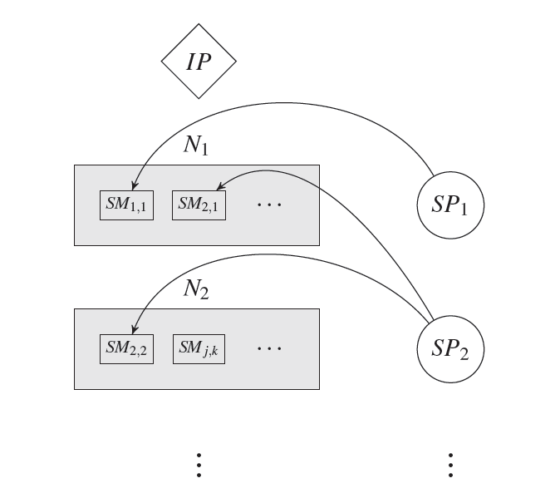
System model
A network of low-end nodes N managed by an infrastructure provider IP
Software providers SP deploy software modules SM on these nodes

Slide 10
Attacker model and security properties
Attackers can:
  Manipulate all the SW on nodes
  Control the network as a Dolev-Yao attacker
  NOT mess with the hardware
In the presence of such attackers we guarantee:
  Software module isolation
  Remote attestation
  Secure remote communication
  [Secure linking]

Slide 11
Protected software modules
Standard SW modules, defining memory sections
  Public text section
    Code and constants
  Private data section
    Runtime data that needs to be protected
  Optional unprotected sections
Layout of a module:
  The load addresses of public and private sections
Identity of a module:
  Layout + contents of text section

Slide 12
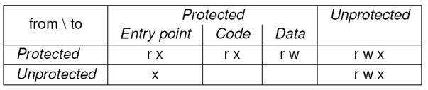
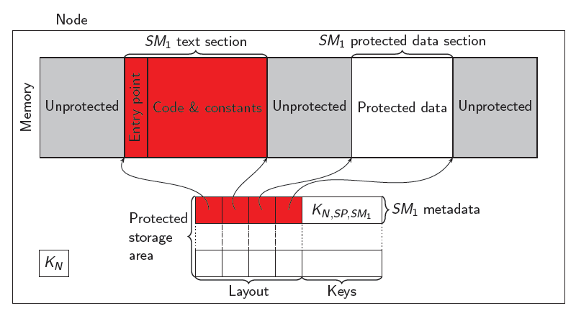
Isolation
By PC-based
access control:

Slide 13
Key management
Strictly symmetric key for performance reasons
Three types of keys:
  Node master keys K_{N} : shared between IP and N
  Provider keys K_{N,SP} : shared between IP, SP and N
  Module keys K_{N,SP,SM} : shared between IP, SP and SM on N
Nodes are initialized with their master key on production
All other keys are derived by means of key derivation functions
  K_{N,SP} = kdf (K_{N} , SP)
  K_{N,SP,SM} = kdf(K_{N,SP} , SM)

Slide 14
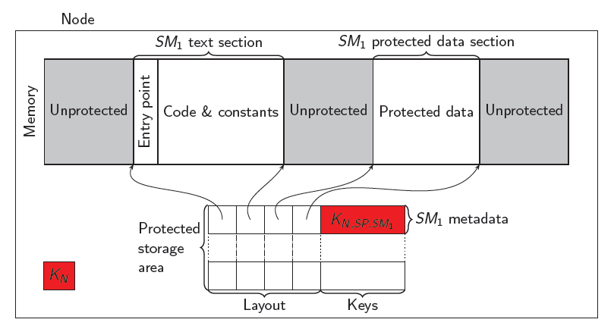
Keys on the device managed by HW
Only computed after enabling isolation
  protect layout, SP
Only usable through special HW instructions
  mac-seal start-address, length, result-address

Slide 15
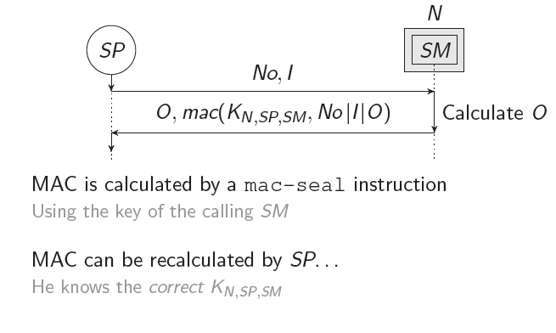
Remote attestation and secure communication

Slide 16
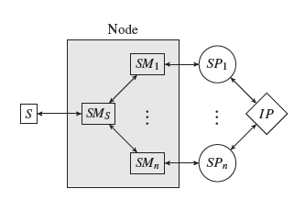
An example (simplified) scenario
Node manages a sensor S by means
of an IP provided module SM_{S}
Various SP’s can install SM’s:
  The SP contacts IP to get a K_{N,SP}
  SP creates SM, and calculates K_{N,SP,SM}
  SM is deployed on N using untrusted OS services
  SM is protected with the instruction:
    protect layout, SP
    This creates K_{N,SP,SM} and enables memory protection on SM
  SP sends a request to SM (including a nonce No)
  SM computes a response (possibly calling SM_{S} and including No) and signs it using the instruction:
    MAC-seal
    This creates a MAC of the response using K_{N,SP,SM}

Slide 17
Some implementation details
Built as an extension of an open-source MSP430 implementation
Main changes:
  Memory access logic that implements PC-based access control
  Hardware implementations of:
    HMAC
    HKDF
    The Spongent 128/128/8 hash function
  The new instructions
Available for download at:
  https://distrinet.cs.kuleuven.be/software/sancus/

Slide 18
Overview
The target platform: Sancus
  J. Noorman, P. Agten, W. Daniels, R. Strackx, A. Van Herrewege, C. Huygens, B. Preneel, I. Verbauwhede, F. Piessens, Sancus: Low-cost trustworthy extensible networked devices with a zero-software trusted computing base, USENIX Security 2013
The secure compiler
  P. Agten, R. Strackx, B. Jacobs, F. Piessens, Secure compilation to modern processors, CSF 2012
  M. Patrignani, P. Agten, R. Strackx, B. Jacobs, D. Clarke, F. Piessens, Secure compilation to Protected Module Architectures, TOPLAS 2015
Modular source code verification
  P. Agten, B. Jacobs, F. Piessens, Sound modular verification of C code executing in an unverified context, POPL 2015

Slide 19
Big picture
I1
M1
Compile
M1’
I2
I3
Malicious source code
Malicious binary code
HW
The compilation of M1 to M1’ should ensure that:
If a property holds of M1 even if it interacts with arbitrary (malicious) source code
THEN
that property holds at run time even if M1’ interacts with arbitrary (malicious)
machine code

Slide 20
Contextual equivalence
Modularization mechanisms provide encapsulation
Contextual equivalence:
  M1 ~ M2 if there is no context that can tell them apart
  Can be used to express security properties
M1.c
static int value = 0;
int plusTwo() {
value +=2;
return value;
}
M2.c
static int value = 0;
int plusTwo() {
value +=1;
value +=1;
return value;
}

Slide 21
Example: maintaining invariants
These modules are contextually equivalent iff the context can not break the invariant
min <= max
static int min = 0;
static int max = 1;
int m() {
if (min <= max) return 0;
else return 1;
}
/* Other functions omitted */
…
static int min = 0;
static int max = 1;
int m() {
return 0;
}
/* Other functions omitted */
…

Slide 22
Conclusion
I1
M1
Compile
M1’
I2
I3
Malicious source code
Malicious binary code
HW
The compilation of M1 to M1’ should preserve contextual equivalence

Slide 23
Naïve compilation
A C module is compiled to a Sancus module
  Space for static (private) vars in the data section
  Machine code for all functions in the text section
  Logical entry points for each publicly accessible function
Calling conventions and call stack:
  Pass parameters through processor registers
  Call stack is maintained in unprotected memory
  A specific return entry point supports returning from a callback

Slide 24
Example issue 1: stack security
Source modules are contextually equivalent but compiled modules are not
  => stack needs protection (confidentiality & integrity)
static int value = 0;
int get() {
return value;
}
void m(void (*f())) {
int x = 0;
f();
value = x;
return 0;
}
static int value = 0;
int get() {
return value;
}
void m(void (*f())) {
f();
return 0;
}

Slide 25
Issue 2: Code address poisoning
Source modules are contextually equivalent but compiled modules are not
  => defensive sanity checks on incoming values (arguments of functions and return values of outcalls)
static int value = 0;
int m(void (*f())) {
f();
value = value - 1;
value = value +1;
return value;
}
static int value = 0;
int m(void (*f())) {
f();
value = value +1;
value = value - 1;
return value;
}

Slide 26
Compilation: conclusions
Many issues like the two example issues we discussed
See the papers for proofs that all issues can be addressed
  Note: these proofs are fragile wrt the programming language considered
Note:
  secure compilation does not address vulnerabilities within the source code
  It only addresses vulnerabilities introduced by shifting abstraction layers

Slide 27
Overview
The target platform: Sancus
  J. Noorman, P. Agten, W. Daniels, R. Strackx, A. Van Herrewege, C. Huygens, B. Preneel, I. Verbauwhede, F. Piessens, Sancus: Low-cost trustworthy extensible networked devices with a zero-software trusted computing base, USENIX Security 2013
The secure compiler
  P. Agten, R. Strackx, B. Jacobs, F. Piessens, Secure compilation to modern processors, CSF 2012
  M. Patrignani, P. Agten, R. Strackx, B. Jacobs, D. Clarke, F. Piessens, Secure compilation to Protected Module Architectures, TOPLAS 2015
Modular source code verification
  P. Agten, B. Jacobs, F. Piessens, Sound modular verification of C code executing in an unverified context, POPL 2015

Slide 28
Big Picture
Consider a program consisting of a number of modules, and their dependencies.
 | C | Java | ML
In | Header file | (Roughly) Interfaces | Signature
Mn | C file | (Roughly) Classes | Structure / Functor
I1
M1
I2
I3
M2
M3
I4
M4

Slide 29
Big Picture
Suppose you have proven a (security) property of module M1 by modular reasoning.
E.g.:
Some invariant holds on the module’s state
Some data in the module remains confidential towards other modules
The integrity of some data in the module is protected from other modules
I1
M1
I2
I3
M2
M3
I4
M4

Slide 30
Big Picture
We have seen how to compile M1 to M1’ such that malicious context and
infrastructure can not do more harm than a malicious source code context
But it is still not guaranteed that verified properties of M1 hold at runtime:
  There may be interactions with M1’ that do not comply with I1,I2,I3
  There may be shared heap memory between M1 and other modules
Can we add runtime checks for these?
I1
M1
M1’
M2’
I2
I3
Compile
M3’
M2
M3
M4’
…
RL
I4
OS
M4
HW

Slide 31
Example context + module
Context
Module

Slide 32
Example context + module
Context
Module

Slide 33
Example context + module
Context
Module

Slide 34
Example context + module
Context
Module

Slide 35
Example context + module
Context
Module

Slide 36
Example context + module
Context
Module

Slide 37
Example context + module
Context
Module

Slide 38
Example context + module
Context
Module

Slide 39
Example context + module
Context
Module

Slide 40
Boundary checks
Pure assertions:
  Boundary checks are just assertion checks
    On entering a function of the module
    On returning from an outcall
Spatial assertions:
  Boundary checks should also maintain the footprint of the module
  And check its integrity
    On return from an outcall
    On entering a function of the module

Slide 41
Implementations
We have an end-to-end implementation
  Verifier = VeriFast [very mature]
  Program transformations for run time contract checking support a subset of C and VeriFasts program logic [prototype]
  Secure compiler is an LLVM based “pragmatic” implementation of a fully abstract compiler [initial prototype]
  Protected Module Architecture is either Sancus or Fides [stable prototypes], but should be Intel SGX soon
Benchmarks show acceptable costs

Slide 42
The road ahead
Making secure compilation compositional:
  Supports mutual distrust between software modules
  Supports per-module construction of a TCB
Dealing with distribution:
  What if different verified modules of the application run on different nodes?
Dealing with I/O:
  At source code level I/O is just a function call
  How should we / do we reason about security of I/O?
Other low-level protection mechanisms:
  What are the right primitives?
    Symmetric vs asymmetric crypto?
    PCBAC versus hardware capabilities?
…

Slide 43
Questions?
Thank you!

Slide 44
References
  J. Noorman, P. Agten, W. Daniels, R. Strackx, A. Van Herrewege, C. Huygens, B. Preneel, I. Verbauwhede, F. Piessens, Sancus: Low-cost trustworthy extensible networked devices with a zero-software trusted computing base, USENIX Security 2013
  P. Agten, R. Strackx, B. Jacobs, F. Piessens, Secure compilation to modern processors, CSF 2012
  M. Patrignani, P. Agten, R. Strackx, B. Jacobs, D. Clarke, F. Piessens, Secure compilation to Protected Module Architectures, TOPLAS 2015
  B. Jacobs, J. Smans, P. Philippaerts, F. Vogels, W. Penninckx, F. Piessens, VeriFast: A powerful, sound, predictable, fast verifier for C and Java, NASA Formal Methods 2011
  P. Agten, B. Jacobs, F. Piessens, Sound modular verification of C code executing in an unverified context, POPL 2015

