Slide 1

CROSSING
Cryptography-Based Security Solutions
Enabling Trust in New and Next Generation Computing Environments
Speaker: Deputy Speaker:
Johannes Buchmann Marc Fischlin

Slide 2






IT security research in Darmstadt
350 IT-security
researchers
CySec
RTG Privacy
and Trust
Notes:
Bild für SFZ

Slide 3

Cryptography-based security solutions
Enabling trust in new and next generation
computing environments
Collaborative Research Center
of the German Research Foundation
Funding up to 12 years
65 researchers working in CROSSING

Slide 4
Gernot Alber Theoretical Quantum Physics
Christian Bischof Scientific Computing
Eric Bodden Secure Software Engineering
Johannes Buchmann Cryptography and Computer Algebra
Lucas Davi System Security
Marc Fischlin Cryptography and Complexity Theory
Matthias Hollick Secure Mobile Networking
Stefan Katzenbeisser Security Engineering
Heiko Mantel Modeling and Analysis of Inf. systems
Mira Mezini Software Technology
Max Mühlhäuser Telecooperation
Ahmad-Reza Sadeghi System Security
Thomas Schneider Engineering Cryptographic Protocols
Haya Shulman Security in Information Theory
Michael Waidner Security in Information Theory
Thomas Walther Laser and Quantum Optics

Slide 5
Why CROSSING?

Slide 6
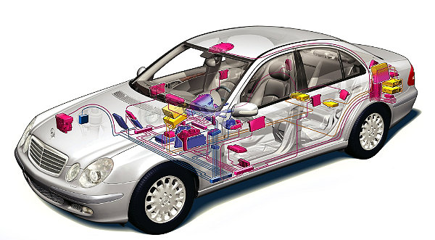
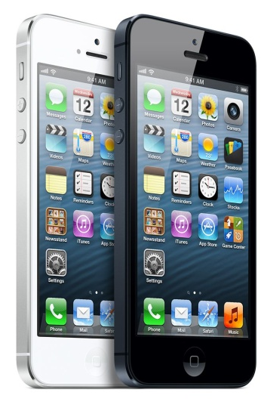

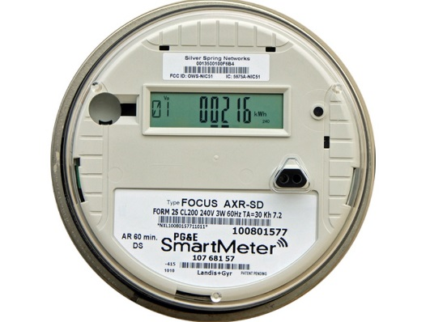
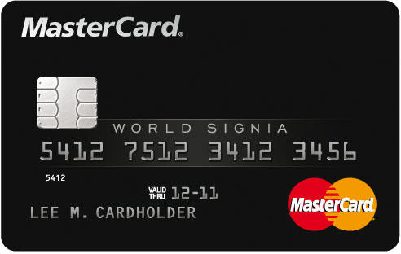
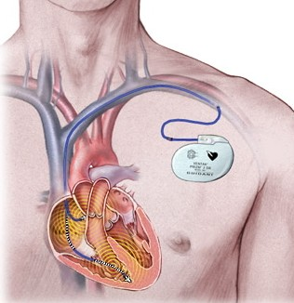
Cryptography indispensable for
trustworthiness of IT:
Privacy: encryption
Authenticity: signatures

Slide 7
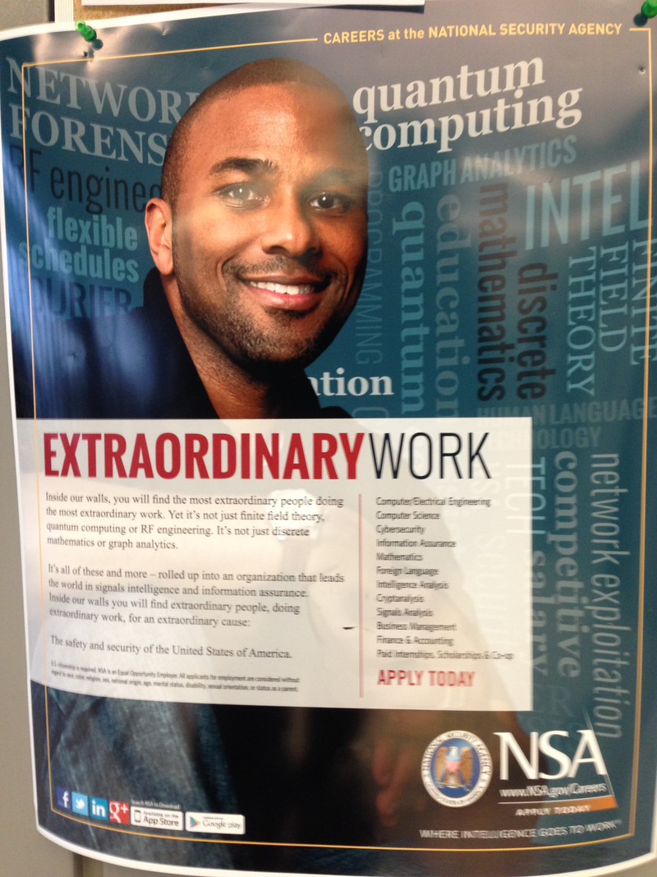
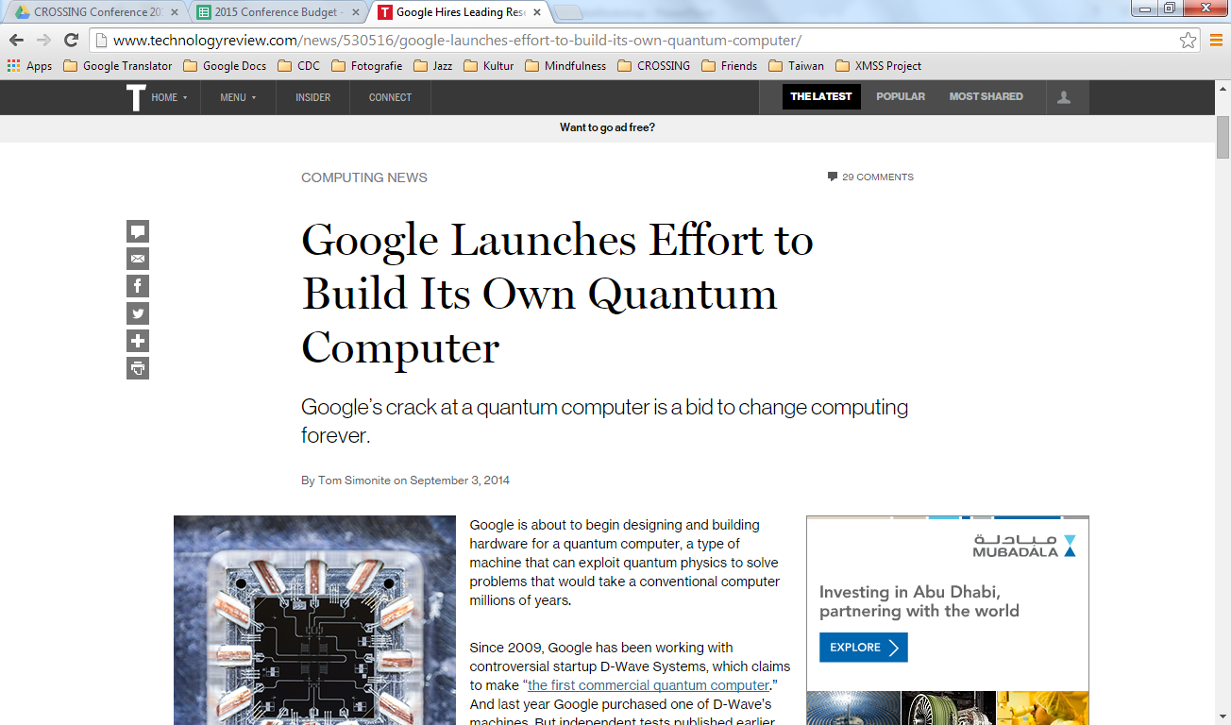
Security of todays cryptography
threathened!
Notes:
total economic impact of cloud technology could be $1.7 trillion to $6.2 trillion annually in 2025 (McKinsey & Co)
The worldwide cloud-based security services market will be worth $2.1B in 2013, rising to $3.1B in 2015, according to Gartner.
http://www.forbes.com/sites/louiscolumbus/2013/11/16/roundup-of-cloud-computing-forecasts-update-2013/

Slide 8
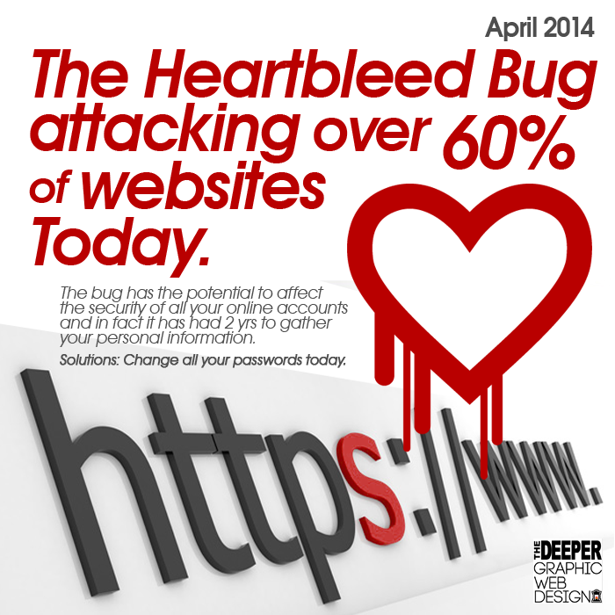
Why CROSSING?
Implementation and integration
introduce vulnerabilities!
Notes:
total economic impact of cloud technology could be $1.7 trillion to $6.2 trillion annually in 2025 (McKinsey & Co)
The worldwide cloud-based security services market will be worth $2.1B in 2013, rising to $3.1B in 2015, according to Gartner.
http://www.forbes.com/sites/louiscolumbus/2013/11/16/roundup-of-cloud-computing-forecasts-update-2013/

Slide 9

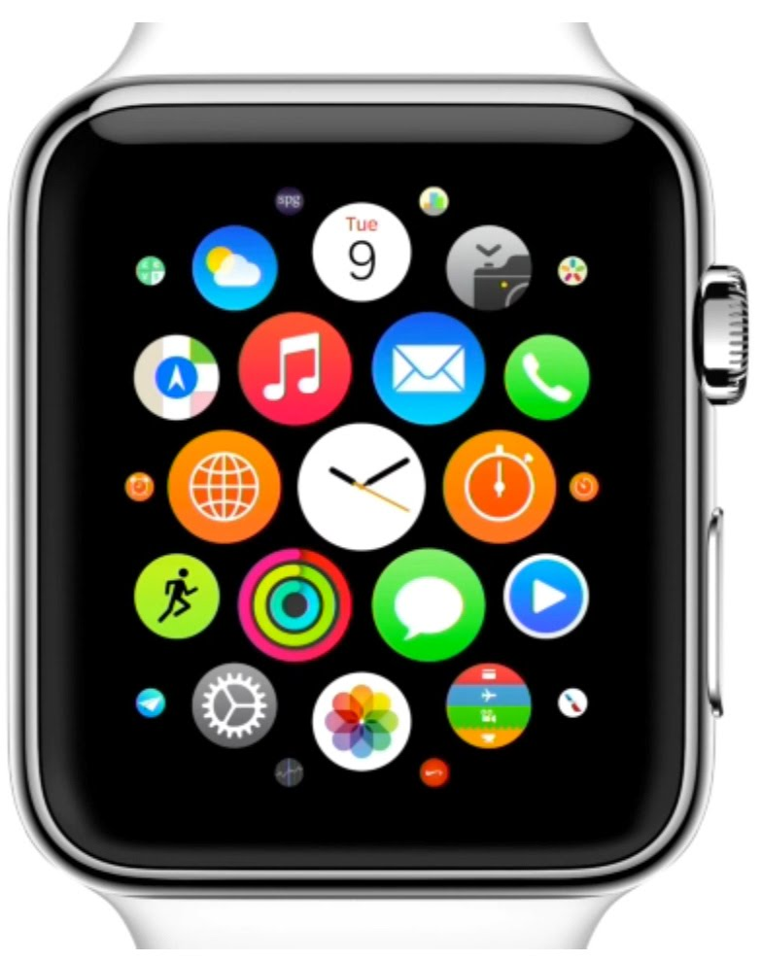
More cryptographic functionality required
Notes:
total economic impact of cloud technology could be $1.7 trillion to $6.2 trillion annually in 2025 (McKinsey & Co)
The worldwide cloud-based security services market will be worth $2.1B in 2013, rising to $3.1B in 2015, according to Gartner.
http://www.forbes.com/sites/louiscolumbus/2013/11/16/roundup-of-cloud-computing-forecasts-update-2013/

Slide 10
CROSSING Goal
To provide cryptography-based security solutions enabling trust in new and next generation computing environments.
  The solutions will meet the efficiency and security requirements of the new environments and will have sound implementations. They will be easy to use for developers, administrators, and end users of IT, even if they are not cryptography experts.

Slide 11






Challenges
Cryptography-based solutions:
Make actors, devices, services trustworthy
Cryptographic primitives:
Strong security guarantees
Practical
New functionalities
Engineering:
Secure implementation
Integration

Slide 12
CROSSING project areas
Cryptography-based solutions
Cryptographic primitives
Engineering

Slide 13
Primitives project area
Strong guarantees, practical, new functionalities
Complexity-based
Hardware-based
Information theoretic

Slide 14
Primitives project area
Strong guarantees, practical, new functionalities
Complexity-based
P1
Future Public-Key
Encryption and
Signature Schemes
P2
Sanitizable
Signatures

Slide 15
Primitives project area
Strong guarantees, practical, new functionalities
Complexity-based
Hardware-based
P1
Future Public-Key
Encryption and
Signature Schemes
Hardware-
Entangled Cryptography
P3
P2
Sanitizable
Signatures

Slide 16
Primitives project area
Strong guarantees, practical, new functionalities
Complexity-based
Hardware-based
Information theoretic
Future Public-Key
Encryption and
Signature Schemes
Hardware-
Entangled Cryptography
Quantum Key
Hubs
P1
P3
P4
P2
Sanitizable
Signatures

Slide 17
Solutions project area
Make actors, devices, services trustworthy

Slide 18
Solutions project area
Make actors, devices, services trustworthy
S1
S1
Scalable Trust Infrastructures

Slide 19
Solutions project area
Make actors, devices, services trustworthy
S2
S1
S2
S2
S1
Scalable Trust Infrastructures
S2
Attestation Protocols

Slide 20
Solutions project area
Make actors, devices, services trustworthy
S2
S3
S1
S2
S2
S1
Scalable Trust Infrastructures
S2
Attestation Protocols
S3
Privacy-Preserving Access and Verifiable Utilization

Slide 21
Solutions project area
Make actors, devices, services trustworthy
S2
S3
S4
S1
S2
S2
S1
Scalable Trust Infrastructures
S2
Attestation Protocols
Privacy-Preserving Access and Verifiable Utilization
S4
Strongly Secure Connection Establishment
S3

Slide 22
Solutions project area
Make actors, devices, services trustworthy
S2
S3
S4
S1
S5
S2
S2
S1
Scalable Trust Infrastructures
S2
Attestation Protocols
Privacy-Preserving Access and Verifiable Utilization
Strongly Secure Connection Establishment
S3
S4
S5
Privacy-Preserving Computation

Slide 23
Solutions project area
Make actors, devices, services trustworthy
S2
S3
S4
S6
S1
S5
S2
S2
S1
Scalable Trust Infrastructures
S2
Attestation Protocols
Privacy-Preserving Access and Verifiable Utilization
Strongly Secure Connection Establishment
S3
S4
S5
Privacy-Preserving Computation
S6
Long-Term Secure Archiving

Slide 24
Engineering project area
Secure implementation and integration
Notes:
Add these relationships:
E1 –
S5 – E3

Slide 25
Engineering project area
Secure implementation and integration
E1
E1
E1
Secure Integration of Cryptographic Software
Notes:
Add these relationships:
E1 –
S5 – E3

Slide 26
Engineering project area
Secure implementation and integration
E1
E1
E2
Secure Integration of Cryptographic Software
E2
Secure Refinement of Cryptographic Algorithms
E1
Notes:
Add these relationships:
E1 –
S5 – E3

Slide 27
Engineering project area
Secure implementation and integration
E1
E1
E3
E2
Secure Integration of Cryptographic Software
Secure Refinement of Cryptographic Algorithms
E1
E2
Compiler for Privacy-Preserving Protocols
E3
Notes:
Add these relationships:
E1 -
S5 – E3

Slide 28



Collaborative development of
28
Notes:
Verweis auf spätere Präsentation von Eric Bodden

Slide 29
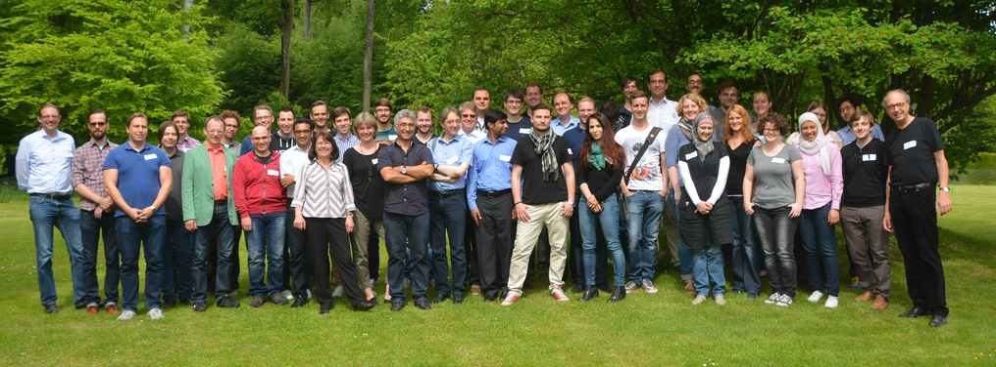
Thank you very much for your attention

